Slide 1
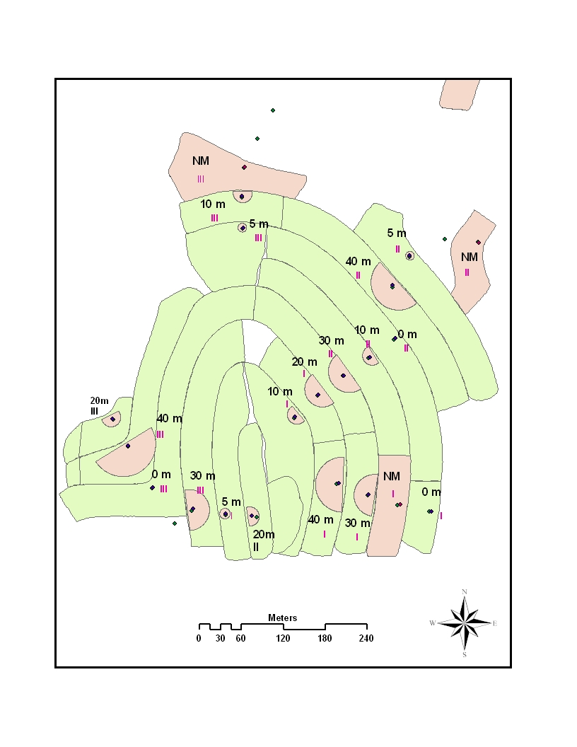
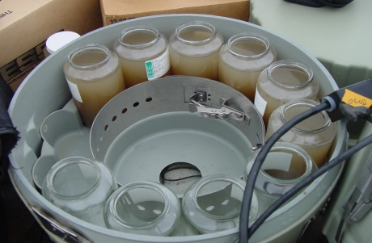
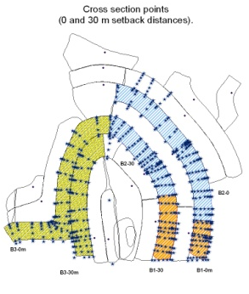
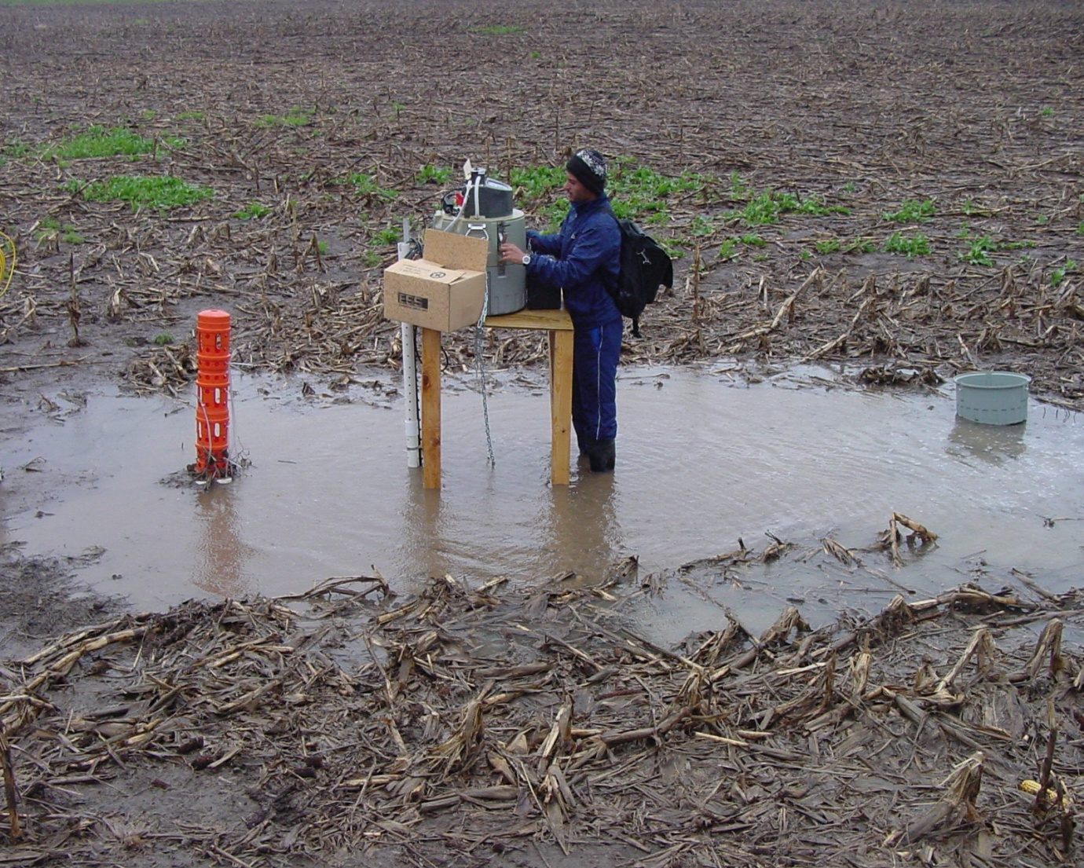
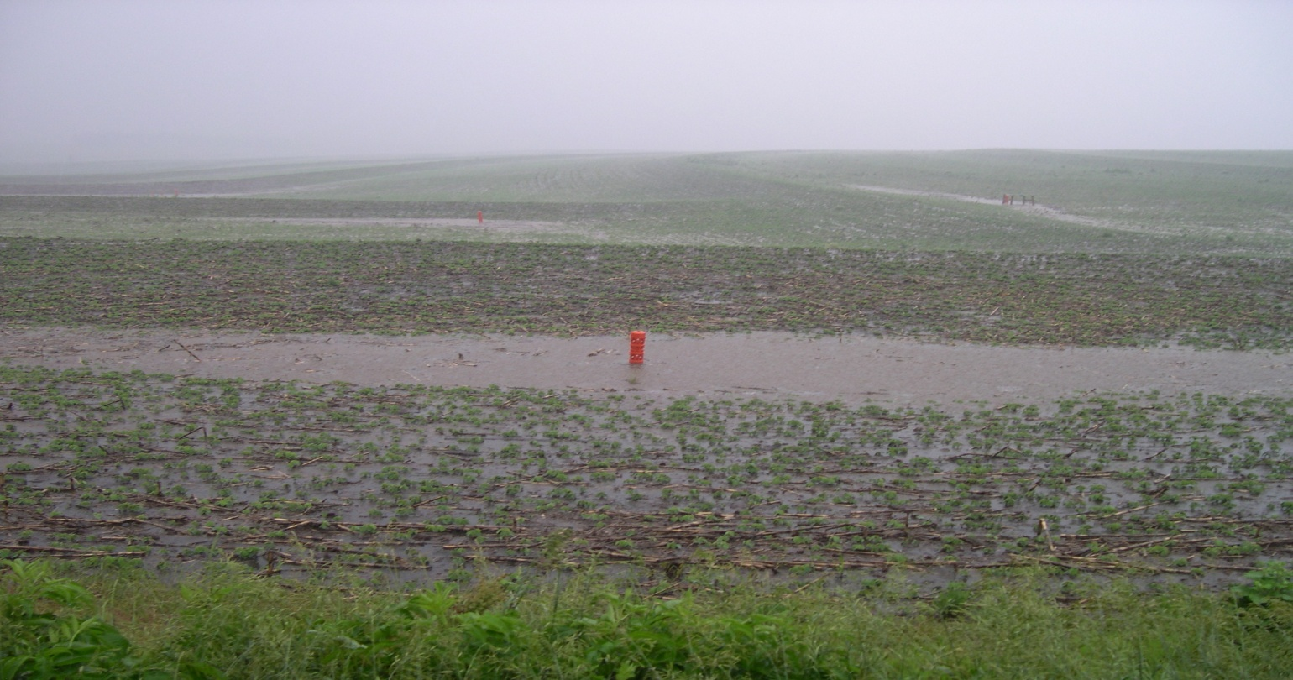
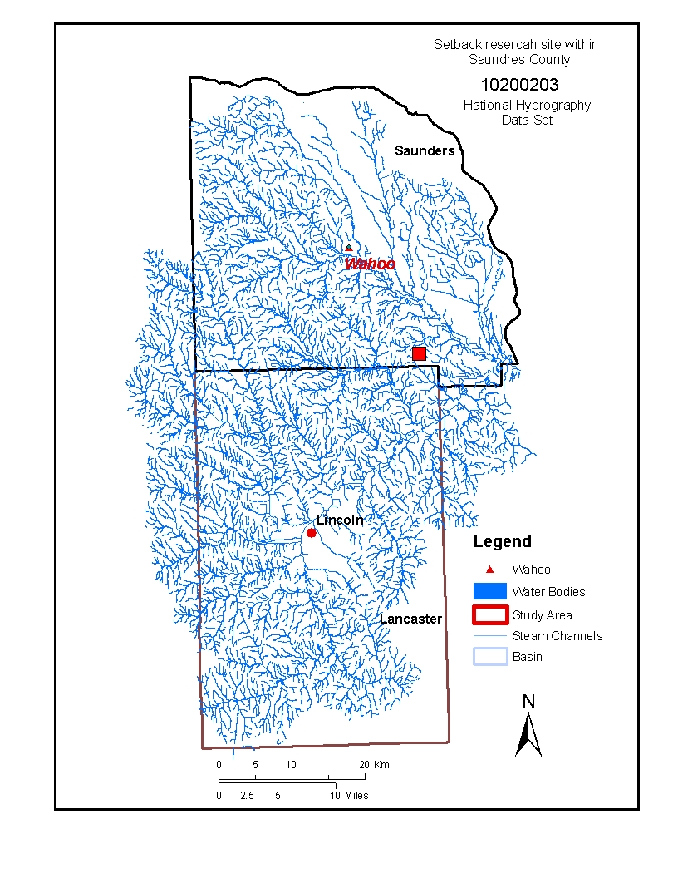
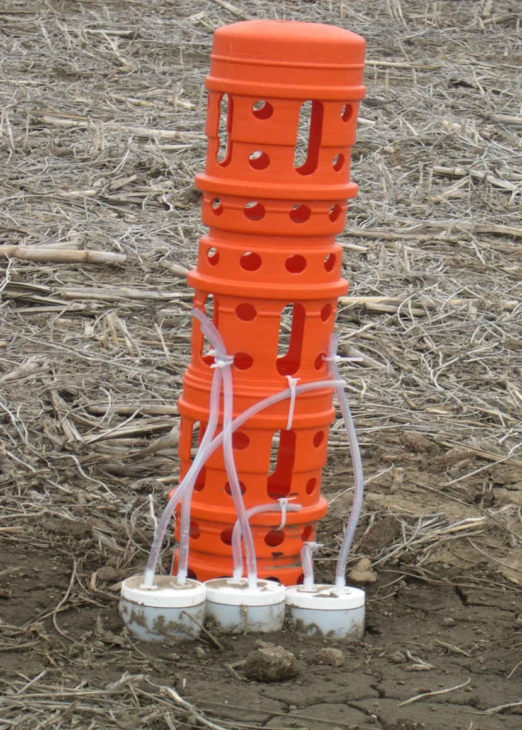
Setback Distance Effect on Phosphorus and Sediment Concentration in Runoff
Following Manure Application
Ahmed Al-wadaey¹*, Charles Wortmann¹, Thomas Franti², Charles Shapiro¹, Dean Eisenhauer²
1.Department of Agronomy and Horticulture, UNL .2 Department of Biological System Engineering, UNL. (* corresponding author)
Introduction
Setback distance effects. Setback distance effects (0 and 30-m ) were not significant for P and sediment concentrations when using the ISCO data from four runoff events (Table 1). The setback distance x runoff event interaction effects were significant for TP and PP due to the variation of rainfall intensities. Sediment and DP concentrations were affected by runoff events. High rainfall intensity resulted in high sediment concentration (third rainfall event volume ). During the fourth rainfall event, rain intensity was low which resulted in low runoff volume, therefore DP concentration was high in runoff samples.
Block | Drainage area | Mean channel length | Setback area relative to drainage area | Runoff volume, mean of 4 events
 | (m²) | (m) | (%) | m³
B1-0 | 4463 | 61 | 0.0 | 212
B1-30 | 7784 | 89 | 25.7 | 209
B2-0 | 20123 | 211 | 0.0 | 708
B2-30 | 11398 | 118 | 17.6 | 338
B3-0 | 21265 | 259 | 0.0 | 440
B3-30 | 15009 | 178 | 13.3 | 201
Agricultural runoff is considered a major non-point source of pollution for surface water bodies, including phosphorus runoff following land application of manure. The risk of P from land-applied manure moving to sensitive waters depends on the interaction of site properties, weather conditions, and management practices. Therefore, it is important to understand how manure application practices affect water quality. A required management practice of large animal feeding operations is that manure should not be applied within 30 m of a direct conduit to surface waters. However, evidence to justify this setback requirement is lacking, especially considering that manure application often results in reduced runoff and erosion.
Research was conducted to develop a low cost method of evaluating the effects of manure application practices on runoff P and sediment concentration and loss under common field scale conditions. The methodology was applied in evaluation of setback distances and drainage basin characteristics on P and sediment in runoff.
 | Total P | Dissolved P | Particulate P | Sediment
Treatment | mg kg⁻¹ |  |  | kg kg⁻¹
No setback | 2.73 | 1.72 | 1.03 | 0.8
30-m setback | 2.76 | 1.69 | 1.17 | 1.2
Setback (S) | NS | NS | NS | NS
Event (E) | NS | ** | NS | *
ExS | *** | NS | * | NS
Table 3. Characteristics of drainage basins with ISCO samplers.
Figure 3. Field layout and setback distances.
Figure 4. Collection of runoff samples using a ISCO sampler after a rainfall event.
Drainage basin features | Runoff volume | Sedim. conc. | TP conc. | PP conc. | DP conc. | Sedimloss | TP loss | PP loss | DP loss
Drainage area | 0.60 | NS | NS | NS | NS | 0.40 | -0.48 | NS | NS
Channel length | 0.55 | NS | NS | NS | NS | 0.39 | -0.47 | NS | NS
LS | NS | NS | NS | NS | NS | NS | NS | NS | NS
Setback : drainage area | NS | 0.43 | NS | NS | NS | NS | NS | NS | NS
Runoff rate | 0.73 | NS | -0.43 | NS | -0.49 | 0.43 | NS | NS | NS
Ponding depth | 0.50 | NS | NS | 0.66 | -0.41 | 0.62 | 0.58 | NS | 0.90
Methods
Table 1. Comparison of 30 m and no setback distance on sediment and P concentrations using ISCO data from four runoff events.
The study was conducted about 30 km northeast of Lincoln NE on a farmer’s field protected with tile-drained terraces (Fig. 1). Samples were collected at 21 risers grouped into three blocks of seven treatments (Fig. 2). The treatments were composted feedlot manure applied with setbacks of 0, 5, 10, 20, 30, and 40 m, and no manure applied (Fig. 3). ISCO (Company's name for automatic water sampler) were installed at the 6 risers of the 0 and 30 m setbacks (Fig. 4) for comparison with the simple bottle technique of collecting samples shown in Fig. 2. Composted feedlot manure was applied without incorporation at 74 Mg ha⁻¹ and 686 kg ha⁻¹ of P₂O₅. At each riser, three 1-L bottles were installed to collect runoff samples at water depths of 7.5, 15, and 30 cm to determine the optimal sampling height (Fig. 2). The inner diameter of the collection tube was about 6 mm. Sample bottles were marked for each block, depth, setback distance and date. In block 2, two bottles were added at each riser to compare sampling with unrestricted and restricted tubes which required 15 and 30 minutes, respectively, to fill the sample bottle.
Statistical analysis was performed using SAS Institute Inc., 2004. PROC MIXED was used to test the effect of setback distance for sediment, total (TP), dissolved (DP) and particulate (PP) concentrations. Paired comparison (T tests) were used to compare sampling methods, including restricted vs. non-restricted tubes) and tube heights. Correlation and regression analyses were used to relate drainage basin features to runoff characteristics.
Using the sample bottle data, particulate and total P concentrations were higher with the first runoff event than with the 3 later events. Application of composted feedlot manure reduced sediment concentration in runoff by 49% (Table 2). Runoff P concentrations were not increased by manure application. The setback distance effects on sediment and P concentrations were not significant at P = 0.05. However, dissolved P tended to decrease with increasing setback distance (P = 0.06) according to: DP concentration = 1.43 – 0.0.15 * setback distance (m), R² = 0.63.
0.5041
Treatment | DP | PP | TP | Sediment
No setback | 1.64 | 1.116 | 2.73 | 0.92
30 m setback | 1.50 | 1.39 | 2.76 | 1.36
Probability | 0.080٭ | 0.039٭ | NS | 0.0093٭٭
Table 4. Correlation coefficients, significant at P = 0.1, of drainage basin features with runoff properties.
0.5041
Figure 5. Accumulated runoff at a riser during a runoff event.
Increased drainage area resulted in increased runoff volume and increased sediment losses. Total P loss decreased with increased mean channel length (Fig.7a). Runoff rate was positively related to runoff volume and sediment loss but negatively related to TP and DP concentration. Losses of sediment, TP (Fig. 7b) and DP were positively related to ponding depth, but DP concentration was less with deeper ponding. Sediment concentration increased as ratio of setback area to drainage area increased(Fig.7c).
Results
 | Total P | Dissolved P | Particulate P | Sediment
Treatment | mg kg⁻¹ |  |  | kg kg⁻¹
0-m setback | 2.81 | 1.48 | 1.33 | 1.72
5-m setback | 3.25 | 1.37 | 1.88 | 1.90
10-m setback | 2.87 | 1.41 | 1.46 | 1.92
20-m setback | 2.68 | 0.79 | 1.89 | 2.30
30-m setback | 2.85 | 1.09 | 1.74 | 1.68
40-m setback | 2.55 | 0.91 | 1.64 | 1.79
No manure | 2.56 | 0.84 | 1.72 | 3.68
Standard Error | 0.37 | 0.23 | 0.26 | 0.50
Event (E) | ** | NS | *** | NS
Treatment (T) | NS | NS | NS | *
T x E | NS | NS | NS | NS
Sampling method. Runoff concentrations were not affected by sampling height except for the first runoff event after compost application when concentrations were higher for the 7.5-cm compared with the higher tube placements (Fig 6.a&b). Runoff concentrations were similar for samples collected with the restricted and unrestricted tubes. There were no significant differences in sediment and P concentrations with the mean concentration of ISCO samples for an event and the concentrations with the sample bottle method (Fig. 7 a&b). Samples collected at the 7.5-cm height with restricted tubes were used for the remainder of the study.
Treatment | DP | PP | TP | Sediment
No setback | 1.64 | 1.116 | 2.73 | 0.92
30 m setback | 1.50 | 1.39 | 2.76 | 1.36
Event | S(0.003) | S*(0.03) | NS | S(0.01)
1 | 1.6342 | 1.4668 | 3.1077 | 1.1221
2 | 1.4458 | 0.9328 | 2.340 | 0.6343
3 | 1.3906 | 1.5337 | 2.7585 | 1.5972
4 | 2.3711 | 0.4637 | 2.8544 | 0.8349
Treatment | NS | NS | NS | NS
Event X Treatment | NS | S**(0.03) | S*(0.0005) | NS
Probability | 0.080٭ | 0.039٭ | NS | 0.0093٭٭
 | TP DP PP SED
Probability | 0.01 0.01 0.01 0.01
Time since Application applied | 0.0001 0.0001 0.0001 0.0001
Drainage Area | NS NS NS NS
Channel gradient | 0.0032 0.0025 0.0004
Channel Length | NS NS NS NS
Topographic factor(LS) | NS 0.0898 NS
Setback Distances | 0.0001 0.0001 0.0004 NS
LS X TRT | 0.0001 0.0001 0.0001
Fig. 6 a&b. Tube inlet height and restricted (R) vs. unrestricted tube effects on sediment and P concentrations were not significant; n=12
Table 2. The effect of setback distance on sediment and P concentrations using sample bottle data from four runoff events.
Figure 7 a,b and c. Effect of the LS, drainage area size and setback : drainage area ratio on P and sediment loss.
30 cm
Drainage basin effects on runoff and pollutant concentration. Drainage areas served by the ISCO samplers differed for several features that could affect runoff concentrations. Minimum and maximum values were: 0.45 to 2.13 ha for drainage area; 61 to 259 m for mean terrace channel length; 1.8 to 3.10 for the slope gradient-length ; 0 to 25.7% of the setback area ratio to the drainage area (Table 3). Mean runoff volume per runoff event ranged from 200 to 700 m³.
Conclusion
An inexpensive method of using bottles with intake tubes set 7.5 cm above ground to collect runoff samples gave similar P and sediment concentrations as the means of multiple samples collected during runoff events with ISCO samplers.
The runoff P concentrations were about twice as high with the runoff event that followed composted manure application than with later runoff events.
Sediment concentration in runoff was reduced with manure application.
Setbacks were ineffective in reducing concentrations of sediment, total P and particulate P in runoff but there was a tendency of reduced dissolved P with increasing setback distance.
Drainage basin characteristics affected runoff volume and sediment and P losses.
15 cm
7.5 cm
Figure 1. Research site.
Figure 2. Sample collection at riser for 3 tube heights.
٭This research was funded by a grant from USDA-CSREES Managed Ecosystems and was implemented with the collaboration of the Nebraska Corn Board.
٭ Thanks also to the farm’s owner for his permission to conduct this research in his farm during 2006-2007.
Fig. 7 a&b. Comparison of ISCO and riser bottle sampling method for TP and PP.

