Slide 1



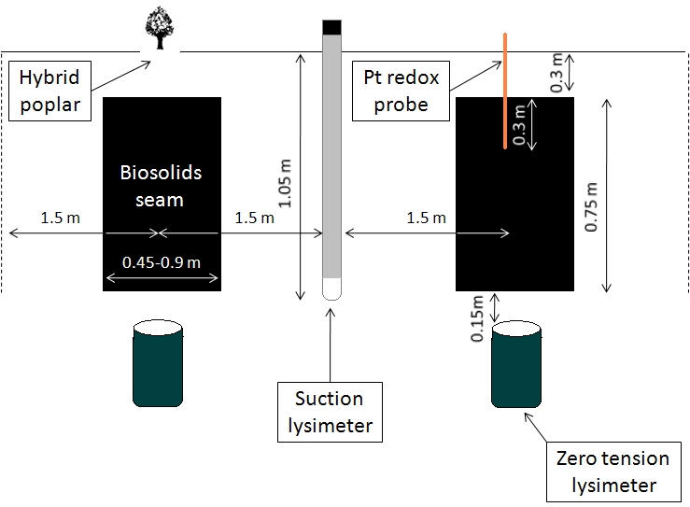
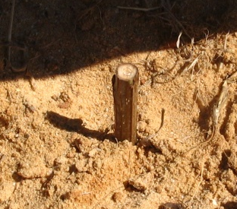
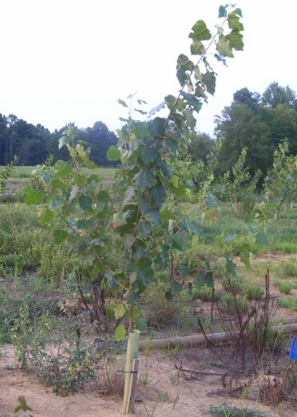
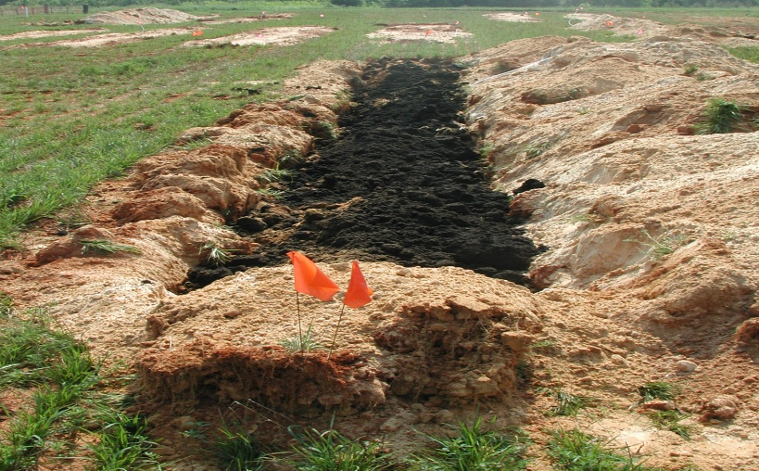
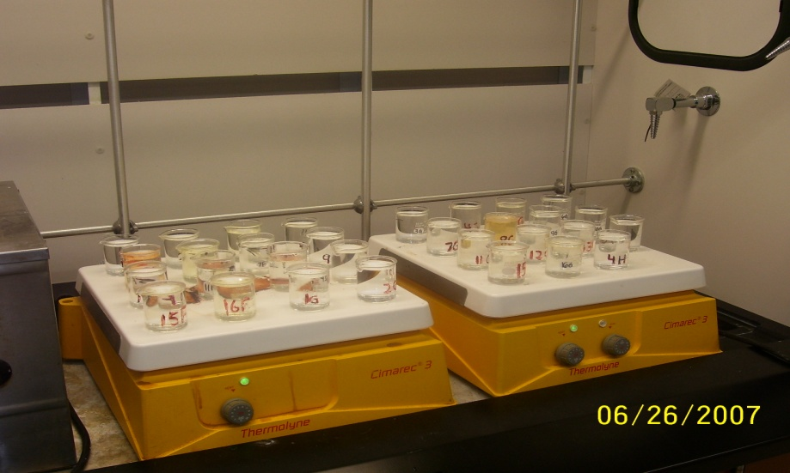
Fate and Transport of Metals from Biosolids Entrenched
For Reclaiming Mineland with Hybrid Poplar
Katrina Lasley, Greg Evanylo, Kirill Kostyanovskiy, Matt Eick and Chao Shang
Department of Crop and Soil Environmental Sciences, Virginia Tech
Biosolids sampling and monitoring schematic.
INTRODUCTION
Deep row incorporation (i.e. entrenching) of biosolids for reclaiming mineland and production of a hybrid poplar bioenergy crop is an alternative utilization method whose potential advantages include:
  Reduction of objectionable odors
  Single high application rate to meet the lifetime N need of the crop
  Avoidance of biosolids application to food chain crops
Nutrient leaching and generation of greenhouse gases are being studied by our research group, but investigation of fate and transport of 503 Rule priority metals and emerging metals of interest (i.e. Ag, Ba, Be, Sn) is needed to assess potential for groundwater impairment.
RESULTS
Temporal and cumulative metal leaching mass. Cumulative leaching (per ha) in control treatments were: <1 g Cu, <0.2 g Ni, <2 g Ba, <1 g Zn. Cd was never detected in control.
Analysis of metals which were infrequently detected
 | Metal
 | Ag | Cd | Pb | Sn
Detection Limit, mg L⁻¹ | 0.006 | 0.004 | 0.016 | 0.027
Total Conc. range, mg L⁻¹ | <0.006-0.046 | <0.004-0.042 | <0.016-0.061 | <0.027
Sample Nos. | 125 | 277 | 277 | 125
Fraction of samples whose concentration>DL | 0.03 | 0.12 | 0.004 | 0
Poplar cutting establishment
March 2007
OBJECTIVE
  To assess potential environmental impact of employing the deep row incorporation of biosolids by determining movement, concentration, and speciation of trace metals in lateral and vertical directions.
Biosolids composition and loading rate for 90 cm trench width. (NA = not applicable.)
Chemical fractions of Ba, Cu, Pb and Zn in anaerobically digested biosolids sampled at application (2006) and in October 2007.
Chemical fractions of Ba, Cu, Pb and Zn in lime stabilized biosolids sampled at application (2006) and in October 2007.
 |  | Anaerobically Digested Biosolids |  | Lime Stabilized Biosolids
Biosolids Property | Pollutant Concentration Limits, PCL (mg kg⁻¹) | Concentration (mg kg⁻¹) | Loading Rate (kg ha⁻¹) | Concentration (mg kg⁻¹) | Loading Rate (kg ha⁻¹)
Application Rate | NA | NA | 426,000 | NA | 656,000
Cd | 39 | 2.3 | 1 | 2 | 0.9
Cu | 1500 | 328 | 139 | 197 | 129
Ni | 420 | 27 | 11.5 | 16 | 10.5
Pb | 300 | 66 | 28 | 53 | 35
Zn | 2800 | 1,473 | 627 | 490 | 322
Ag | NA | 23 | 9.8 | 10 | 6.6
Ba | NA | 442 | 188 | 195 | 128
Be | NA | <5 | --- | <5 | ---
Sn | NA | 27 | 11 | 17 | 11
N, total Kjeldahl | NA | 53,133 | 22,601 | 44,533 | 29,212
P | NA | 26,533 | 11,286 | 8,667 | 5,685
pH | NA | 8.5 | NA | 12.3 | NA
FIELD METHODS
  Treatments were established on a mineral sands mine reclamation site near the Coastal Plain-Piedmont fall line in Dinwiddie County, VA in summer 2006.
  Trenches instrumented with lysimeters were filled at two rates each with lime stabilized and anaerobically-digested biosolids.
August 2007
SUMMARY
  Lateral movement of Cd, Cu, Ni and Pb, as detected by suction lysimeters, was negligible. Zinc (at 0.21-0.34 mg/L) and Ba (at 0.29-0.78 mg/L) were detected occasionally.
  Metal leaching was highest initially and decreased with time, except for Ba. Silver, Cd, Pb and Sn rarely moved vertically.
  Leached metal fractions were primarily in the colloidal-phase.
  Biosolids stabilization type affected the metal leaching mass of only Cu, with more Cu transported from the high pH lime stabilized material, likely complexed by soluble organic matter.
  Copper was largely organically bound and Pb was found in the residual fraction of both biosolids types, and neither changed with time. More Ba was found in the residual fraction of anaerobically than lime stabilized biosolids, but neither changed with time. More Zn was organically complexed in the lime-stabilized and exchangeable and oxide-bound in the anaerobically digested biosolids, but there was little change with time in either biosolids type.
Biosolids in trenches 0.75 m deep x 15 m long x 0.90 m wide.
Filtered through 0.45 µm membrane filter
for soluble metal species
Digested using EPA 200.7 for total metals
Analyzed by ICP-AES for Ag, Al, Ba, Be,
Cd, Cu, Fe, Mn, Ni, Pb, Sn, Zn
Application rates of biosolids treatments.
LABORATORY METHODS for LEACHATE ANALYSIS
LABORATORY METHODS for LEACHATE ANALYSIS
Anaerobically Digested Biosolids
Lime Stabilized Biosolids
Trench Width (m)
0.45
0.9
0.45
0.9
Application Rate, Mg/ha
213
426
328
656

