Slide 1
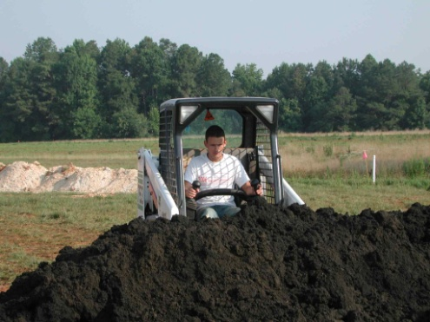
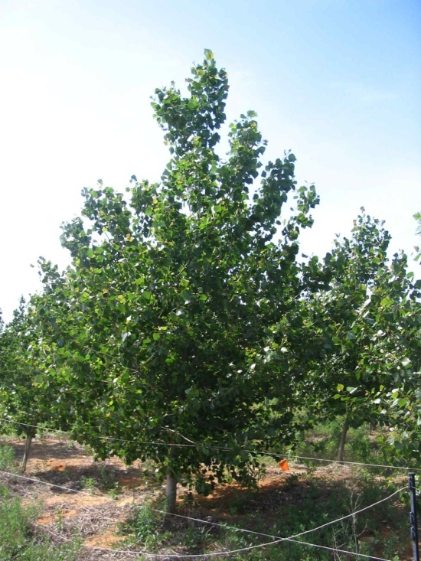
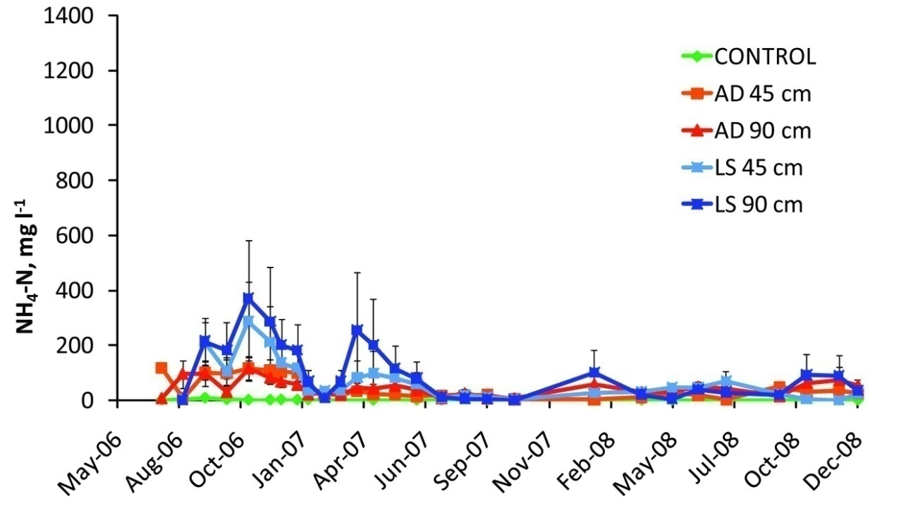
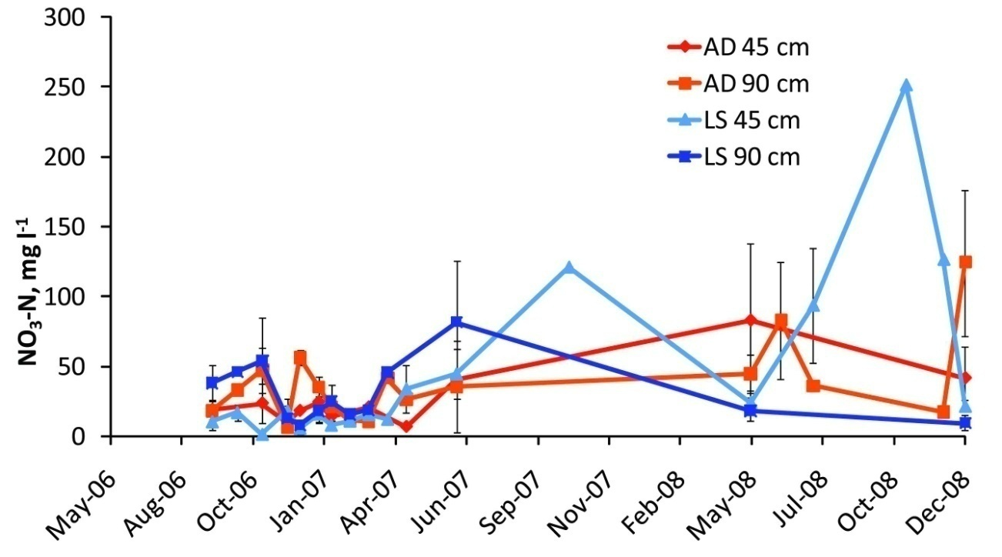
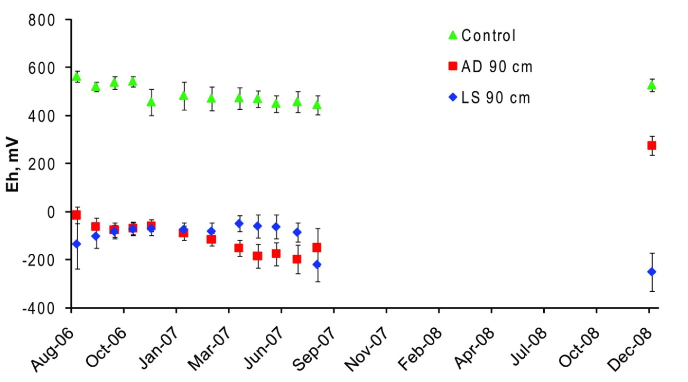
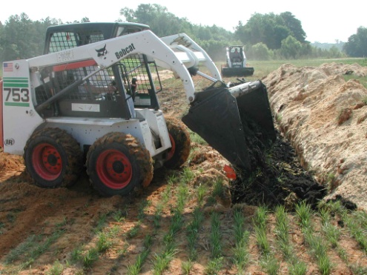
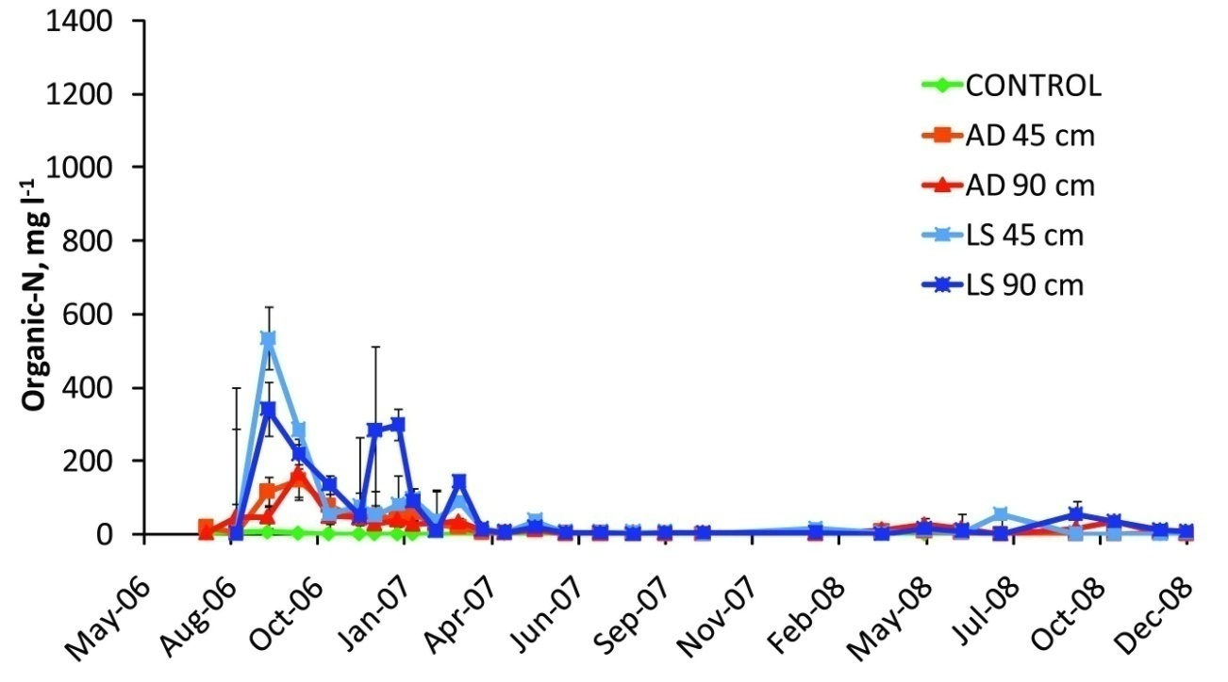
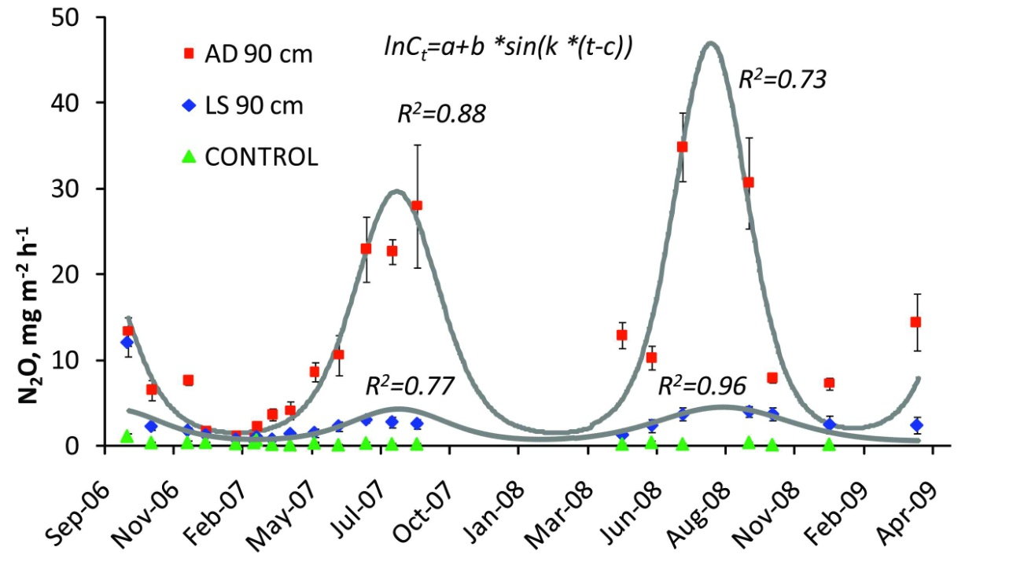
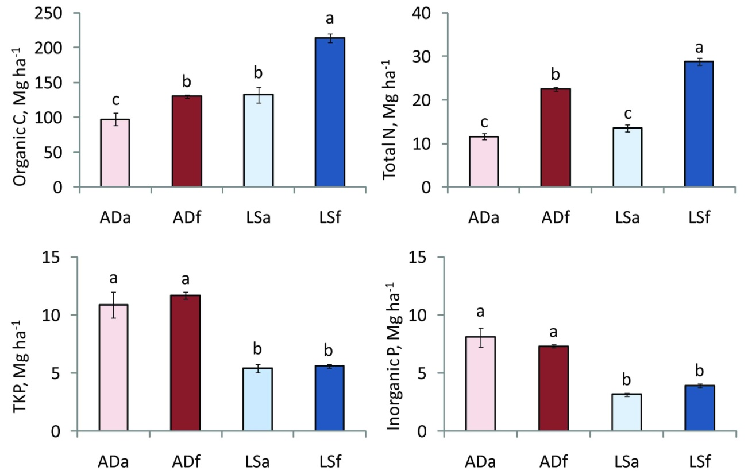
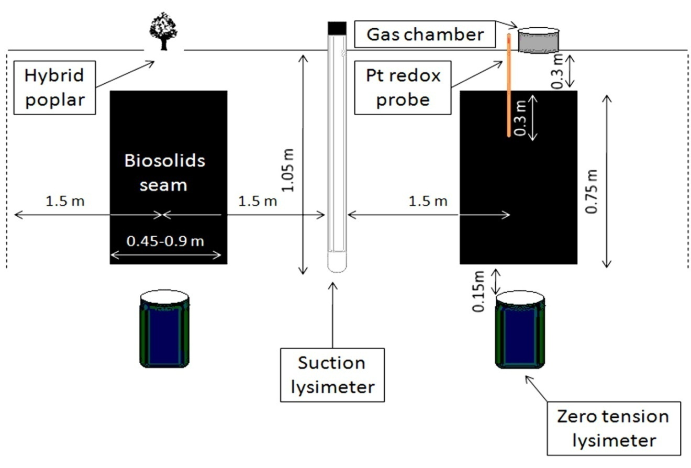
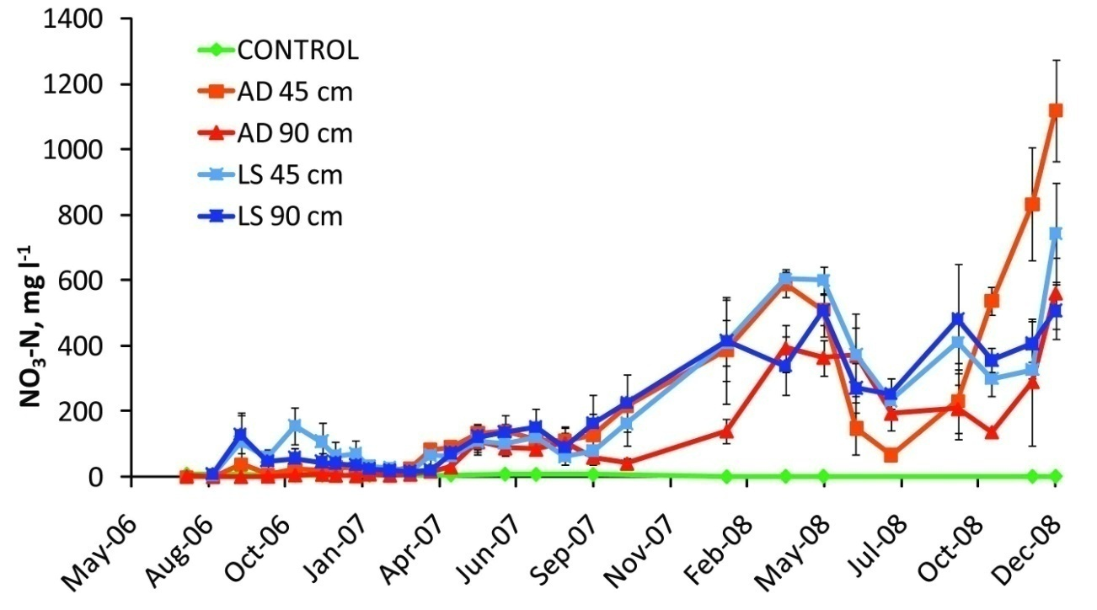
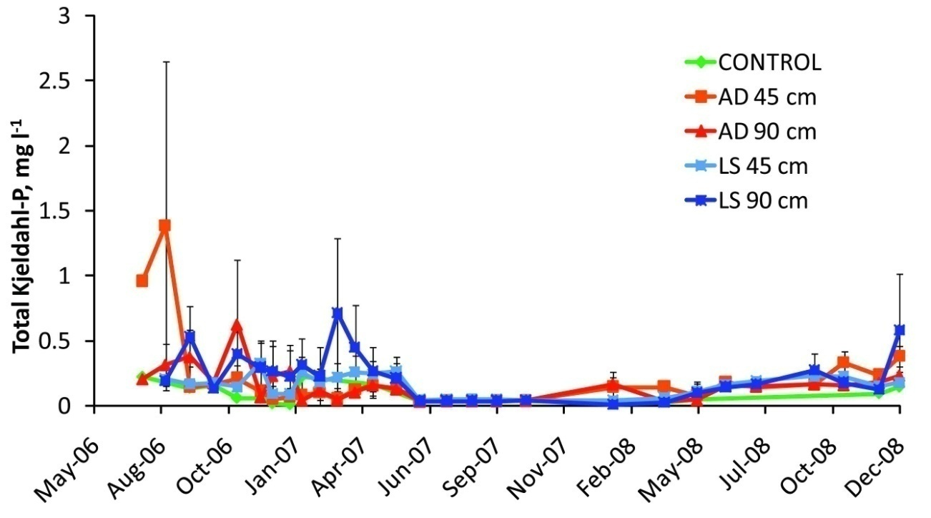
Nitrogen, Phosphorus and Carbon Transformation in Deep Row Biosolids Incorporation for Hybrid Poplar Production in Coastal Plain Mine Reclamation Sites Kirill Kostyanovskiy (kkostya@vt.edu), Greg Evanylo, Katrina Lasley, Tom Fox, Chao Shang, Beshr Sukkariyah and Lee Daniels, Virginia Tech, Blacksburg, VA
PROBLEM
Nitrogen and phosphorus contamination of groundwater and reduction of carbon sequestration benefits via greenhouse gas emissions are important environmental effects of biosolids recycling.
INTRODUCTION
Deep row incorporation (DRI) is a biosolids recycling method that is especially appropriate for reclaiming disturbed land because of the extremely high application rates used.
Nutrient additions in excess of the vegetation requirements, especially in coarse-textured soils, can potentially impair water quality. Increasing C and N additions with biosolids DRI can also generate emissions of greenhouse gases N₂O and CH₄ and decrease the value of C sequestration.
OBJECTIVES
Compare the effects of DRI biosolids type and rate on N and P leaching losses;
Determine the effects of aging on the N, C and P dynamics in the DRI biosolids seams;
Compare the effects of biosolids type on N₂O emissions;
Compare the effects of DRI biosolids type on hybrid poplar biomass dynamics, C, N and P sequestration.
METHODS
Study design:
Each plot measured 6×15 m and contained two rows (15 m) for application of biosolids (trenches) or fertilizer;
The treatments were replicated 4 times in a randomized complete block design;
Each row was planted with hybrid poplar (5) to achieve 3×3 m or 1077 trees ha⁻¹.
The treatments established were:
Control banded with 56 kg (P, K) ha⁻¹ yr⁻¹ as triple superphosphate and potash;
Anaerobically digested (AD) and lime stabilized (LS) biosolids applied in trenches.
Instrumentation:
Zero tension and suction lysimeters were installed for collection of leachate;
Pt redox probes were used for oxidation-reduction potential measurements;
Incubation chambers were installed for greenhouse gas collection.
RESULTS AND DISCUSSION
Leaching of N and P:
Vertical N leaching from the entrenched biosolids occurred initially as NH₄-N and org-N, and, as nitrification progressed, mostly as NO₃-N.
P loss was negligible.
Suction lysimeters detected lateral N leaching.
Transformations in the biosolids seams:
Redox potential was low in LS biosolids but increased in AD.
Total N lost was 50% in AD and LS.
Organic C decreased 25 and 40% for AD and LS, respectively.
Greenhouse gas emissions:
N₂O production was higher in AD than LS.
Global warming potential of AD was 4.6 times higher than LS.
Hybrid poplar growth response:
Biomass production after 2 years was similar across the biosolids treatments.
Amounts of C, N and P sequestered were less than the corresponding losses at the given tree density.
Lateral flow of NO₃-N detected by suction lysimeters within 2 years of DRI.
DRI biosolids study establishment (2006) and hybrid poplar development after 2 years (2007-2008).
Global warming potential of N₂O.
Treatment | N appl., kg ha⁻¹ | C appl., Mg ha⁻¹ | N₂O-N, kg ha⁻¹ | C-equiv, Mg C ha⁻¹
AD 90 cm | 22600 | 131 | 795.0 a | 101.5 a
LS 90 cm | 29200 | 216 | 172.4 b | 22.0 b
Control | - | - | 49.1 c | 6.3 c
C, N and P transformations in 2 years. AD_{a}/LS_{a}-aged, AD_{f}/LS_{f}-fresh biosolids.
Leaching masses of N and P, and hybrid poplar total biomass, C, N and P sequestration.
Biosolids DRI instrumentation. Plot transect.
Treatment | Total N leached | Total P leached | Tree biomass | C, total | N, total | P, total
 | ---------------kg ha⁻¹------------------- |  | ---------------Mg ha⁻¹--------------- |  | --------------kg ha⁻¹--------------
AD 45 cm | 232.0±47.5 a | 0.13±0.01 b | 5.65±0.80 ab | 2.82±0.40 ab | 62±9 ab | 9.7±1.4 ab
AD 90 cm | 443.9±182.7 a | 0.44±0.14 ab | 6.40±1.07 ab | 3.20±0.54 ab | 71±12 ab | 11.0±1.8 ab
LS 45 cm | 419.7±176.3 a | 0.17±0.06 b | 5.88±0.73 a | 2.94±0.36 a | 65±8 a | 10.1±1.2 a
LS 90 cm | 701.8±356.5 a | 0.52±0.14 a | 3.08±0.37 b | 1.54±0.19 b | 34±4 b | 5.3±0.6 b
Control | 4.0±1.9 b | 0.04±0.01 c | 4.21±0.63 ab | 2.11±0.31 ab | 47±7 ab | 7.2±1.1 ab
Biosolids and their constituents loading rates.
Biosolids treatment | Biosolids rate, Mg ha⁻¹ | pH | Organic C, kg ha⁻¹ | Organic-N, kg ha⁻¹ | NH₄-N, kg ha⁻¹ | NO₃-N, kg ha⁻¹ | Total P, kg ha⁻¹
AD 45 cm | 213 | 8.5 | 65,400 | 8550 | 2,750 | 1 | 5,650
AD 90 cm | 426 |  | 130,800 | 17,100 | 5,500 | 3 | 11,300
LS 45 cm | 328 | 12.3 | 108,250 | 13,950 | 640 | 5 | 2,850
LS 90 cm | 656 |  | 216,500 | 27,910 | 1,290 | 10 | 5,700
CONCLUSIONS
The DRI in coarse-textured soils should not be employed due to detrimental N leaching;
Emissions of the N₂O offset most of the C sequestration benefits in the AD biosolids;
Decreased biosolids rates and increased tree density may reduce N leaching risks.
Leaching of N and P forms into zero tension lysimeters within 2 years of DRI.

