Slide 1



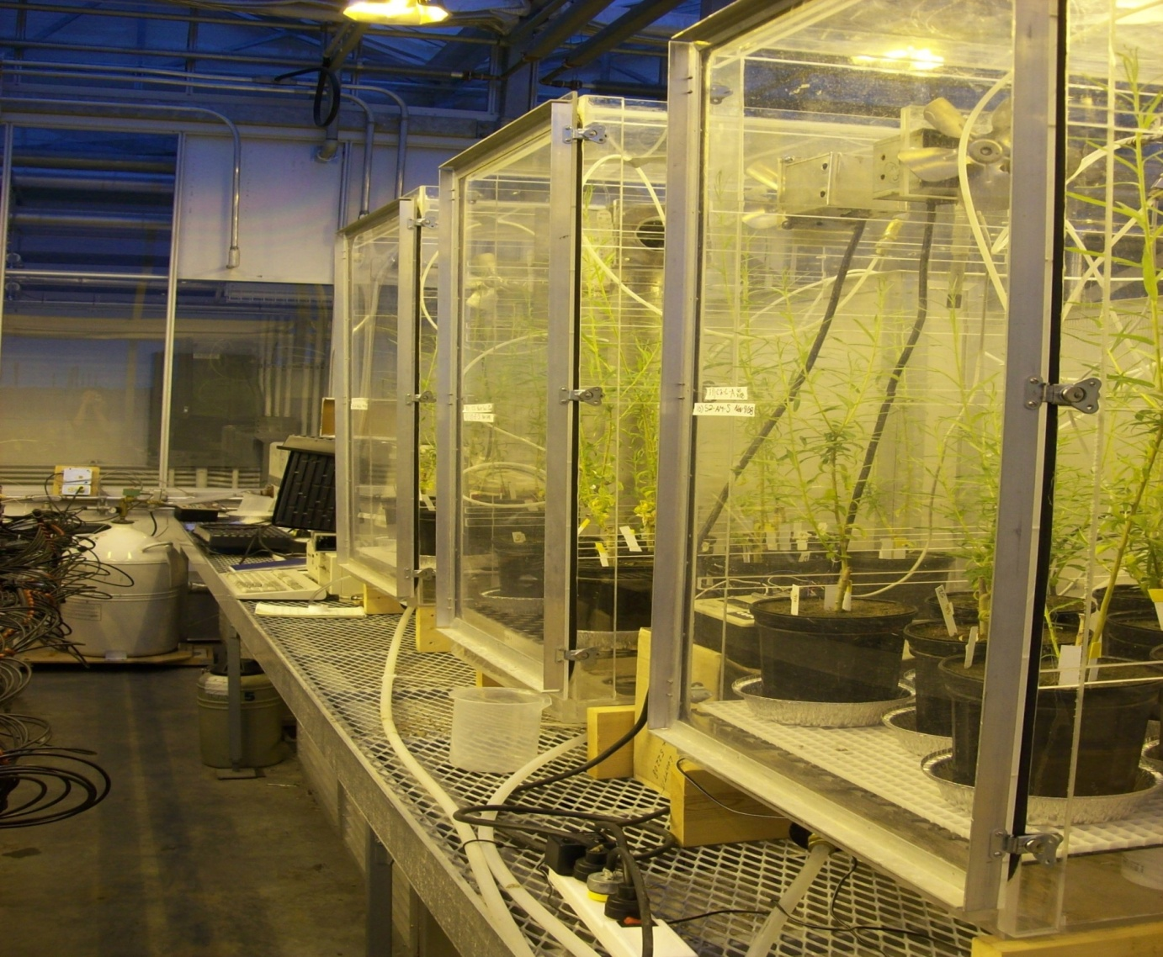
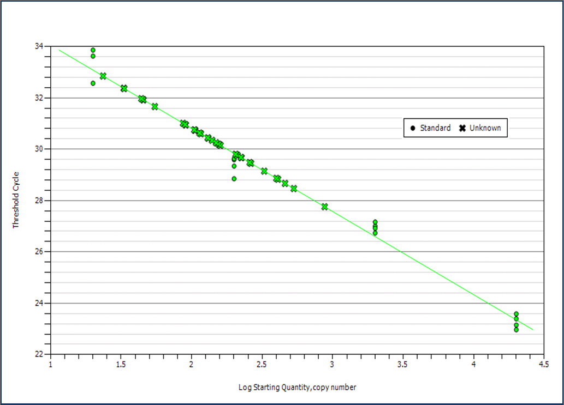
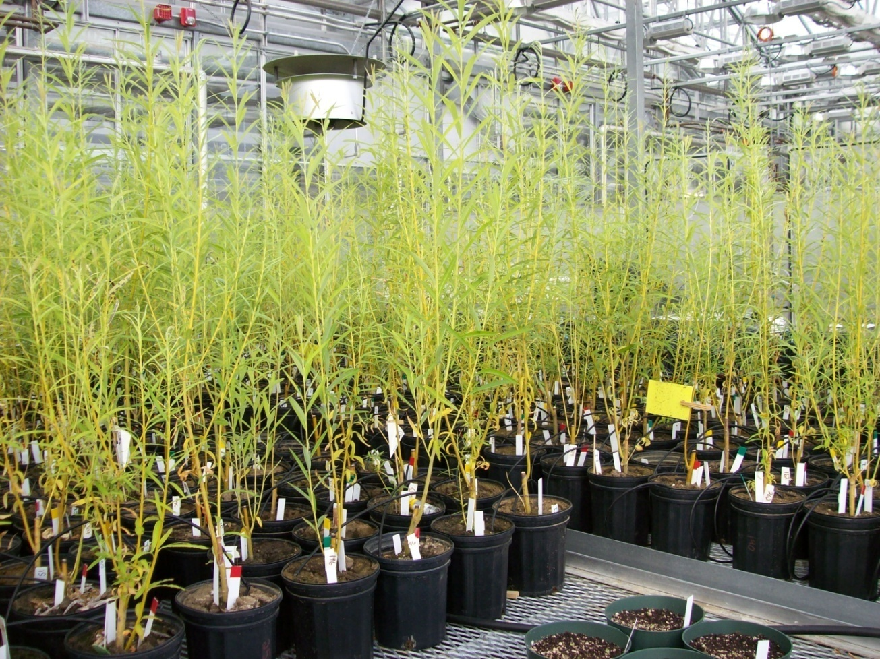
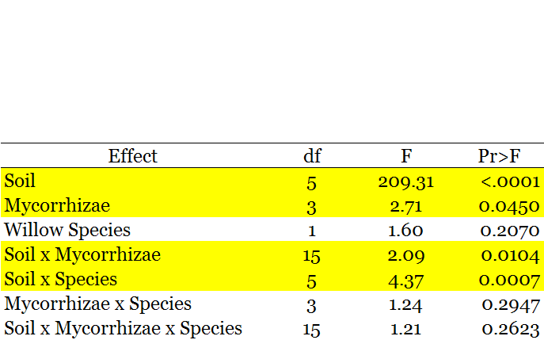
Nitrous oxide emissions and microbial communities associated with mycorrhizal-inoculated willows
A.L. Straathof^{1*}, C. Wagner-Riddle¹, J.N. Klironomos², M.M. Hart² and K.E. Dunfield¹
¹ Department of Land Resource Science, School of Environmental Science, University of Guelph
²Biology and Physical Geography Unit, I.K. Barber School of Arts and Sciences, University of British Columbia, Okanagan
* Corresponding Author: astraath@uoguelph.ca
Introduction
N₂O Emissions
nirS Quantification
Cultivated willow trees (Salix spp., Fig. 1) are a bioenergy crop colonized by both ecto- and arbuscular mycorrhizal fungi (EM, AM). The relationship between soil microbes, mycorrhizae and nitrous oxide (N₂O) emission is not well understood, though each contributes to the nitrogen cycle. This study will determine the effect of mycorrhizae on nutrient cycling, N₂O gas emissions and microbial communities associated with N₂O production in agricultural soils.
The objectives of this greenhouse experiment were to:
Determine if growing willow trees in different field soils inoculated with mycorrhizae (EM, AM, EM+AM) influence N₂O gas emissions from soil
Quantify functional genes associated with nitrification and denitrification in soil
Determine if inoculation influences the biomass production of willow trees
Degenerate primers nirS cd3aF (forward, 20 bp, 50% GC) and nirS R3cd (reverse, 19 bp, 53% GC ) targeted a 400bp region in the second half of the nirS gene.
40 cycles were run on a Bio-Rad iQ5 thermal cycler using SYBR Green dye and FAM fluorescence to measure concentrations of double stranded DNA at each cycle’s end.
Gene copy numbers were determined from a standard curve (Fig. 7) created by Bio-Rad iQ5 software from a 10-fold dilution series of known-concentrations of DNA plasmid (20 – 20 000 copies µl⁻¹ DNA). Plasmid was extracted from Pseudomonas aeruginosa, cloned and quantified using NanoDrop spectrophotometry.
Threshold Cycle
N₂
Figure 4: Mean Hourly Flux of N2O From Soil Types
Org-N
nifH
nosZ
N₂O
Log Starting Quantity – Copy Number
Figure 7: Standard curve of nirS gene copy numbers from dilution series of DNA plasmid
NH₄⁺/NH₃
norB
PCR efficiency averaged 108%, R² = 0.98, slope = -3.15.
Quantitative analysis of the nirS gene in extracted DNA revealed gene copy numbers were affected by soil type (Fig. 7, p<0.05). Loams contained the highest copies of the genes while Sands had the least. Means differed significantly (p<0.05) between, but not within, soil textures.
Specificity of the amplified product was confirmed using melt curve analysis which denatured amplified DNA, reducing fluorescence in increments. Target DNA melted at 92°C.
amoA,
hao
NO
N₂O
NO₂⁻
nirS nirK
NO
nar
NO₂⁻
Figure 3: Willows in flow-through steady state chambers used for measuring N₂O flux.
Figure 5: N₂O flux data from a 3-day period (Trial 12/14)
NO₃⁻
Figure 2: Functional genes of the nitrogen cycle (red) code for enzymatic transformation of various forms of mineral, organic and atmospheric N (black). nirS is quantified thus far in this study.
Plant presence and soil type significantly affected mean hourly N₂O emissions (p<0.05). Highest emission averages were seen from bare soils which had reduced evapotranspiration, keeping soils in an anaerobic state, which promoted denitrification. With or without a willow present, Clay 1 soils had emission averages more than 5x that of other flux rates (Figs. 4, 5) again as a result of prolonged saturation.
Figure 8: Quantities of nirS functional
gene in different soil types
Figure 1: Willows in the greenhouse after 4 months of growth.
Methods
Biomass Production
Summary
Six Southern Ontario soils were collected from agricultural sites with a range of soil texture and other properties. Soils containing willow trees were inoculated with Glomus intraradices (AM) and/or Hebeloma cylindrosporum (EM).
1) Trace Gas Measurement: October 30-December 19, 2008
N2O fluxes were quantified using a flow-through steady state chamber technique (Fig. 3). 4 chambers each contained 1 treatment of 8 pots which were measured for 3 days. Pot soil was saturated with water at the onset of measurements to simulate precipitation and thus an emission event.
N2O concentrations were measured using tuneable diode laser absorption spectroscopy
2) Molecular Analysis: December 9- Present
DNA was extracted from a 0.5g soil sample of each replicate using MoBio DNA Power Soil Extraction Kit
Extractions were amplified in real-time quantitative Polymerase Chain Reactions (qPCR) to determine copy numbers of the nitrite reductase gene nirS from a standard curve
3) Biomass Analysis: December 19 - January 2009
All willows were harvested, dried and weighed to determine treatment influence on aboveground production
Table 1: Analysis of Variance on soil type, mycorrhizal inoculation and willow species effect on above-ground biomass of willow trees. Significant effects (p< 0.05) are highlighted.
Preliminary results suggest that soil type, and not mycorrhizal inoculation, is the dominant factor influencing rates of N₂O gas emission from the soil surfaces of potted willow trees.
Soil type and mycorrhizal inoculation significantly affected above-ground biomass of the biofuel crops Salix spp.
Mean hourly N₂O flux values from induced emission events were increased in Clay soils most probably as a result of substrate availability and the prolonged anaerobic environment provided by micropores in this soil type
Loam soils had the highest quantities of the nitrite reducing gene nirS; soil type had an effect on gene quantity
Ongoing and future analysis for this project include:
Further investigation to determine treatment effect on cumulative N₂O emissions
Molecular quantification of several additional genes responsible for nitrification and denitrification (N₂O production) at various points of the N-cycle including amo, nirK, nosZ, norB and ammonia-oxidizing archaea
Investigating correlations between mean N₂O emissions, microbial quantities and treatments
Determination of C:N ratio in aboveground biomass, soil NO₃ and NH₄ concentrations, soil organic carbon content and molecular analysis of root DNA for mycorrhizal colonization of inoculated species
Figure 6: Mycorrhizal treatment affects
willow biomass production
Soil type influenced biomass production (p<0.05) likely as a result of varying nutrient content and water availability. Ectomycorrhizal treatments resulted in significantly higher willow biomass production than the control (Fig. 6).
Acknowledgements
are due to the Natural Sciences and Engineering Research Council for funding this research through Strategic Network Grants, technicians Dean Louttit and Kamini Khosla for valuable input, and University of Guelph students Avanthi Wijesinghe, Brian Ohsowski, and Michael Zima for contributions.

