Slide 1

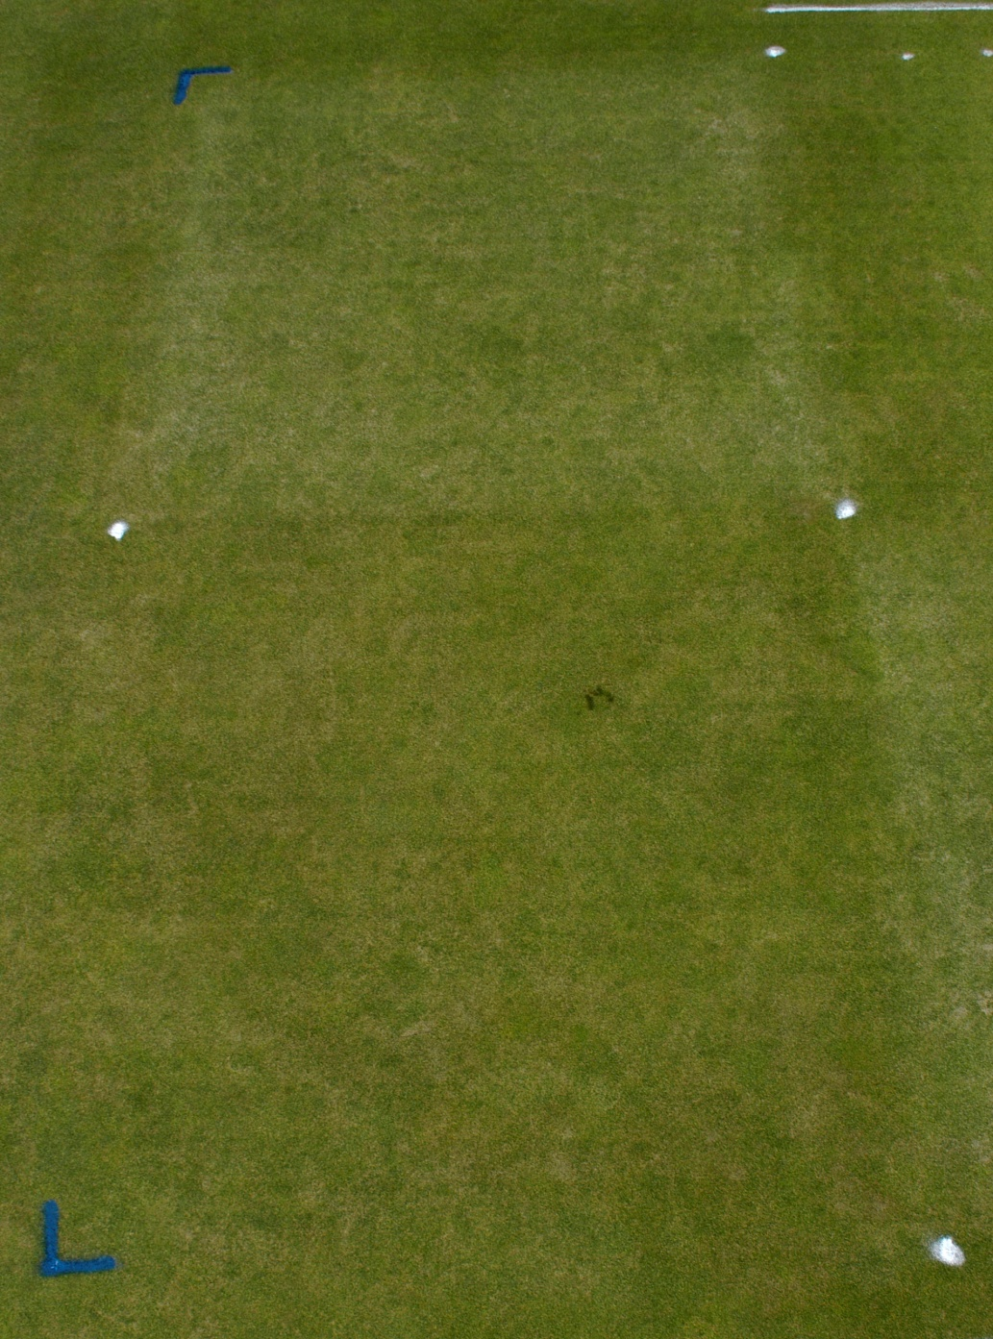
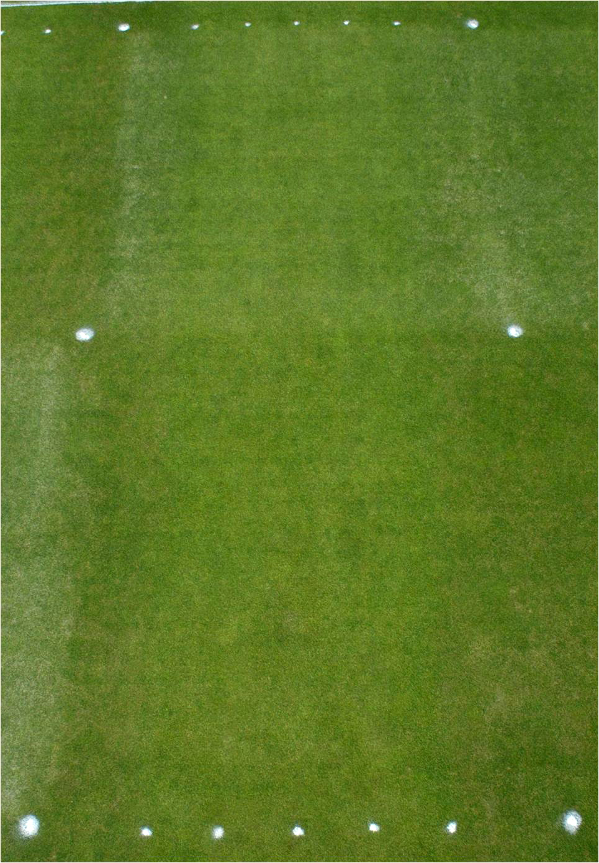
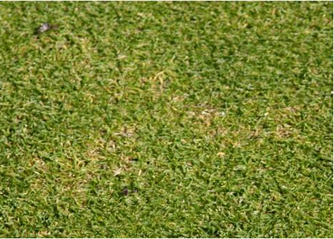
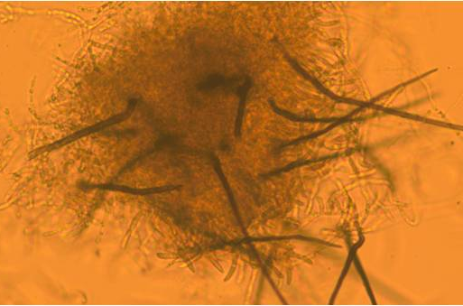
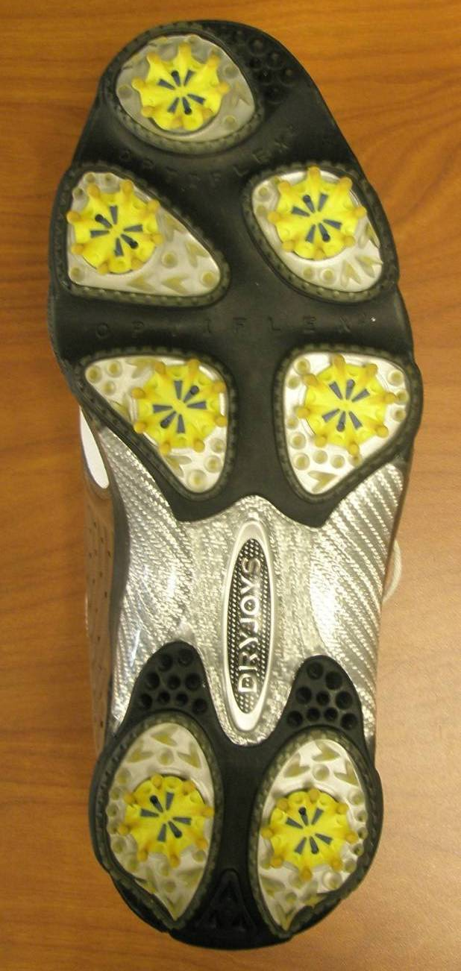
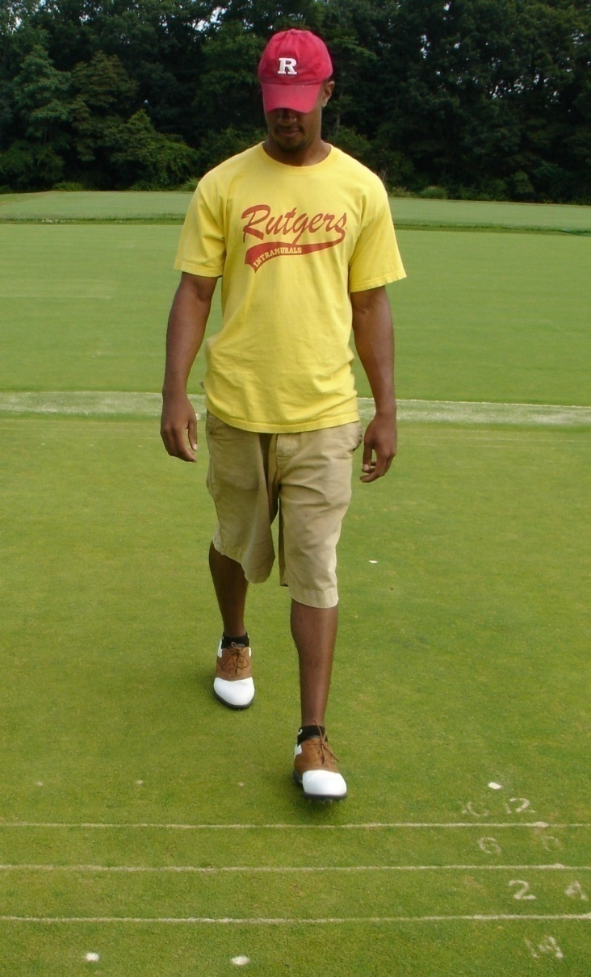
Sand Topdressing and Foot Traffic Effects On Anthracnose Severity of Annual Bluegrass Putting Green Turf
Joseph A. Roberts, John C. Inguagiato, James A. Murphy, and Bruce B. Clarke
Introduction
Anthracnose (Colletotrichum cereale) is a destructive disease of weakened turf that occurs throughout the world and is particularly severe on annual bluegrass (Poa annua) maintained as putting greens
Management practices that enhance abiotic stress may predispose turf to anthracnose.
Light frequent sand topdressing (i.e. 0.3-L m⁻² wk⁻¹) can reduce anthracnose severity
Incorporation methods (i.e. vibratory rolling or soft or stiff brushing) does not enhance anthracnose severity
Foot traffic over sand topdressing could exacerbate wounding associated with topdressing, thus increasing anthracnose severity
Results - 2007
Foot traffic dramatically reduced anthracnose severity 15 to 28% throughout 2007 regardless of sand topdressing (Figure 5)
Sand topdressing initially subtly increased anthracnose severity 7% in 2007, but continued topdressing reduced disease severity 5 to 9% by the end of the summer (Figure 6)
A treatment interaction occurred on 12 July 2007 when sand topdressing increased disease severity in plots not receiving foot traffic, but not in plots receiving intense foot traffic (Figure 7)
Sand
Sand
No Sand
No Sand
Figure 5. Anthracnose severity as affected by foot traffic in 2007
Figure 1. Anthracnose symptoms on a Poa annua putting green
Figure 2. C. cereale acervuli and conidia from infected Poa annua leaf tissue
b
a
a
a
No Traffic
Traffic
Objectives
Evaluate the effect of foot traffic on the severity of anthracnose
Determine whether the effect of light frequent topdressing on anthracnose severity is independent of foot traffic
Figure 6. Anthracnose disease response to sand topdressing in 2007
Conclusions
Foot traffic dramatically reduced anthracnose severity regardless of sand topdressing in 2007 and 2008
Sand topdressing subtly increased anthracnose severity initially in 2007, but continued weekly applications topdressing reduced disease by the end of 2007 and again in 2008
The interaction effect indicated that foot traffic effects are independent of the benefits obtained through regular sand topdressing
Figure 7. Treatment interaction means observed on 12 July 2007
Figure 6. Anthracnose severity as affected by sand topdressing in 2007
Materials and Methods
Results - 2008
Foot traffic dramatically reduced anthracnose severity 2 to 24% throughout 2008 regardless of sand topdressing (Figure 8)
Sand topdressing did not increase anthracnose disease in 2008, and reduced disease up to 9% on 5 of 11 rating dates (Figure 9)
A treatment interaction occurred on 22 July 2008 when topdressing reduced anthracnose severity in plots that received intense foot traffic, but not in plots that did not receive foot traffic (Figure 10)
7-yr old annual bluegrass turf maintained at a 3.2-mm mowing height was used for this study
  Sandy loam root zone
  Insects and other diseases controlled
  Trinexapac-ethyl (Primo MAXX) was applied at 49.9 g a.i. ha⁻¹ every 14-d during the growing season
  Nitrogen (NH₄NO₃) applied 4.9 kg ha⁻¹ every 14-d
  Irrigation applied to obtain moderately dry conditions
Recommendations for Golf Course Managers
Applying sand topdressing regularly to annual bluegrass putting green turf can significantly reduce anthracnose disease
  light and frequent applications - 0.3 L m⁻² every 7 to 14 days
  heavier and less frequent applications - 1.2 L m⁻² every 21 to 42 days
Methods that incorporate sand without severe bruising should be used
Sand topdressing can be applied even under intense foot traffic
Figure 3. Foot Joy golf shoe equipped with soft-spikes
  Split Plot Design, 2 x 2 factorial with 4 replications
Figure 8. Anthracnose severity as affected by foot traffic in 2008
Main plots
No Traffic
Foot Traffic (Golf Shoe)
5-d wk⁻¹ at 327 footsteps m⁻²
or 200 rounds day⁻¹
Subplots
No topdressing
Topdressed weekly at
0.3 L m⁻²
(1 ft³/1000 ft²)
References
c
c
Hathaway, A.D., and T.A. Nikolai. 2005. A putting green traffic methodology for research applications established by in situ modeling. Int. Turfgrass Soc. Res. J. 10:69-70.
Inguagiato, J.C. 2009a. Anthracnose severity influenced by cultural management of annual bluegrass putting green turf. Ph.D. Dissertation. Rutgers University, New Brunswick, NJ.
Murphy, J., F. Wong, L. Tredway, J. Crouch, J. Inguagiato, B. Clarke, T. Hsian, and F. Rossi. 2008. USGA Best management practices for anthracnose on annual bluegrass turf. Golf Course Manage. 76:93-104
Smiley, R.W., P.H. Dernoeden, and B.B. Clarke. 2005. Compendium of turfgrass diseases. 3rd ed. The American Pathological Society, St. Paul, MN.
a
b
^{(Hathaway and Nikolai, 2005)}
Anthracnose severity was rated periodically using a line-intersect grid count method
All data was subjected to analysis of variance (ANOVA) using SAS 9.1.3 for windows
Treatment differences were determined using Fisher’s protected LSD at the 0.05 probability level
Funding
Figure 9. Anthracnose severity as affected by sand topdressing in 2008
Figure 10. Treatment interaction means observed on 22 July 2008
Rutgers Center for Turfgrass Science
New Jersey Agricultural Experiment Station
Golf Course Superintendents Association of America
Golf Course Superintendents Association of New Jersey
United States Golf Association
Figure 4. Student (Brian Ross) performing foot traffic

