Slide 1


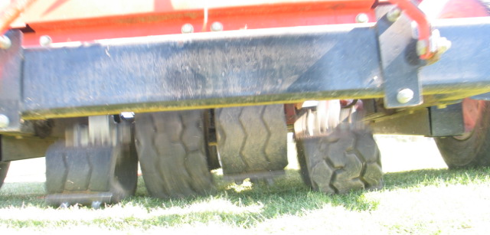
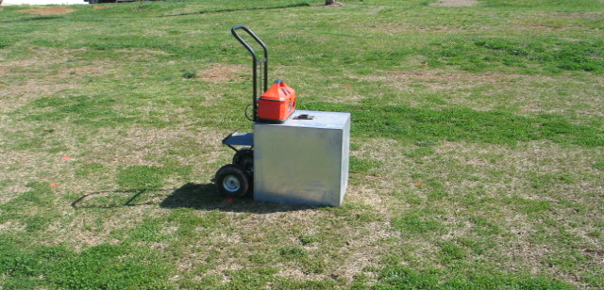
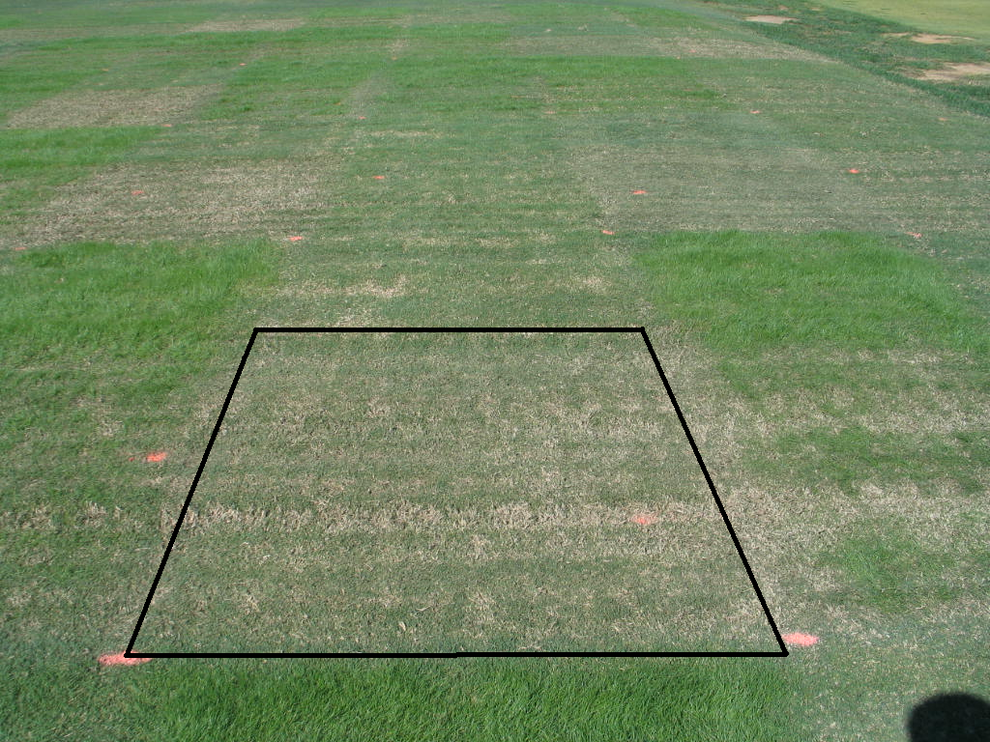
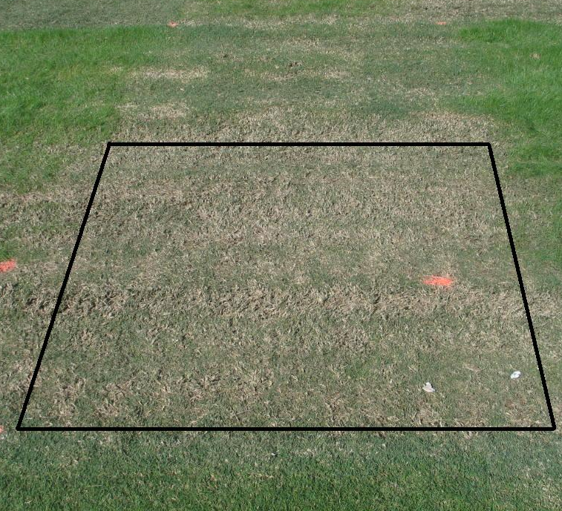
Effects of trinexapac-ethyl on the traffic tolerance of four bermudagrass cultivars
W. D. Haselbauer*, J. C. Sorochan, J.T. Brosnan, B. J. Horvath, T. J. Samples
Department of Plant Sciences University of Tennessee
Abstract
Bermudagrass [Cynodon dactylon (L.) Pers.] is the most commonly used warm season turfgrass on athletic fields in the southern United States. Trinexapac-ethyl (TE) data describing the effects of TE on bermudagrass athletic fields is limited. A two year study was initiated at the University of Tennessee (Knoxville, TN) in 2008 evaluating the effects of TE applications on the traffic tolerance of four bermudagrass cultivars. The experiment was a 4 x 3 x 2 factorial with 3 replications including bermudagrass cultivars ‘Tifway’, ‘Riviera’, ‘Patriot’, and ‘Celebration’, TE treatments (no TE, TE at 6.49 g a.i. ha⁻¹ applied until 14 days prior to trafficking, and TE at 6.49 g a.i. ha⁻¹ applied until overseeding), and overseeding (no overseeding and overseeding at 67 g m⁻²). TE treatments were applied sequentially, on 14 day intervals, beginning on 18 July. 30 games of simulated traffic were applied with a CADY traffic simulator beginning 10 September. Digital image analysis was performed to quantify turfgrass color and percent cover. ‘Tifway’ and ‘Celebration’ maintained greater percent cover over both ‘Riviera’ and ‘Patriot’ under simulated traffic. For instance, after 18 games of simulated traffic ‘Tifway’ and ‘Celebration’ yielded 62% and 58.5% cover, respectively while ‘Patriot’ and ‘Riviera’ measured 24.18% and 49.5%, respectively. TE applications applied until two weeks prior to trafficking yielded increased percent cover on all rating dates from initial traffic until 5 November (17 games and initial bermudagrass dormancy) compared to applications of TE applied until overseeding. No differences were detected between plots not receiving TE and those treated with TE until two weeks prior to trafficking on the same rating dates for 9 out of the 13 dates. These data suggest that applications of TE on bermudagrass athletic fields should be ceased at least two weeks prior to the onset of traffic stress.
‡
Introduction
Maintaining a turfgrass cover is important in keeping a safe and playable athletic field. In the transition zone the most commonly used warm season grass on athletic fields is bermudagrass [Cynodon dactylon (L.) Pers. and C. dactylon x C. traansvalensis Burtt Davy] due to its recuperative potential and ability to tolerate high temperature extremes during the summer (Puhalla, 1999).
Trinexapac-ethyl (TE), a group A or type II plant growth regulator (PGR) is widely used in the turfgrass industry. Found to increase stolon numbers (Johnson, 1994), reduce vertical vegetative growth and increase sod strength of bermudagrass (Fagerness, 2002), TE is believed to be an effective maintenance strategy to maintain turfgrass cover on athletic fields. Currently, data showing the effects of TE on bermudagrass athletic fields is limited.
In 2008, a study was conducted at the East Tennessee Research and Education Center at the University of Tennessee (Knoxville, TN) to evaluate the performance of four bermudagrass cultivars as effected by overseeding and different TE application timings.
Results for Non-Overseeded Plots
Figure 3. Cady Traffic Simulator
Figure 4. Light Box for DIA
‡
Table 1: Percent green cover for trafficked bermudagrass cultivars
 | Number of Simulated Games
 | 5 |  | 10 |  | 15 |  | 20 |  | 25
Cultivar | Turfgrass Cover (%)
Tifway | 93.0 | a† | 83.8 | a | 66.5 | a | 50.4 | a | 32.2 | a
Riviera | 90.6 | ab | 82.1 | a | 56.7 | b | 36.6 | b | 16.4 | b
Patriot | 88.5 | b | 70.0 | b | 26.2 | c | 13.9 | c | 5.0 | c
Celebration | 93.7 | a | 84.8 | a | 63.8 | ab | 42.3 | ab | 19.7 | b
† Percent green cover values followed with any of the same letters are not significantly different according to Fishers Protected LSD(0.05)
Results for Overseeded Plots
Table 2: Percent green cover for trinexapac-ethyl (TE) treated, non-overseeded plots
 | Number of Simulated Games
 | 5 |  | 10 |  | 15 |  | 20 |  | 25
PGR† | Turfgrass Cover (%)
A - No TE | 92.0 | ab‡ | 81.8 | a | 46.8 | b | 31.4 | b | 16.7 | a
B - 3 TE applications | 93.2 | a | 86.7 | a | 61.4 | a | 41.6 | a | 21.7 | a
C - 5 TE applications | 89.2 | b | 72.1 | b | 51.7 | b | 34.5 | ab | 16.5 | a
† A = No TE, B = TE applied until 14 days before traffic, and C = TE applied until 14 days after traffic
‡ Percent green cover values followed with any of the same letters are not significantly different according to Fishers Protected LSD(0.05)
Table 3: Percent green cover for trafficked bermudagrass cultivars
 | Number of Simulated Games
 | 5 |  | 10 |  | 15 |  | 20 |  | 25
Cultivar | Turfgrass Cover (%)
Tifway | 92.9 | ab‡ | 87.5 | a | 81.4 | a | 73.1 | a | 61.5 | a
Riviera | 90.7 | bc | 85.5 | a | 76.8 | a | 62.1 | a | 45.0 | b
Patriot | 89.4 | c | 76.1 | b | 45.9 | b | 32.5 | b | 22.1 | c
Celebration | 94.1 | a | 87.7 | a | 84.0 | a | 71.9 | a | 56.5 | a
† Overseeding occurred between 5 and 10 simulated athletic field traffic games on 22 September 2009
‡ Percent green cover values followed with any of the same letters are not significantly different according to Fishers Protected LSD(0.05)
†
Objectives
Determine how different cultivars of common (‘Riviera’ and ‘Celebration’) and hybrid (‘Tifway’ and ‘Patriot’) bermudagrass respond to simulated athletic field traffic.
Determine how cultivars of common and hybrid bermudagrass respond to simulated athletic field traffic when treated with trinexapac-ethyl.
Determine how cultivars of common and hybrid bermudagrass respond to simulated athletic field traffic when overseeded with perennial ryegrass.
Table 4: Percent green cover for trinexapac-ethyl (TE) treated, overseeded plots
 | Number of Simulated Games
 | 5 |  | 10 |  | 15 |  | 20 |  | 25
PGR† | Turfgrass Cover (%)
A - No TE | 91.6 | a¶ | 84.6 | ab | 65.1 | b | 51.4 | b | 36.0 | b
B - 3 TE applications | 92.6 | a | 87.7 | a | 75.9 | a | 63.1 | a | 50.4 | a
C - 5 TE applications | 91.1 | a | 80.3 | b | 75.2 | a | 65.2 | a | 52.4 | a
† A = No TE, B = TE applied until 14 days before traffic, and C = TE applied until overseeding
‡ Overseeding occurred after 7 simulated games on 22 September 2009
¶ Percent green cover values followed with any of the same letters are not significantly different according to Fishers Protected LSD(0.05)
Conclusions for Non-Overseeded Plots
‘Tifway’ and ‘Celebration’ after five games and ‘Tifway’, ‘Celebration’, and ‘Riviera’ after 10, 15 , 20, and 25 games maintained greater percent green cover than ‘Patriot’ (Table 1).
After 25 games ‘Tifway’ had the greatest percent green cover followed by ‘Celebration’ and ‘Riviera’ which had greater percent green cover than ‘Patriot’ (32.2, 19.7, 16.4, and 5.0%, respectively) (Table 1)
TE applications applied until 14 days before trafficking yielded higher percent green cover values than TE applied until 14 days after traffic and no TE applications after 15 games. However, after 25 games no differences between TE applications occurred (Table 2).
‡
Materials and Methods
Experimental Design
Three factor randomized complete block design with three replications
Four bermudagrass cultivars – ‘Tifway’, ‘Riviera’, ‘Patriot’ and ‘Celebration’
TE applications – No TE, TE at 6.49 g a.i. ha⁻¹ applied until 14 days prior to trafficking, and TE at 6.49 g a.i. ha⁻¹ applied until 14 days after trafficking (overseeding)
Perennial ryegrass overseeding – No overseeding and overseeding at 67 g m⁻²
Plots were 1.5 m by 3 m
Experiment Implementation
TE Applications began 18 July 2008 and were applied on 14 day intervals. Application two was stopped 15 August 2008 (3 total apps) and application three was stopped 26 September 2008 (5 total apps)
Overseeding occurred on 22 September 2008 (7 simulated games)
Traffic was applied with the Cady traffic simulator (CTS) (Figure 3) (Henderson at al. 2005) three times a week from 8 September until 21 November 2008 (30 simulated games) and was stopped for one week after overseeding.
Two passes with the CTS = one simulated game
Data Collection and Analysis
Digital image analysis (DIA) using a light box (Figure 4) and SigmaScan Pro© to determine turfgrass percent green cover (Karcher et al. 2007) was performed after every traffic event
Statistical analysis was performed with MMAOV in the SAS system for percent green cover but no overseeding interaction was found and that factor was removed to separate means from either overseeded or non-overseeded plots
Conclusions for Overseeded Plots
‘Tifway’ and ‘Celebration’ after five games and ‘Tifway’, ‘Celebration’, and ‘Riviera’ after 10, 15, 20, and 25 games maintained greater percent green cover then ‘Patriot’. (Table 3).
After 25 games ‘Tifway’ and ‘Celebration’ had the greatest percent green cover followed by ‘Riviera’ then ‘Patriot’ (61.5, 56.5, 45.0, and 22.1%, respectively) (Table 3)
After 15 games (11 days after overseeding) overseeded plots that received either TE treatments maintained a higher percent green cover through the traffic season than plots not receiving TE (Table 4).
Figure 1. TE applied until 14 days before simulated athletic field traffic (13 games)
Figure 2. TE applied until 14 days after simulated athletic field traffic (13 games)
Literature Cited
Puhalla, J., J. Krans, M. Goatley. 1999. Sports Fields: A manual for design construction and maintenance. John Wiley and Sons, N.J.
Johnson, B.J. 1994. Influence of plant-growth regulators and mowing on 2 bermudagrasses. Agronomy Journal 86(5): 805-810
Henderson, J. J., J.L. Lanovaz, J.N. Rogers III, J.C. Sorochan, and J.T. Vanini,. 2005. A new apparatus to stimulate athletic field traffic: The cady traffic simulator. Agronomy Journal. 97(4): p. 1153-57.
Fagerness, M.J., F.H. Yelverton, D.P. Livingston and T.W. Rufty. 2002. Temperature and trinexapac-ethyl effects on bermudagrass growth, dormancy , and freezing tolerance. Crop Science 42:853-858
Karcher, D.E. and M.D. Richardson. 2003. Quantifying turfgrass color using digital image analysis. Crop Science. 43(3): p. 943-951.
~74% cover
~45% cover

