Slide 1

Turnover of wetland sediments on mineralization of carbon, nitrogen and phosphorus
Qingren Wang* and Yuncong Li
Tropical Research and Education Center
Department of Soil and Water Science
IFAS, University of Florida
ASA-CSSA-SSSA 2009, Pittsburgh, PA

Slide 2
Outline
Brief introduction about the Everglades wetland
Recycling of carbon in wetland system
Experiment setup, sampling and analysis
Results, conclusion and discussion

Slide 3
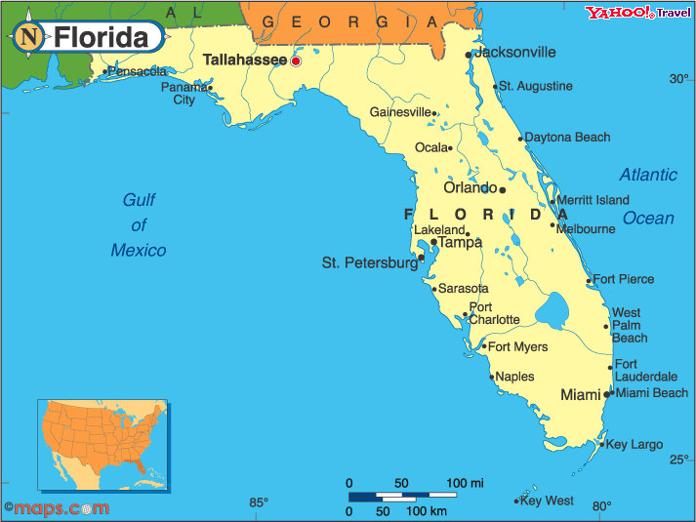
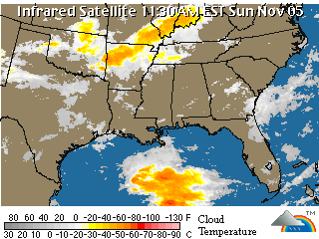
TREC-Homestead

Slide 4
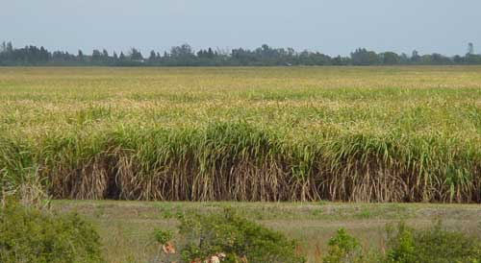
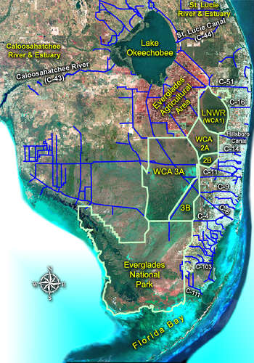

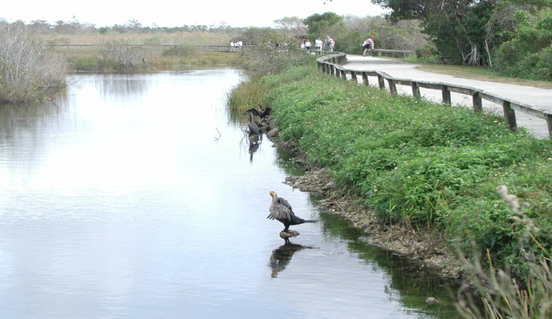
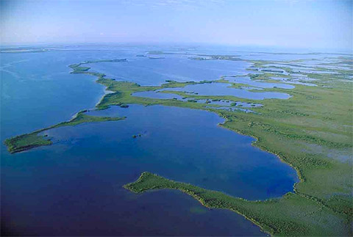
Eco-Environment in south Florida
Agriculture
Natural ecosystem
National Park
Florida Bay

Slide 5
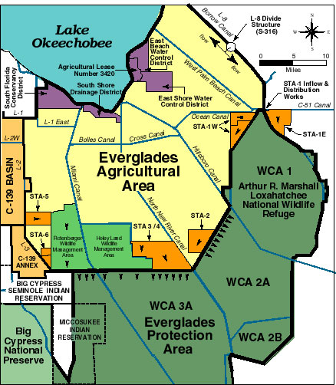
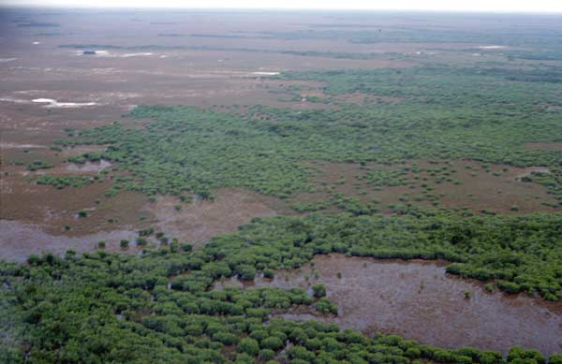
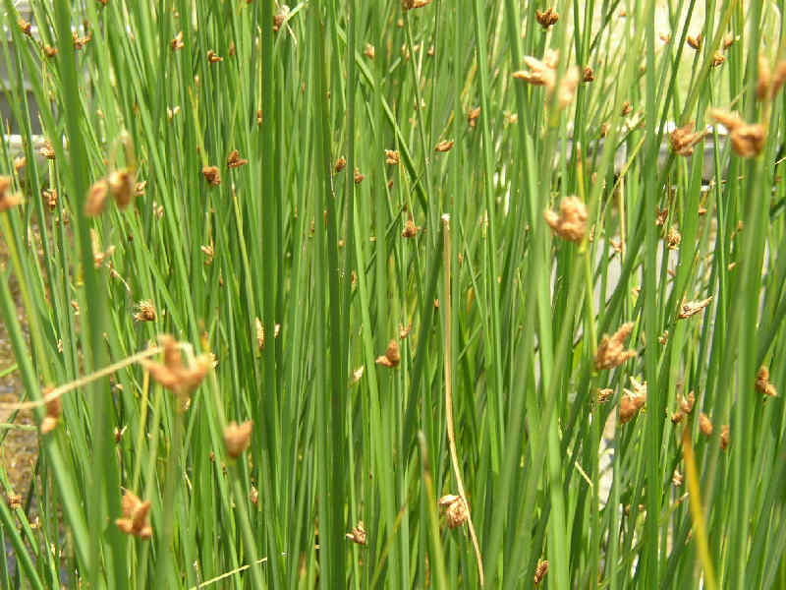
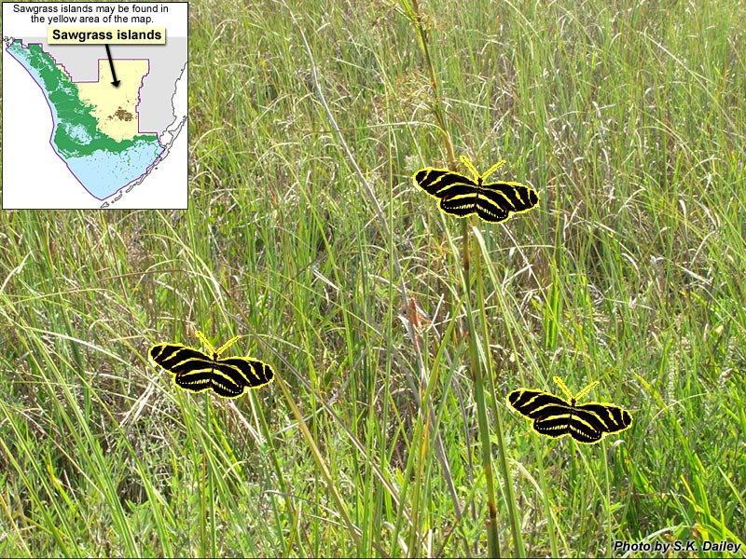
Natural Eco-environment in the Everglades wetland
Bulrush:
Scirpus rubiginosus
Sawgrass:
Cladium jamaicense

Slide 6
Why carbon in wetlands?
Wetlands are an important part of the global carbon inventory: up to 1/3 of total global soil carbon is stored in wetlands
Carbon in wetlands is relatively stable
Carbon accumulation is based on vegetation types and soil fertility
Decomposition rate depends on water content and temperature

Slide 7
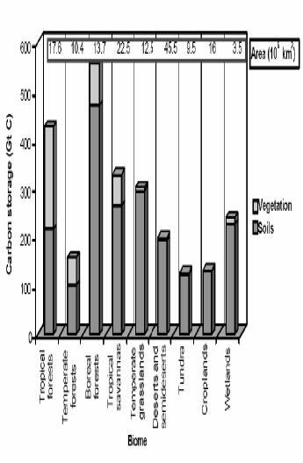
Importance of wetlands
Mitra et al, 2005, Curr. Sci.

Slide 8
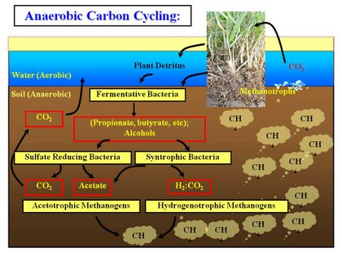
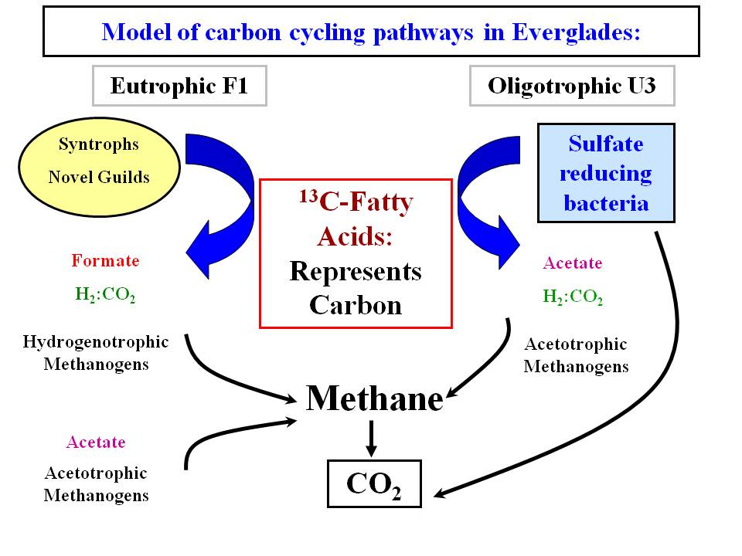
Carbon cycling in wetlands
Chauhan, 2007: http://sites.google.com/site/ashvinichauhan/syntrophic-methanogenic-associations-in-florida-wetlands

Slide 9
Hypothesis
Sediment mineralization was dependant on vegetation type and temperature at the same moisture and other conditions

Slide 10
Experiment
Intact sediment columns were collected from wetland sites with two different main vegetations: Bulrush and Sawgrass (both are native plants).
Kept these columns in three growth chambers with temperature at: 30, 25, and 20 ºC, respectively.
Carbon emission and nutrient mineralization were monitored through sampling without disturbing the sediments for 380 days.

Slide 11
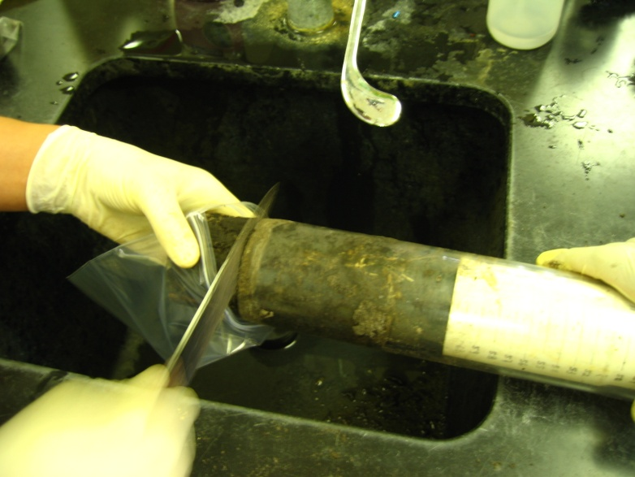
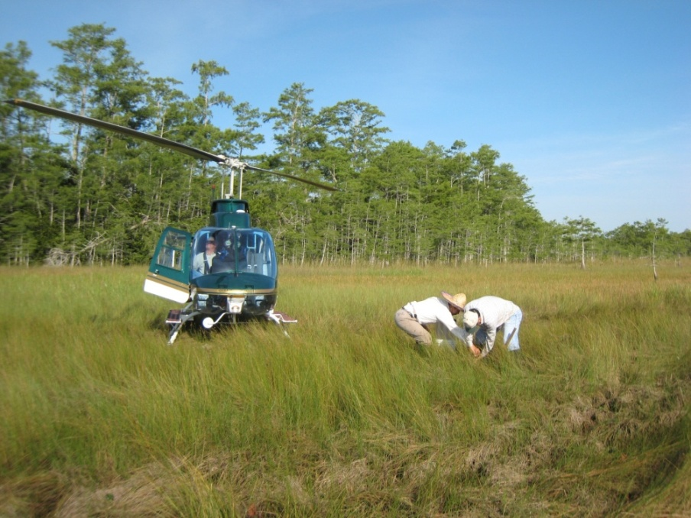
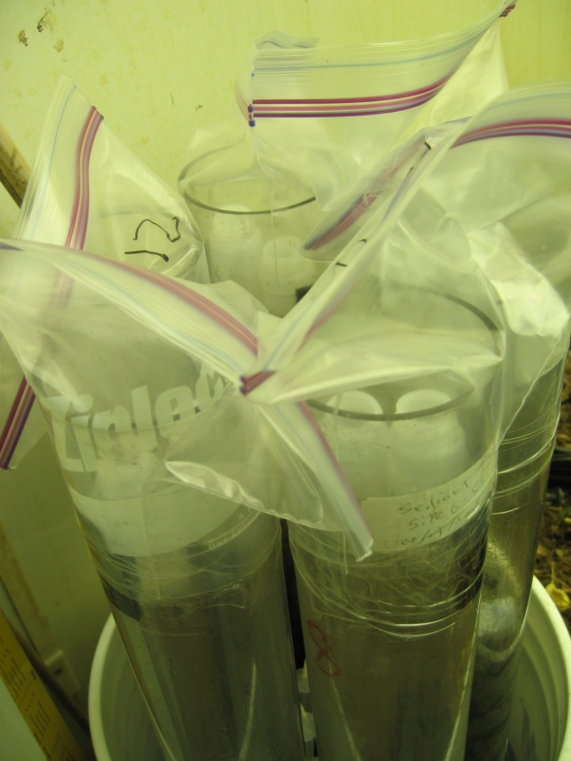
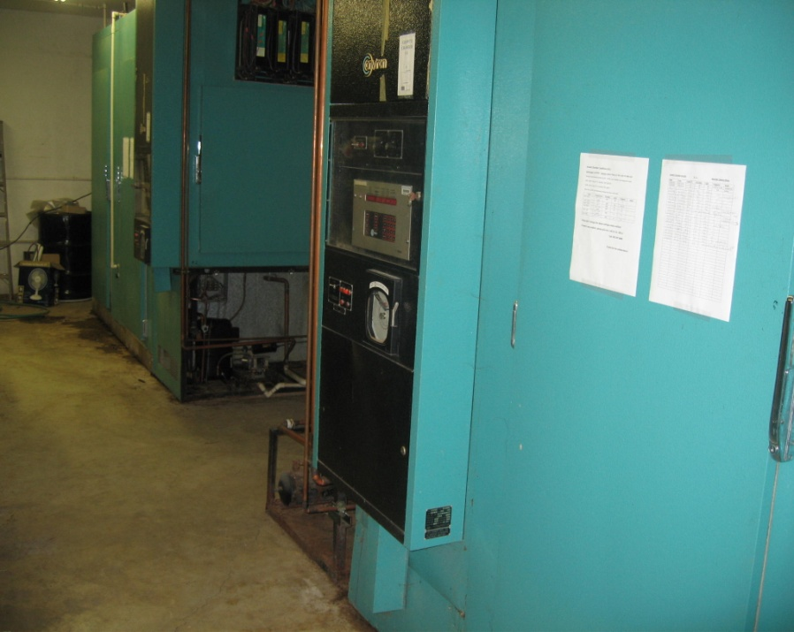
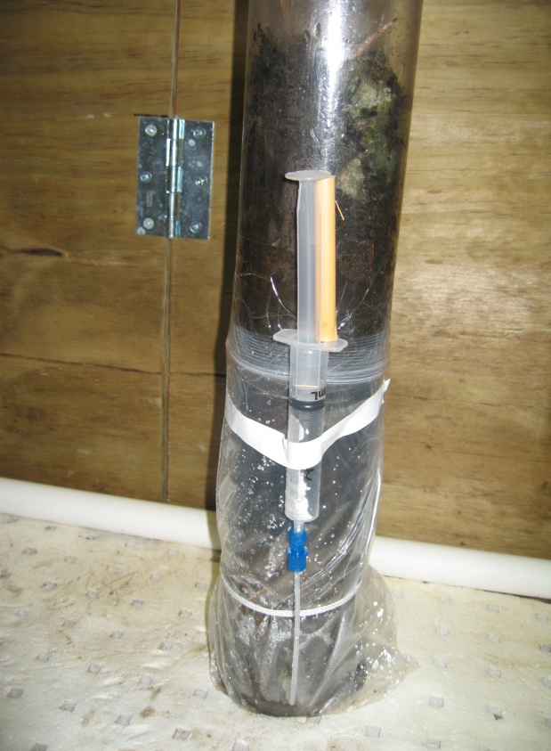
Sediment collection & experiment setup

Slide 12
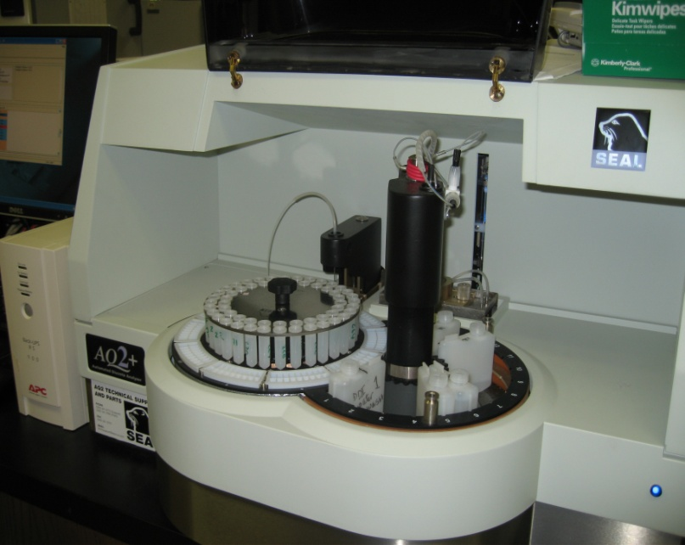
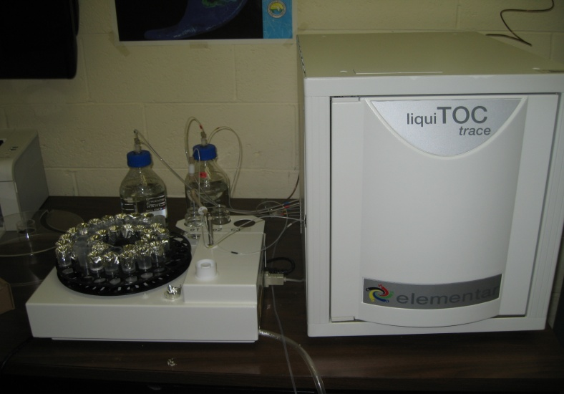
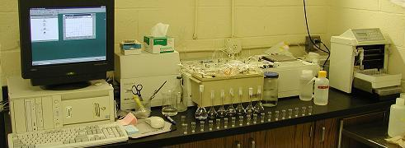
Sample analyses
Carbon analysis: LiquiTOC
Nitrate and ammonium: Seal AQ2+
Ortho phosphorus: Auto-analyzer (AA-3)

Slide 13
Major results
Turnover of sediments for C, N, and P with time.
Sediment mineralization vs. vegetation type.
Effect of temperature on sediment turnover.

Slide 14
Carbon mineralization rate

Slide 15
Accumulative CO₂-C with time

Slide 16
Expressed by exponential growth model
y = a * Exp(-bx)
x-time (days), and y-accumulative amount of CO₂-C released from sediments
 | Sawgrass | Bulrush
a | 13285.65 | 11023.78
b | 0.0273 | 0.0261
R² | 0.977 | 0.969

Slide 17
Impacted by temperature (CO₂–C)
Temperature (ºC)

Slide 18
Nitrogen mineralization
Time (day)

Slide 19
Accumulative N
Time (day)

Slide 20
Phosphorus mineralization

Slide 21
Accumulative phosphorus

Slide 22
Impacted by temperature (NO₃–N)
Temperature (º C)

Slide 23
Impacted by temperature (NH₄-N)
Temperature (º C)

Slide 24
Impacted by temperature (P)
Temperature (º C)

Slide 25
Conclusions (1)
The turnover of organic C was rapid in the first 100 days.
The accumulative amount of C mineralized can be well described by an exponential growth model.
Nitrogen turnover was low at first 100 days and sharply increased afterwards.
Phosphorus mineralization was low throughout the whole experimental period.

Slide 26

Conclusions (2)
Sawgrass had a greater turnover on C and N but lower on P than did bulrush.
High temperature improves the turnover of organic C and NH₄-N for both species but that of P only for bulrush.
The turnover of NO₃-N was the greatest at 25 ºC, especially for sawgrass.
Factors in controlling the turnovers are rather complicated, C:N ratio (18.9 in sawgrass vs. 13.8 in bulrush) might be one of them.

