Slide 1
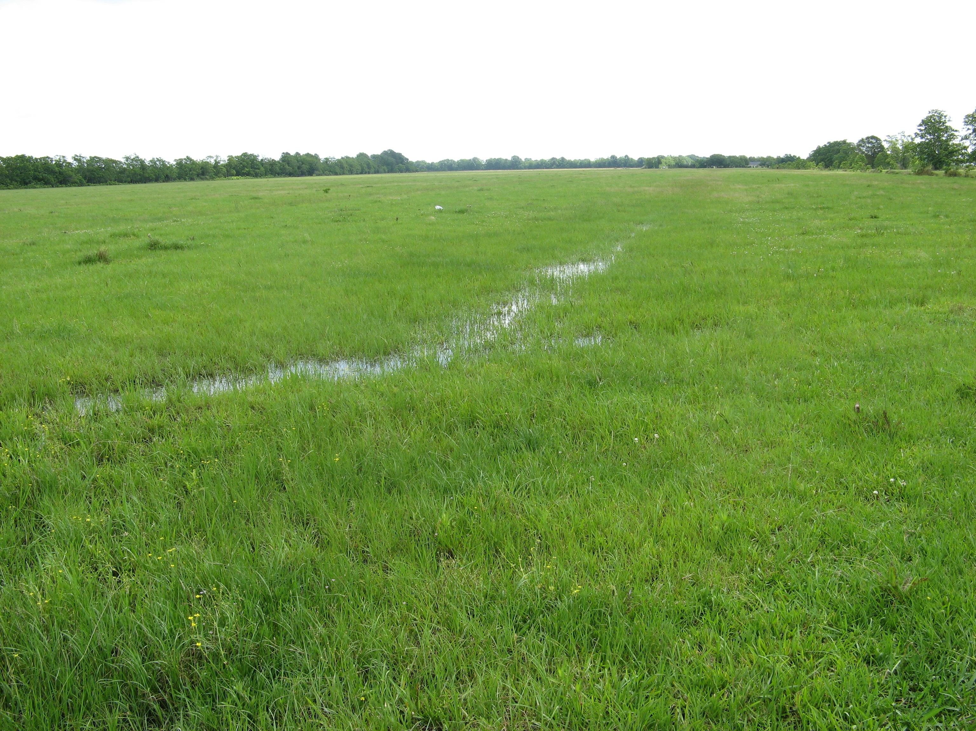

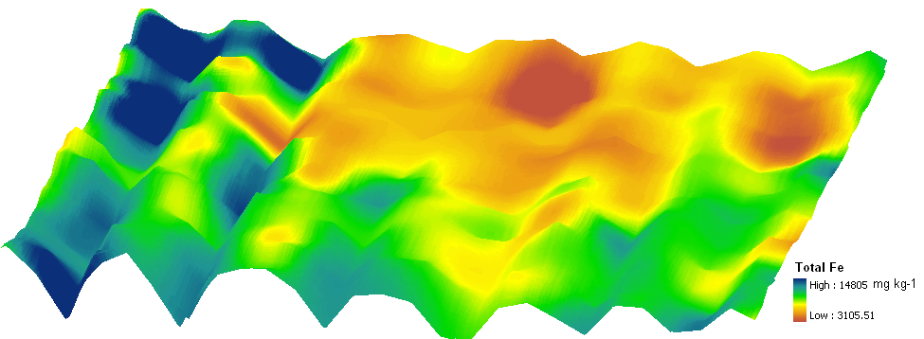
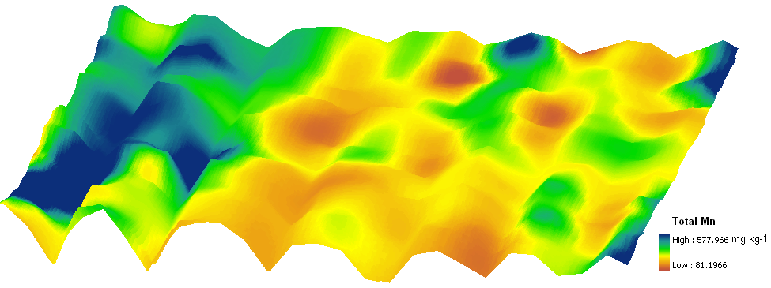
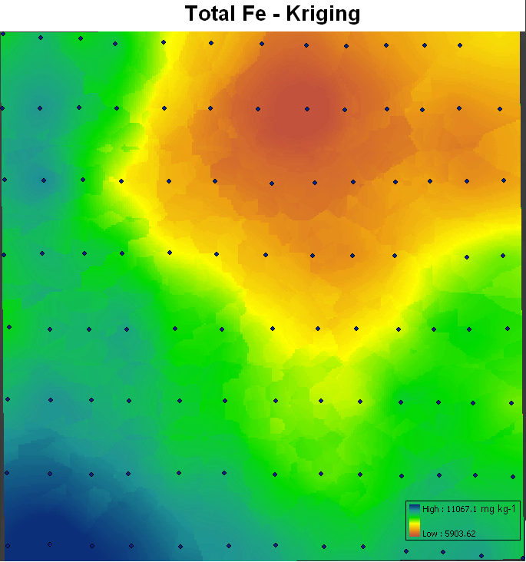
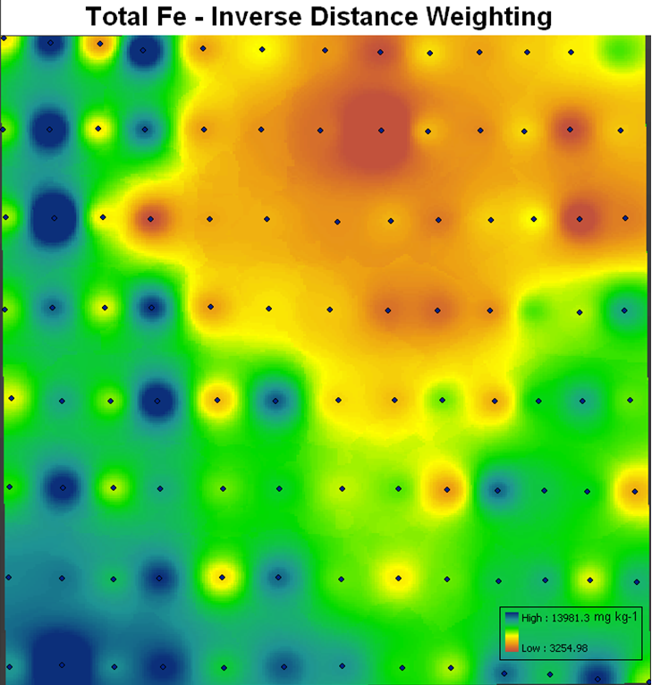
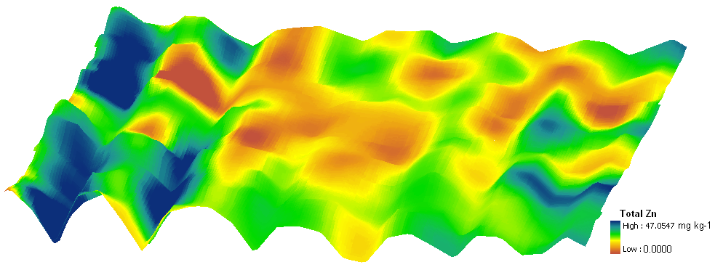

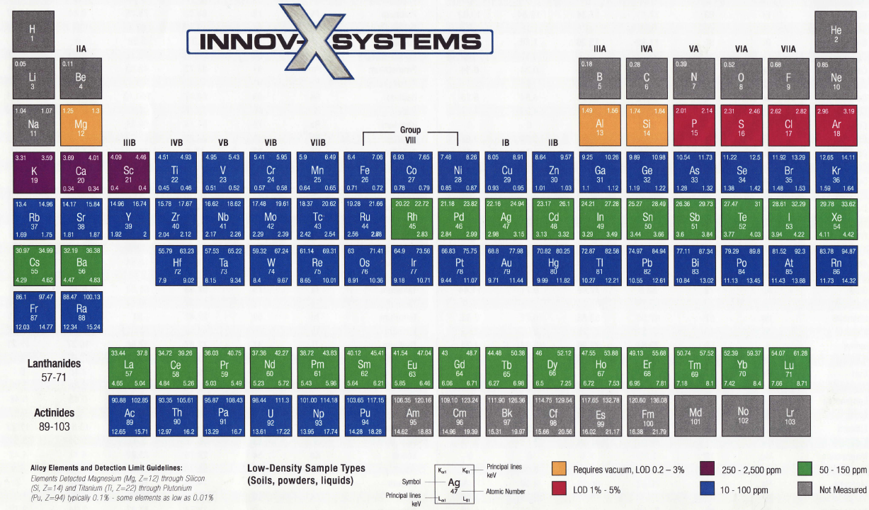
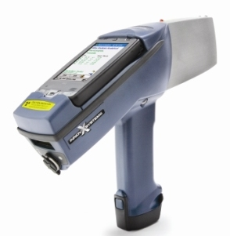
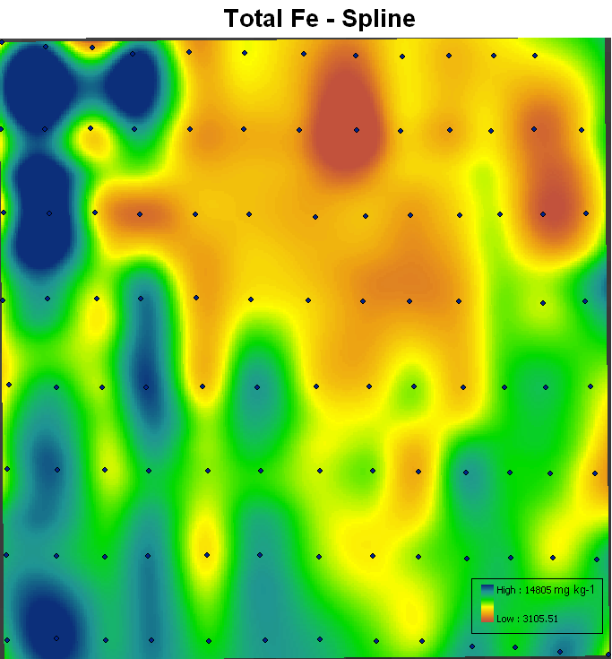
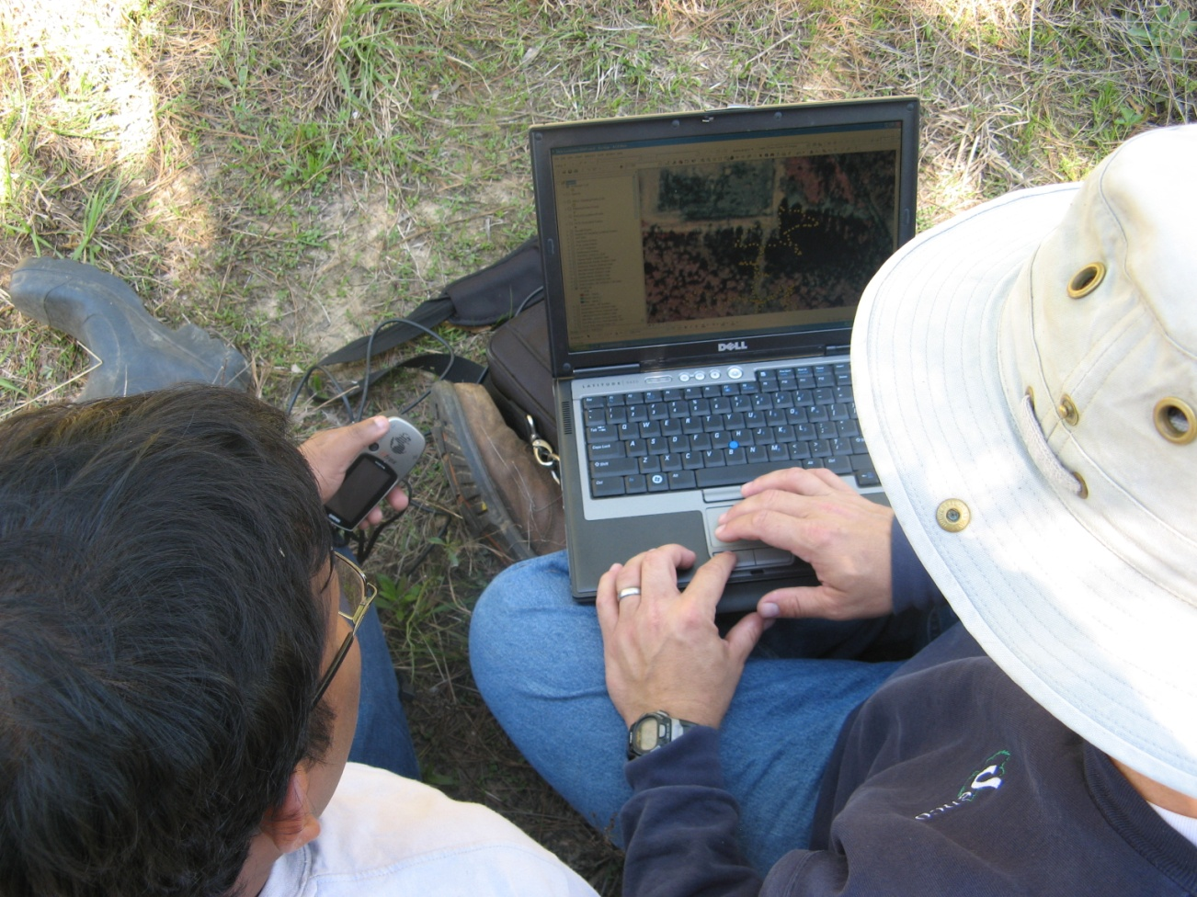
Spatial Modeling Of Soil Nutrients: A PXRF Approach
Weindorf, D.¹, Y. Zhu¹, S. Johnson¹, and N. Bakr¹
¹School of Plant, Environmental and Soil Sciences, LSU AgCenter, Baton Rouge, LA 70803, dweindorf@agcenter.lsu.edu
ABSTRACT
The use of commercial fertilizers on farms in Louisiana pose a threat to water quality as a nonpoint source of nutrient enrichment of surface waters. Given high annual rainfall, nutrients have a propensity to move off-site into bayous and surface streams. The dynamics of such movement are site specific and strongly related to topography, vegetative cover, soil texture, and management practices. Until now, sporadic soil sampling and laboratory testing of nutrients has given farmers a cursory sense of nutrient levels in their fields, but with little understanding of spatial variability or temporal movement of nutrients. This study uses global positioning system (GPS) referenced field portable x-ray fluorescence (PXRF) spectrometry to rapidly assess a variety of different nutrients at 104 points in a 1.75 ha field. Scanning and interpolation analysis was completed in the field, on-site using Innov-X PXRF equipment and a laptop computer GPS/GIS system. Results clearly show the ability of this system to provide farmers with high resolution nutrient distribution maps on-site, which can be used for precision application of fertilizer in response to crop needs.
Methods
An Innov-x Alpha series portable x-ray fluorescence (PXRF) spectrometer was used to quantify total Fe, Mn, and Zn at 104 points in surface soil of a field in St. Landry Parish, LA.
Points were linearly located in swales and ridges at ~10 m apart.
Point locations were georeferenced using Garmin e-trex handheld GPS units.
Scanning data from each site was imported into ESRI ArcGIS 9.2 for spatial interpolation.
Inverse distance weighting (IDW), kriging, and spline interpolation were used to assess the spatial variability of nutrients in the fields.
Interpolations were linked to LIDAR elevation data and rendered in 3D using ESRI ArcScene 9.2.
Results
Fe and Zn were significantly correlated with elevation (p>0.05) .
Inverse distance weighting (IDW) interpolation produced maps either too heavily weighted on sample collection points or over emphasizing the grid sampling scheme.
Kriging interpolation identified the general spatial concentrations of the nutrients, but failed to detect the elevational influence of the swales.
Spline interpolation produced superior maps which readily show the significant influence of swale elevation.
Fe, Mn, and Zn all tended to accumulate in swales near one side of the field where standing water was observed on several occasions.
Introduction
Surface water quality is a major concern in Louisiana. Yet farmers have limited access to quick, quantifiable nutrient data for their fields. Often, they are left to collect a few samples and wait weeks for results. Using PXRF, quantifiable elemental data is rapidly available for a host of plant essential elements including Cu, Fe, Mn, Zn, and at higher levels, Ca, Mg, and K. Also, a wide range of heavy metals such as Pb, As, Cd, and Hg can be assessed via this method.
The Jeanerette silt loam (Fine-silty, mixed, superactive, thermic Typic Argiaquoll) occupies the evaluated site with slopes of 0-1%. The site is in improved pasture with swales installed to channel runoff. Horses and cows have grazed the field periodically for 20 years and hay is cut and harvested 2-3 times annually. Approximately 120-30-100 lbs/A NPK are applied annually (half in the spring, half in the summer). Ryegrass is occasionally planted as a winter forage and fertilized with 50 lbs/A K.
The field sits adjacent to Bayou Wikoff part of the Mermentau River Basin (Plaquemine–Brule Watershed Subsegment).
3-D spline interpolations of PXRF data (Fe, Mn, Zn) combined with LIDAR data.
Conclusions
PXRF linked to GIS/GPS can provide high quality, on-site quantification of soil nutrients.
Fe and Zn were significantly correlated with elevation (p>0.05).
Compared to kriging or IDW, spline interpolation appears to provide superior modeling of soil nutrient spatial variability.
Future Work
Will focus on temporal sequencing of spatial variability maps to monitor soil nutrient movement in response to precipitation, fertilization, and management practices.
Will compare differences in spatial variability patterns of XRF total elemental analysis vs. ICP selective extraction methods.
Sequential process for producing on-site interpolations from PXRF data.

