Slide 1

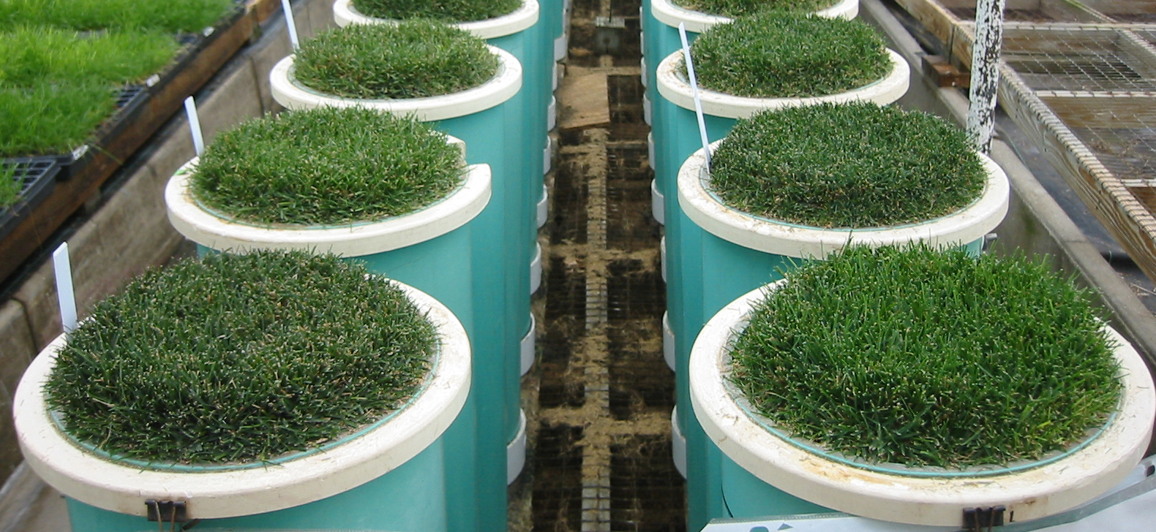
¹³C Discrimination and Water Use Efficiency of Perennial Ryegrass
Genotypes in Response to Wilt-Based Irrigation
J. D. Lanier, J. S. Ebdon and M. DaCosta
Department of Plant, Soil and Insect Sciences, University of Massachusetts Amherst
Introduction & Objectives
Photo 1. Perennial ryegrass subject to WB treatment at wilt (left foreground) vs. perennial ryegrass subject to WW treatment at full turgor (right foreground).
Results & Discussion
Theory
C₃ plants such as perennial ryegrass discriminate against the heavier ¹³C isotope in favor of the lighter ¹²C isotope during carboxylation. ¹³C isotope discrimination (Δ) and water use efficiency (WUE) are inversely related in C₃ plants by stomatal conductance. Low Δ has been proposed as a screening method for higher WUE. Stomatal closure in response to water stress reduces the ratio of intercellular carbon (c_{i}) to that of the atmosphere (c_{a}), thereby reducing the opportunity for biological discrimination against ¹³C. Discrimination against ¹³C provides an integrated average of isotopic ratio over the life of the analyzed tissue. Thus, lower Δ (c_{i}/c_{a} ratio) values suggest greater incidence of stomatal closure (due to water stress) and higher WUE. This relationship has not been investigated in response to wilt-based (WB) irrigation.
Wilt-Based (WB) Irrigation
Traditional recommendations specify deep, infrequent irrigation to encourage deep rooting and promote maximum turfgrass drought tolerance (Beard, 1973; Bennett and Doss, 1960; Qian and Fry, 1996). The practice of WB irrigation incorporates a timing variable, by scheduling irrigation at the earliest onset of water stress indicated by leaf fold and roll (wilt). Unlike deficit irrigation methods, WB irrigation does not require specialized equipment and is therefore more suitable for practical application. The implementation of WB strategies can conserve irrigation water by promotion of greater rooting and and moisture loss to evaporation. Drought tolerance benefits of WB have been associated with lower leaf water and osmotic potentials, which enable turfgrass plants to maintain favorable water relations during stress periods (Qian and Fry, 1996).
Study Objectives
To compare six perennial ryegrass genotypes in terms of variation in Δ and WUE in response to two irrigation schedules: well-watered (WW), and wilt-based (WB).
Δ and WUE in Response to Wilt-Based Irrigation
Differences in Δ (and c_{i}/c_{a} ratio) due to irrigation main effect (WW vs. WB) were observed in both years; Δ was consistently lower under WB when compared to WW (Table 2). Lower Δ values suggest greater stomatal closure (water stress) and higher WUE. Stomatal closure is a drought avoidance mechanism and precedes any detectable loss in whole-plant productivity under mild water stress (i.e. WB).
In 2007 lower Δ under WB irrigation was an indication of physiological stress (lower c_{i}/c_{a} ratio), which was not readily apparent according to whole-plant parameters. Yield (productivity), ET (whole plant water use) and WUE measurements did not vary due to irrigation treatment in 2007 (Table 2). In 2008 moisture stress was apparent at both the whole-plant and physiological levels, as genotypes subjected to WB irrigation had lower yield, WUE, and Δ in comparison to WW (Table 2).
Genetic variation in 2007 for Δ (c_{i}/c_{a} ratio) under WB was correlated with wilting tendency (Figure 1) but no relationship was observed in 2008. No difference among irrigation treatments was detected in either year for ET. Most of the genetic variation in WUE in 2007 (88%) and 2008 (96%) was attributable to yield (Figure 2).
In 2007 WUE and Δ were not correlated among genotypes in response to WW or WB irrigation. In 2008 WUE and Δ were found to be positively correlated under WW irrigation (r²=0.89, p≤0.02), while no significant correlation was detected for genotypes under WB treatment. In theory WUE and Δ are inversely related provided that the assumptions outlined by Farquhar and Richards (1984) have not been violated. Previous studies with Kentucky bluegrass (Ebdon et al., 1998) have shown serious departures from the constant leaf temperature assumption can occur in greenhouse studies, reducing the predictive value of Δ for WUE. Furthermore, our methods for measuring productivity as clipping yields may not account for carbon allocation at the whole-plant level.
WB: 50% leaf fold
WW: full turgor
Table 2. Overall effect of well-watered (WW) and wilt-based (WB) irrigation averaged across perennial ryegrass genotypes in 2007 and 2008.
Irrigation | ET (mm d⁻¹) | Yield (mg d⁻¹) | WUE (mg mL⁻¹ d⁻¹) | Δ (‰)
2007
Well watered, WW | 4.2 | 12.9 | 0.026 | 22.65
Wilt-based, WB | 4.4 | 11.7 | 0.022 | 22.52
WW vs. WB | NS† | NS | NS | *
2008
Well watered, WW | 2.8 | 16.5 | 0.046 | 23.04
Wilt-based, WB | 3.5 | 11.4 | 0.030 | 22.83
WW vs. WB | NS | *** | *** | *
†, *, *** non-significant, significant at the 0.05 and 0.001 levels, respectively.
Materials & Methods
Conclusions
Cultivar Selection and Establishment
Six genotypes of perennial ryegrass (Lolium perenne L.) were selected for study. Selections were seeded to weighing lysimeters in sand-based media (September 2006 and September 2007) and placed in a semi-controlled greenhouse environment for an eight month establishment period.
Irrigation Treatments
Following establishment, irrigation treatments in the summer of 2007 and 2008 consisted of two regimes [well-watered (WW) and wilt-based (WB)] arranged in a complete factorial design with six different perennial ryegrass genotypes. There were 4 replications (blocks) for a total of 48 lysimeters.
Table 1. Detail of irrigation treatment levels.
Measurements Following 68-d of WW and WB:
Yield: leaf biomass accumulated above 5 cm mowing height over 4-d period.
Evapotranspiration (ET): water loss over 4-d period, measured by gravimetric water balance method (Ebdon et al., 1998).
Water Use Efficiency (WUE): calculated as yield to ET ratio (mg mL⁻¹ d⁻¹).
Wilting Tendency: the number of days to wilt or the total number of wilt (irrigation) events during the treatment period for lysimeters subject to WB treatment.
¹³C Discrimination (Δ): carbon isotope composition (δ¹³C) of a sample determined as: δ¹³C = [(R_{sample}/R_{standard}) – 1] x 1000. Carbon isotope discrimination derived from δ¹³C values calculated as: Δ = (δ_{a} – δ_{p})/(1 + δ_{p}).
c_{i}/c_{a} ratio: The ratio of intercellular carbon (c_{i}) to ambient carbon (c_{a}). Derived from Δ and calculated by solving for c_{i}/c_{a} in the following equation: Δ = a + (b − a) (c_{i}/c_{a}). a is the fractionation caused by diffusion in air (4.4‰) and b is the fractionation caused by carboxylation (27‰).
Figure 1. Relationship between c_{i}/c_{a} ratio (and Δ) values and wilting tendency among perennial ryegrass genotypes subject to WB irrigation in 2007.
¹³C isotope discrimination, Δ (and c_{i}/c_{a} ratio), was the only measurement in perennial ryegrass to show a significant response to differential irrigation (WW and WB) in both years.
Whole-plant measurements including WUE, ET and yield were not significantly affected by irrigation in all years.
In some years, Δ was correlated with wilting tendency measured as the number of days to wilt or as the total number of wilt events.
No consistent relationship between Δ and WUE was observed due to violations in Δ theory.
Well-Watered (WW) | Wilt-Based (WB)
Replacement of 100% of ET on a 4-day cycle Imposed for 68-d 2007: 17 irrigation events 2008: 17 irrigation events | Replacement of 100% of ET at wilt (50% leaf fold and roll) Imposed for 68-d 2007 average: 7.3 irrigation events 2008 average: 6.4 irrigation events
Literature Cited
Literature Cited
Beard, J. B. 1973. Turfgrass: Science and culture. Prentice-Hall, Englewood Cliffs, NJ.
Bennett, O. L., and B. D. Doss. Effect of soil moisture level on root distribution of cool-season forage species. Agron J. 52: 204-207.
Ebdon, J. S., A. M. Petrovic, and T. E. Dawson. 1998. Relationship between carbon isotope discrimination, water use efficiency, and evapotranspiration in Kentucky bluegrass. Crop Sci. 38:157-162.
Farquhar, G. D., and R. A. Richards. 1984. Isotopic composition of plant carbon correlates with water use efficiency of wheat genotypes. Aust. J. Plant Physiol. 11:539-552.
Qian, Y., and J. D. Fry. 1996. Irrigation frequency affects zoysiagrass rooting and plant water status. HortScience. 31:234-237.
Figure 2. Relationship between WUE and yield averaged across irrigation treatments in genotypes of perennial ryegrass in 2007 and 2008.
2009 International Annual Meetings
American Society of Agronomy
Crop Science Society of America
Soil Science Society of America
November 1-5, Pittsburgh, PA

