Slide 1


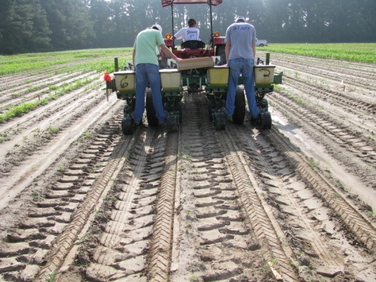
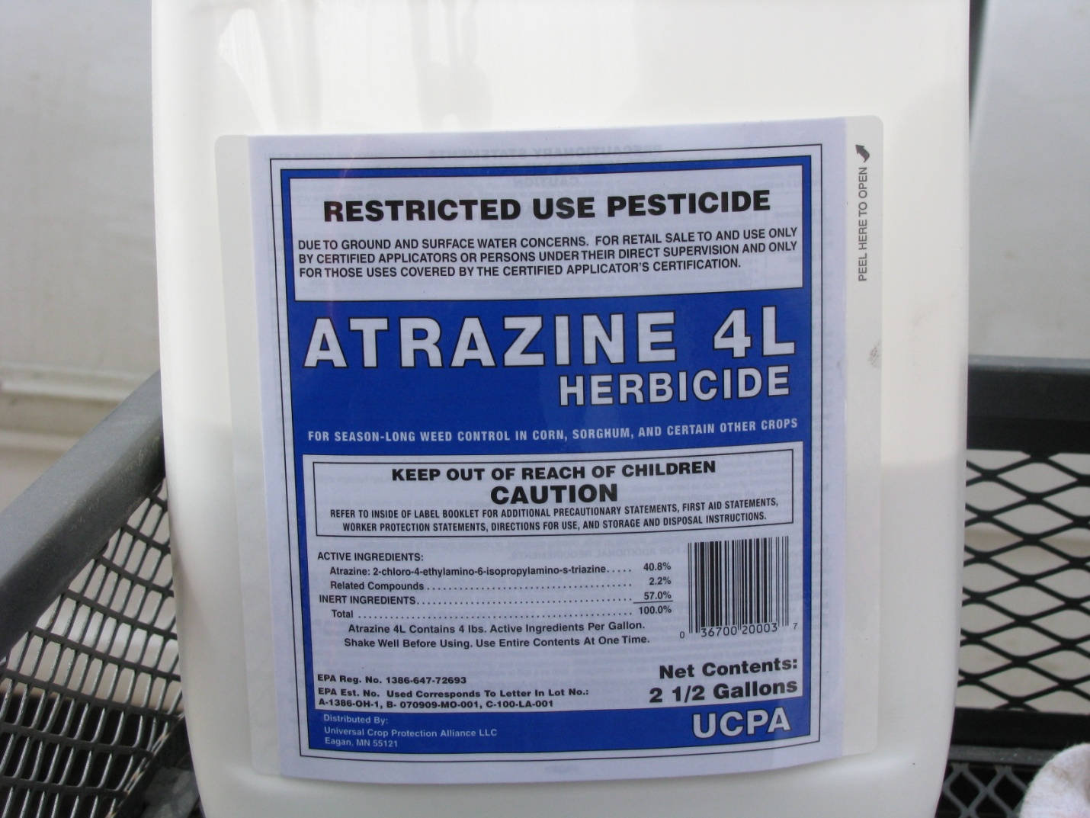
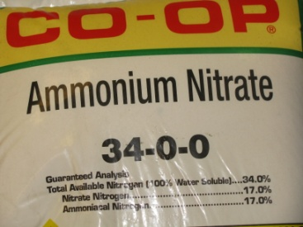
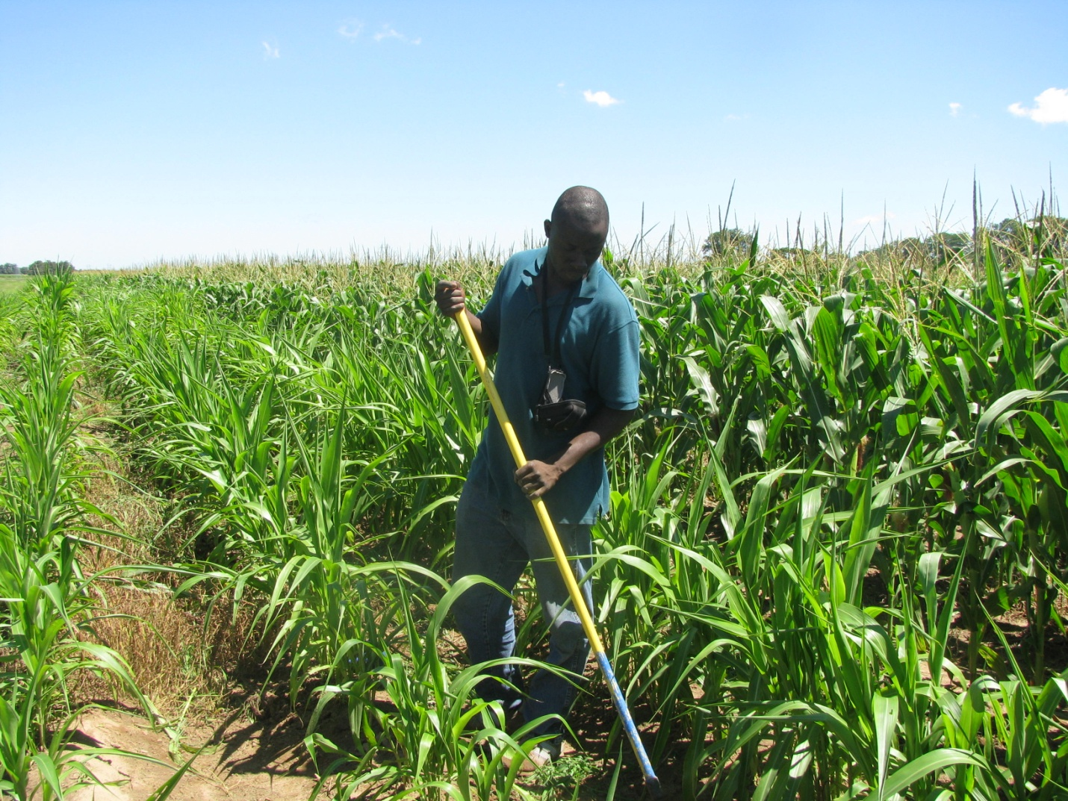
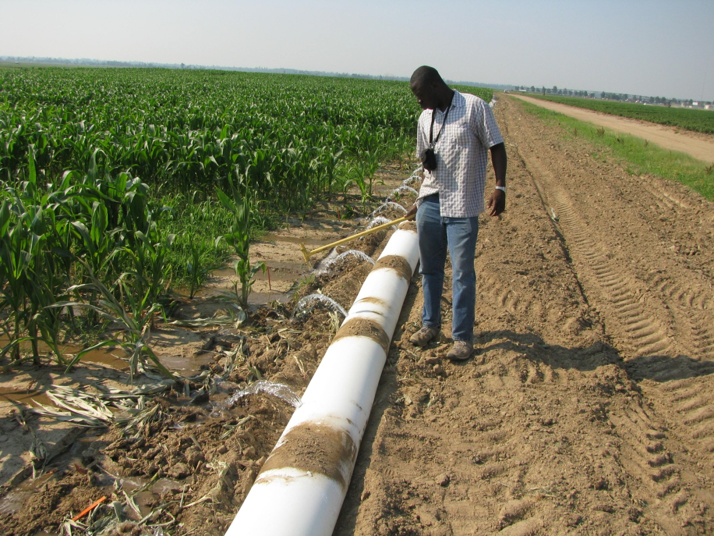

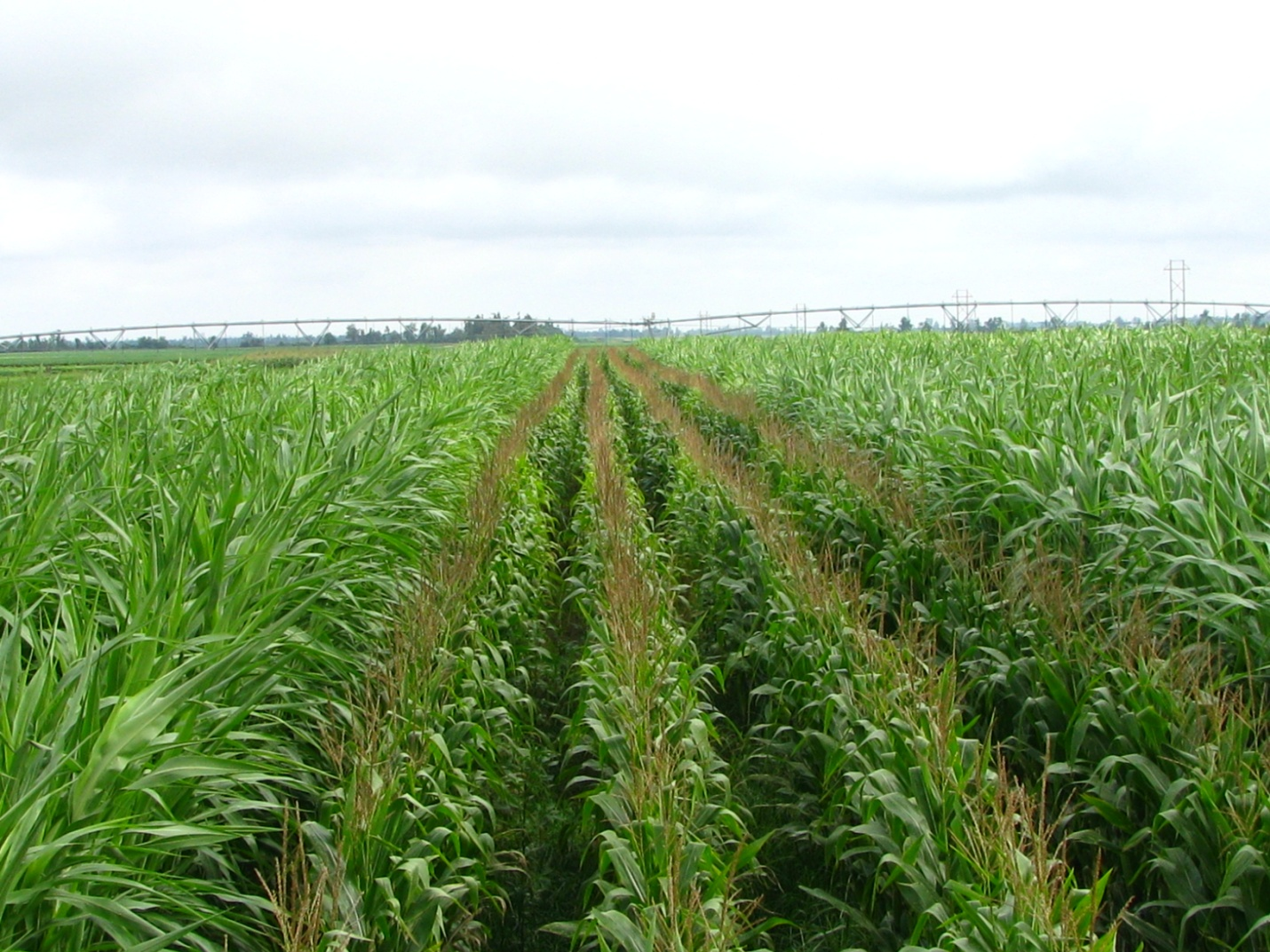
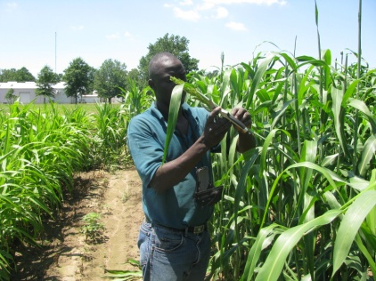
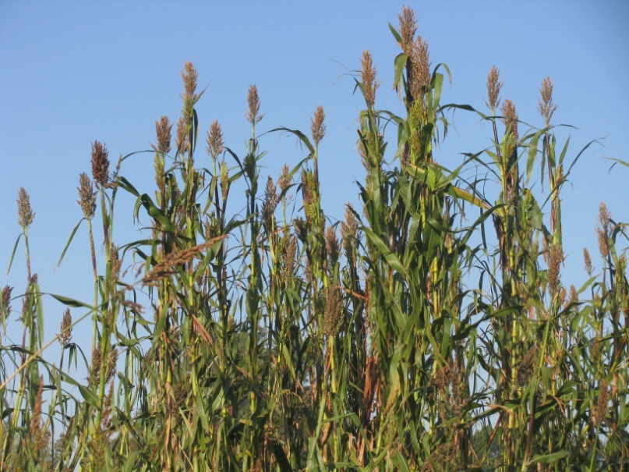

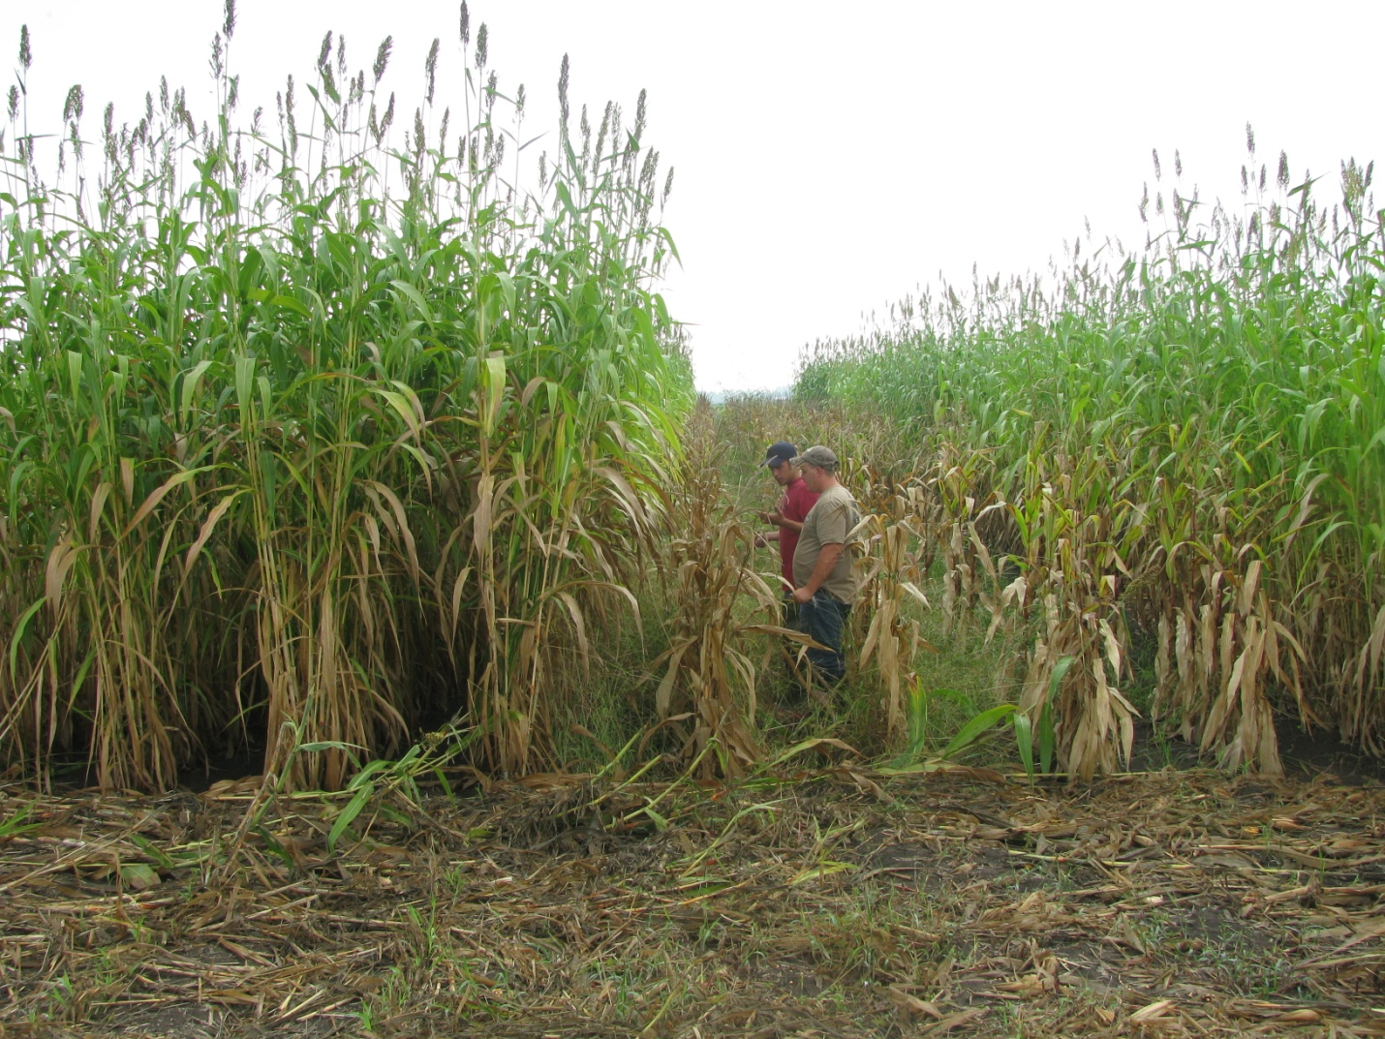
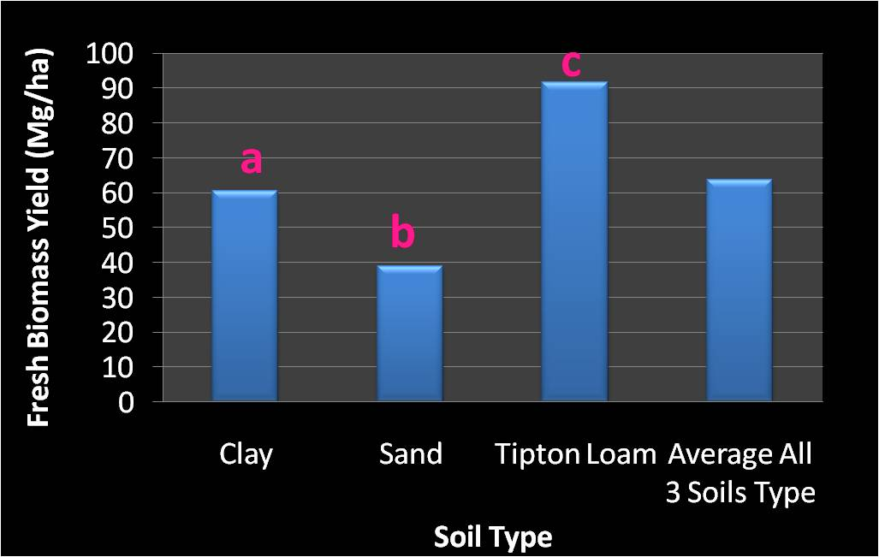
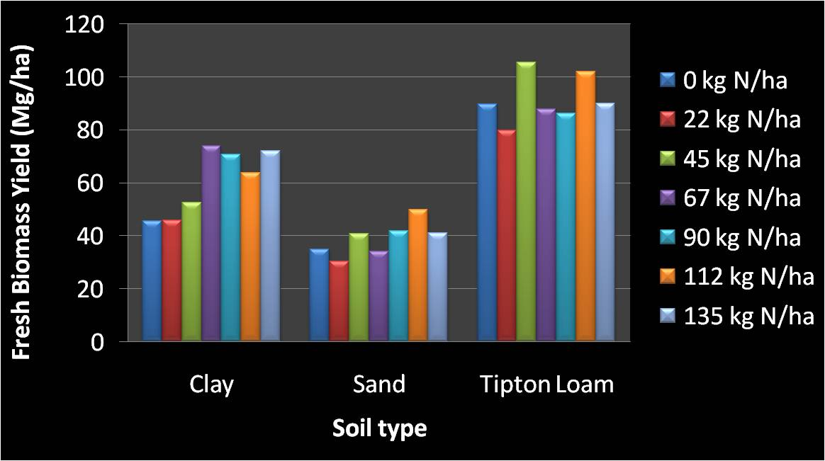
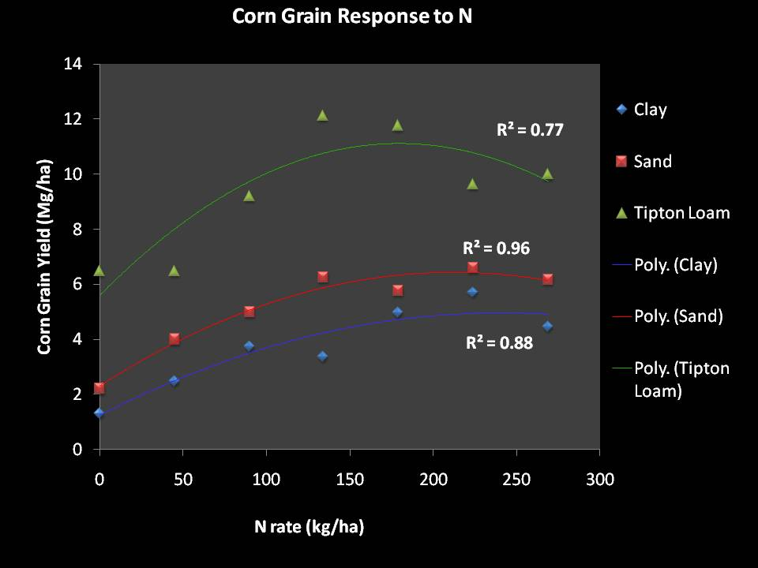
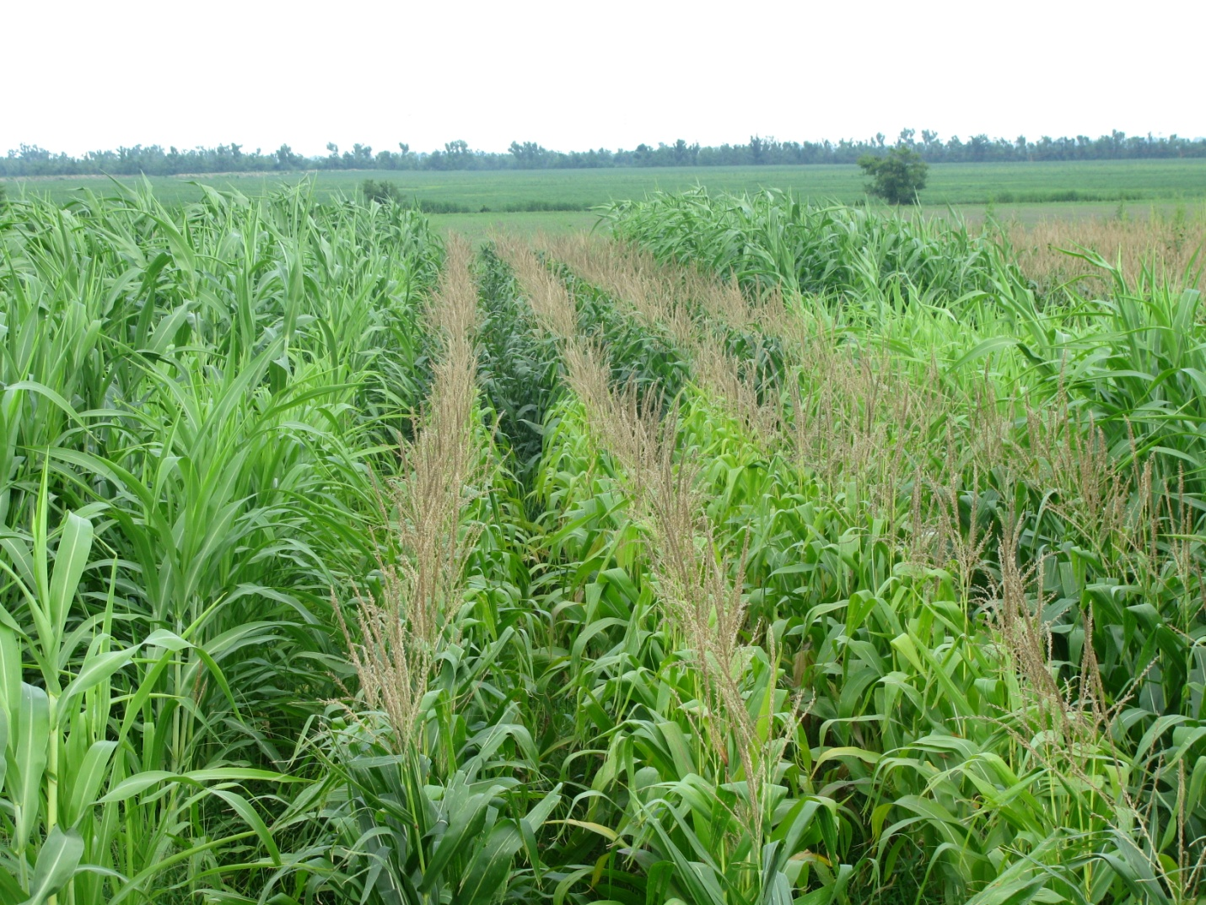
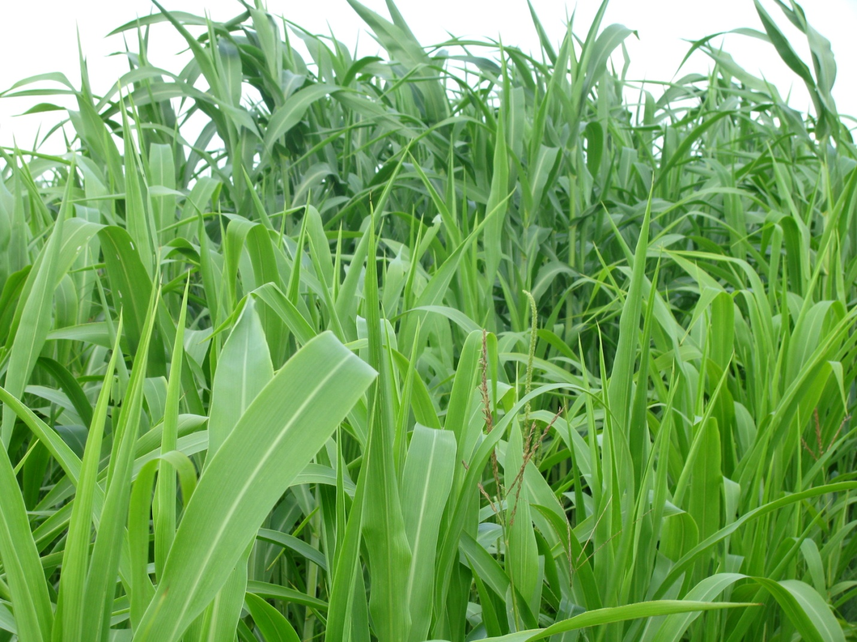
Biomass Production From Sweet Sorghum Under Different Soil Type and Nitrogen Rate
Roland Holou & Gene Stevens
Plant Science Division, University of Missouri – Columbia
ABSTRACT
Material and Methods
Due to (1) the impact of N on plant production, its economical and environmental impact, (2) the scale of energy needed to face worldwide demand, (3) the need to make the biofuel production system sustainable and profitable, it is very important to study how to make biofuel plants more N efficient and how to create an environment that better suits their production. Up to today, very little research has been done to test how N fertilization affects the production of ethanol from sweet sorghum grown in the field. Our objectives was to determine the optimum N rates and the best soil type to produce sweet sorghum. Our results showed a highly significant effect of the soil type on both the fresh and the dried biomass yield of sweet sorghum (P<.0001). The N rate did not significantly affect either the fresh biomass yield (P=0.06) or the dried biomass yield (P=0.27). The amount of water accumulated in sorghum stalk was related to the soil type (P<.0001) and to the N rate applied (P=0.01). Using only the total biomass to access the impact of N fertilization on sweet sorghum production for biofuel purposes is a misleading method. Indeed, unlike what many people think, although sweet sorghum is N efficient, in order to maximize feedstock yield while using it for biofuel production, great attention needs to be paid to the soil type and N fertilization.
Study area: Southeast Missouri.
Randomized complete block (4 repeats).
Seven N treatments: 0, 22, 45, 67, 90, 112, 135 kg N/ha.
Plot sizes: 4 rows (76.2 cm wide each & 7.5 m long).
Soil type = clay, sand, and Tipton loam.
Rotation system: soybean/cotton/corn .
  Sweet sorghum variety = M81-E .
Planting Early May
2 Atrazine applications
N source: NH₄NO₃
Field hoed
Irrigation as needed
Missouri
Plot Design
Deheading in September
Harvest in October
Study area
Results
References
Impact of Soil Type on Sweet Sorghum Fresh Biomass Yield
Impact of N on Sweet Sorghum Biomass Yield
Contrast Sweet Sorghum vs. Corn Response to N
Soileau, J., and B. Bradford. 1985. Biomass and sugar yield response of sweet sorghum to lime and fertilizer. Agronomy Journal 77:471.
Acknowledgement
Thanks to the Missouri Life Science Research Board and to the Missouri Fertilizer and Ag Lime Board for funding this research.
Impact of soil is highly significant (P<.0001).
Highest yield was recorded on loam soil.
Sorghum after soybean did not respond to N (P=0.06).
N effect on sorghum biomass yield was neither found significant (Soileau and Bradford, 1985).
Corn responded to N (P<0.0001) in same field where sweet sorghum did not.
As shown by the difference of plant height and leaves color (pictures above), sweet sorghum grown after corn is responding (2009 data, just harvested and data not analyzed yet): High C:N ratio in corn residues N immobilization during decomposition by soil microorganisms?

