Slide 1





Influence of Aeration Implements, Amendment and Soil Taxa on Phosphorus losses in Grasslands
D.H. Franklin, D.M. Butler and M.L. Cabrera

Slide 2
Introduction
Attenuation of rainfall within the solum may help:
Extend forage productivity during droughty periods
Retard flooding during periods of heavy rainfall
Move nutrients and contaminants into soil to be better utilized, transformed or sequestered
Animal manures can be
An environmental hazard
An economic resource for added N, P, K, Ca and C

Slide 3
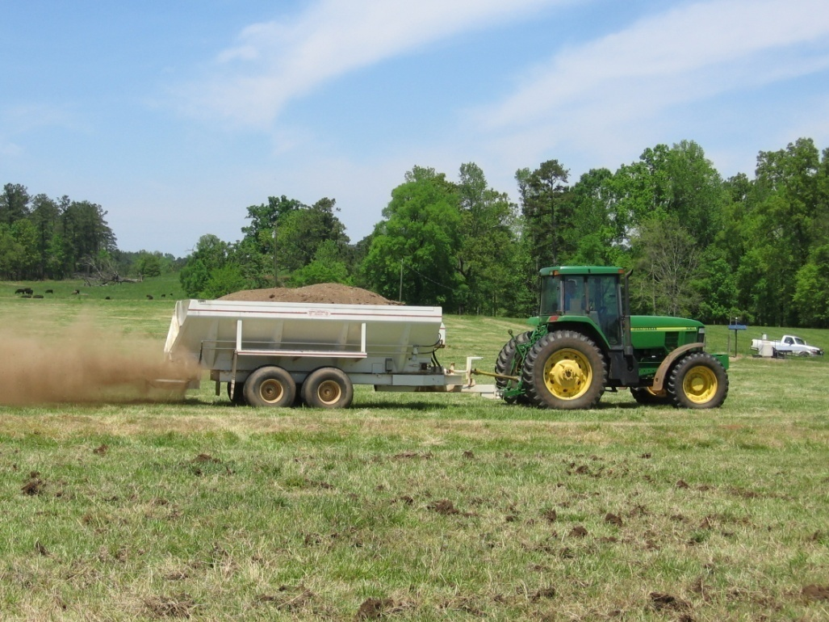
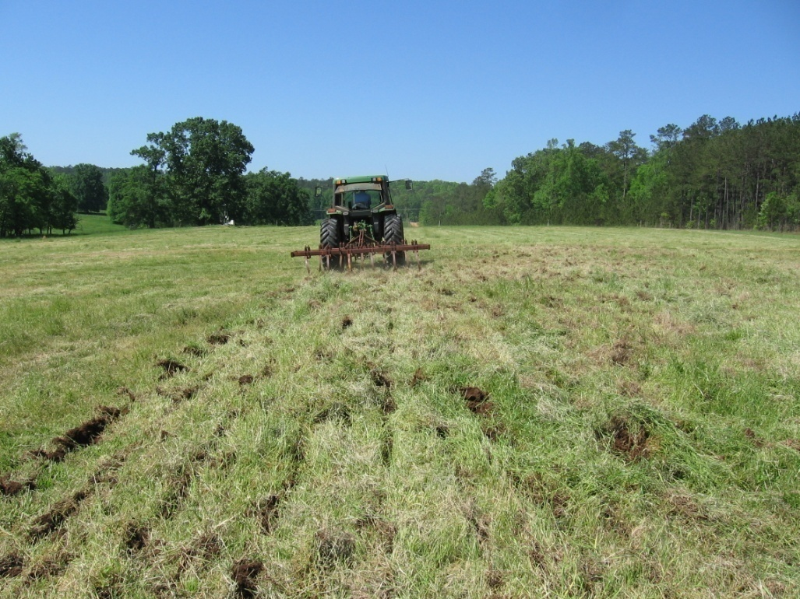
Introduction
Following surface application of broiler litter mechanical aeration may be able to increase infiltration and improve soil/nutrient contact time and thereby retain more resources in the soil

Slide 4
Objectives
Review three studies, 2 small plot studies and one field-scale paired watershed study
Determine impact of aeration of runoff volume and P losses in runoff
Mixed fescue-bermudagrass grasslands

Slide 5
Methods – Three studies
Hutchins et al. (2007)
Mechanical aeration in mixed fescue-bermudagrass [tall fescue (Festuca arundinacea Schreb.)/bermudagrass (Cynodon dactylon L.)] grasslands
P amendments
Broiler litter, dairy slurry, mineral
Soil taxa varied among studies
(hydrologic properties)

Slide 6
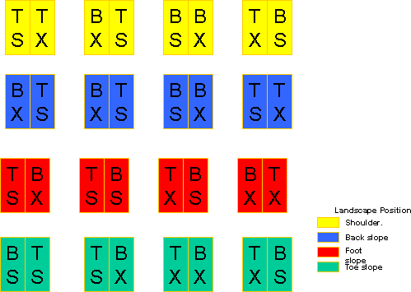
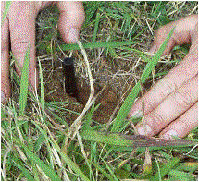
Rainfall Simulation – Slit Aeration, 2-m² Plots Altavista (fine-loamy, mixed, semiactive, thermic Aquic Hapludults)
Treatments
Nutient - B = Broiler Litter; T Triple Super Phosphate
Aeration - X = Control (none); S = Spike
Spike

Slide 7
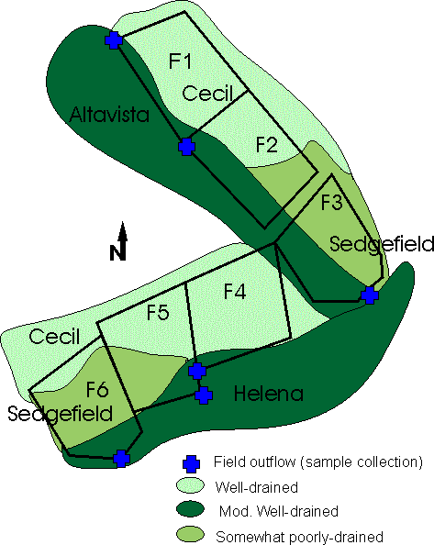
Natural Rainfall – Scale 0.8-ha Fields Multiple Soil taxa, Broiler litter
Treatments
Aeration - With & Without
Paired Watersheds
(before and after)
Fields 2, 5, 6 were aerated
Cecil (fine,kaolinitic, thermic Typic Kanhapludults),
Altavista (fine-loamy, mixed, semiactive, thermic Aquic Hapludults),
Helena (fine, mixed, semiactive, thermic Aquic Hapludults), and
Sedgefield (fine, mixed, active, thermic, Aquultic Hapludalfs)

Slide 8
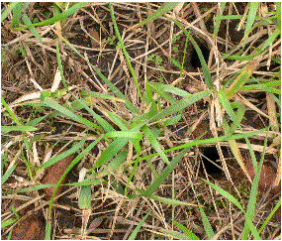
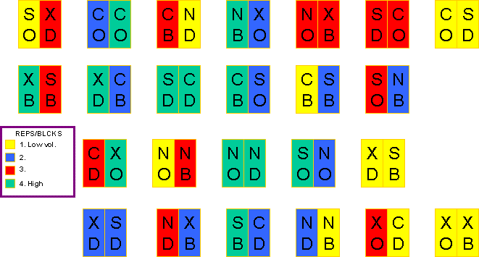
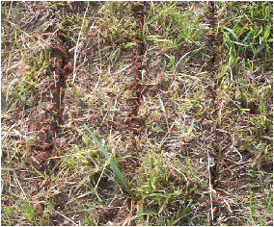
Rainfall Simulation - Scale 2 m² Plots Cecil (fine, kaolinitic, thermic Typic Kanhapludults)
Treatments
Nutient O = Control (none); B = Broiler Litter; D = Dairy Slurry
Aeration X = Control; N = No-till (disk); S = Spike; C = Core
Core
No-till

Slide 9
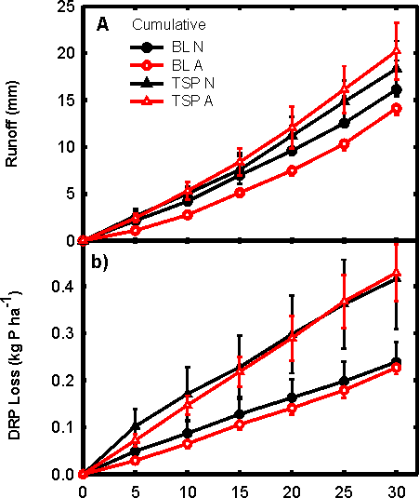
Results Rainfall Simulation – Slit Aeration, 2 m² Plots Altavista (fine-loamy, Aquic Hapludults)
Aerated Plots, fertilized with broiler litter attenuated more rainfall
Aeration alone did not affect cumulative mass losses of TKP, DRP, TKN, or NH₄-N
Time (min runoff)

Slide 10
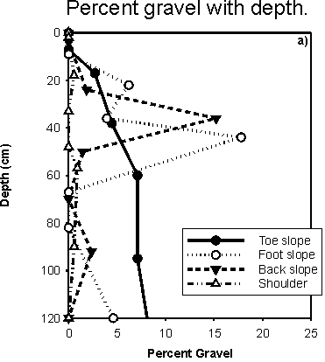
Results Rainfall Simulation – Slit Aeration, 2-m² Plots Altavista (fine-loamy, Aquic Hapludults)
Footslope
position
attenuated twice as
much runoff
and
Cumulative P
Shoulder
Backslope
Footslope
Toeslope

Slide 11
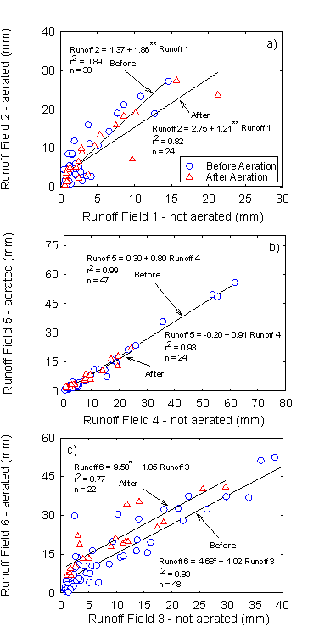
Results Natural Rainfall – Slit Aeration, 0.8-ha Fields
Effect of aeration
On Runoff volume
varied
Well-drained soil
aeration reduced runoff
Poorly-drained soil aeration increased runoff

Slide 12
Results Natural Rainfall – Slit Aeration, 0.8-ha Fields
Effect of aeration
On DRP Loss
Varied
TKP similar to DRP
Well-drained soil
aeration reduced P loss
Poorly-drained soil aeration increased P loss

Slide 13
Results Natural Rainfall – Slit aeration, 0.8-ha Fields
Poorly-drained soils on which aeration exacerbated runoff and P losses had shallower: redoxomorphic features
Bt and Bc horizons
Line colors indicate: Black, depth Bt begins; Red, redox features begin; and green, BC begins

Slide 14
Results Rainfall Simulation – Slit, core and no-till Aeration, 2 m² Plots, Cecil (fine, kaolinitic Typic Kanhapludults)
Core aeration reduced runoff volume when broiler litter was applied
None of the mechanical aeration treatments tested reduced runoff when either dairy slurry or no amendments were applied
Runoff volume
Time (min runoff)

Slide 15
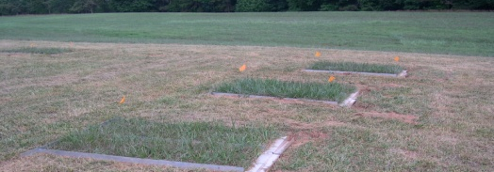
Results Rainfall Simulation – Slit, core and no-till Aeration, 2-m² Plots, Cecil
Core aeration was most effective in reducing P losses in runoff for all P fractions measured

Slide 16
Results Rainfall Simulation – Slit, core and no-till Aeration, 2-m² Plots, Cecil
Soils were compacted to simulate cattle grazing
Again core aeration tended to out perform other mechanical aeration treatments on the well-drained Cecil soil
P Export

Slide 17
SoiL P
Continued P adsorption and relatively low levels of soil P suggest that soil still has further capacity to adsorb P

Slide 18
Total suspended sediments

Slide 19
Conclusions
Results varied depending on soils and drainage class
Small Plot Studies
Aerated Plots, fertilized with broiler litter attenuated more rainfall
Footslope position attenuated more rainfall than the shoulder, backslope or toeslope
Core aeration reduced TKP (46%) and DRP ( 62%) from plots fertilized with broiler litter
Core aeration lost significantly less dissolved P fractions (TDP and DRP) than no aeration, slit or no-till aeration

Slide 20
Conclusions
Results varied depending on soils and drainage class
Field Scale Study
On fields with well-drained soils, aeration reduced DRP losses (35%)
Aeration exacerbated runoff and P losses in poorly-drained soils

Slide 21


