Slide 1

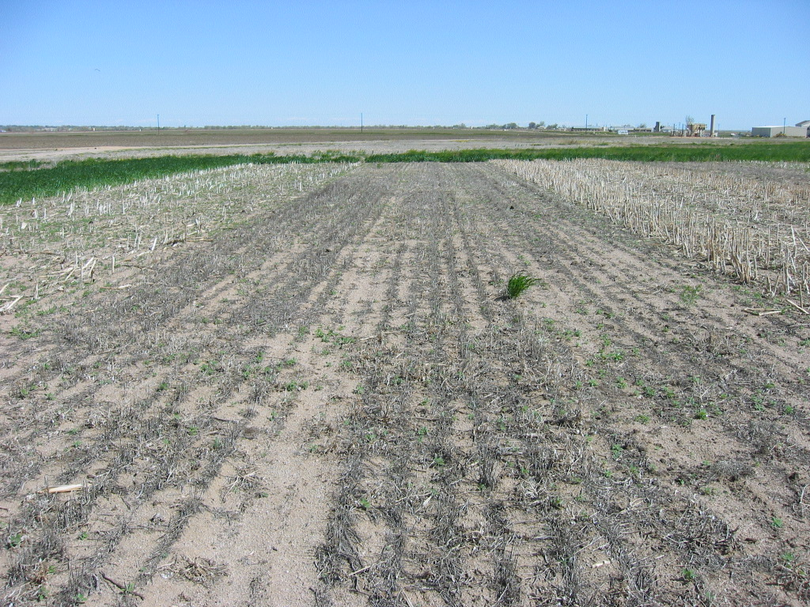
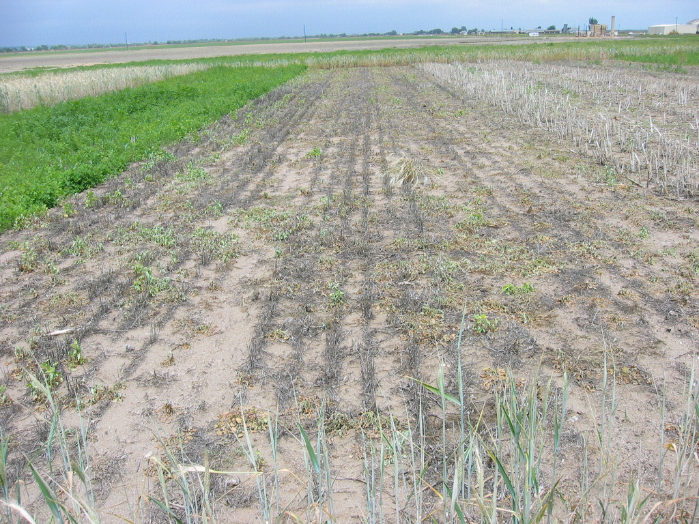
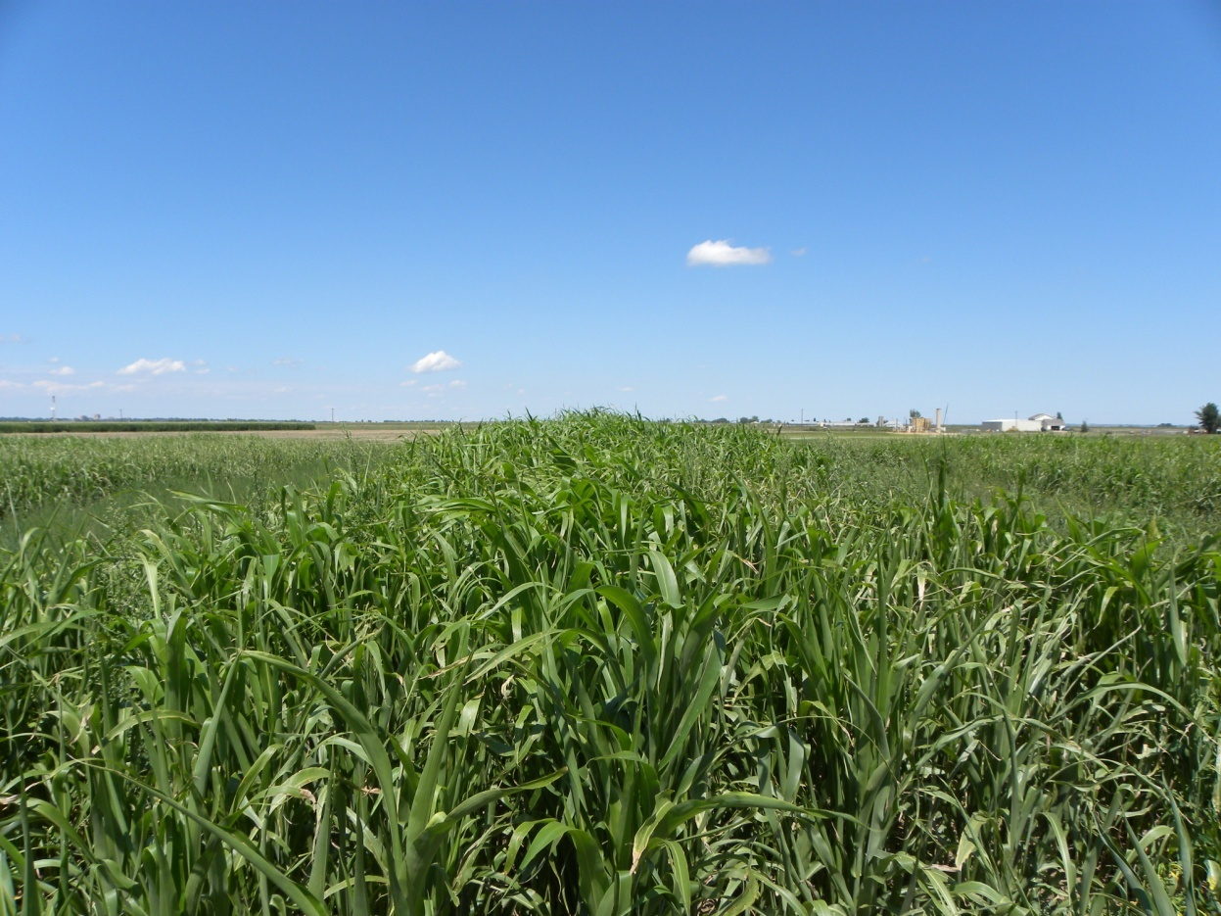
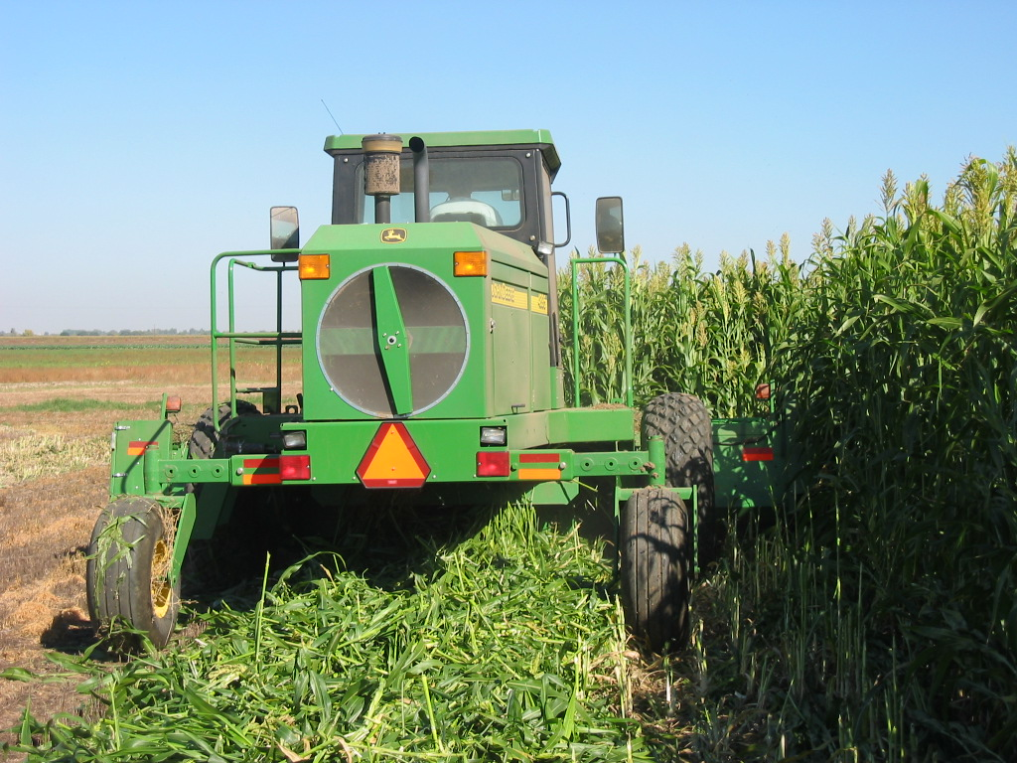
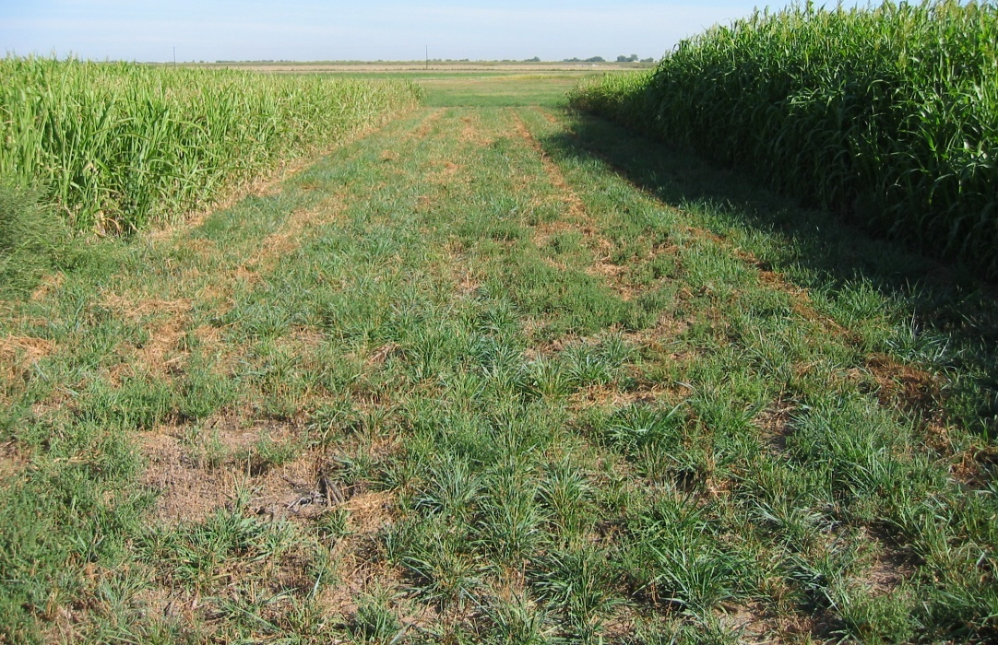
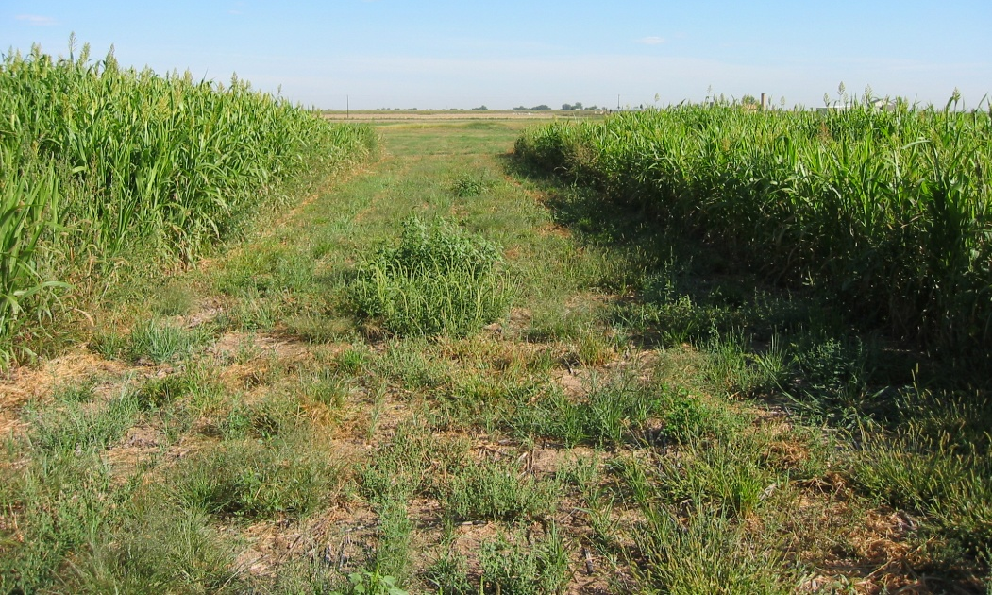
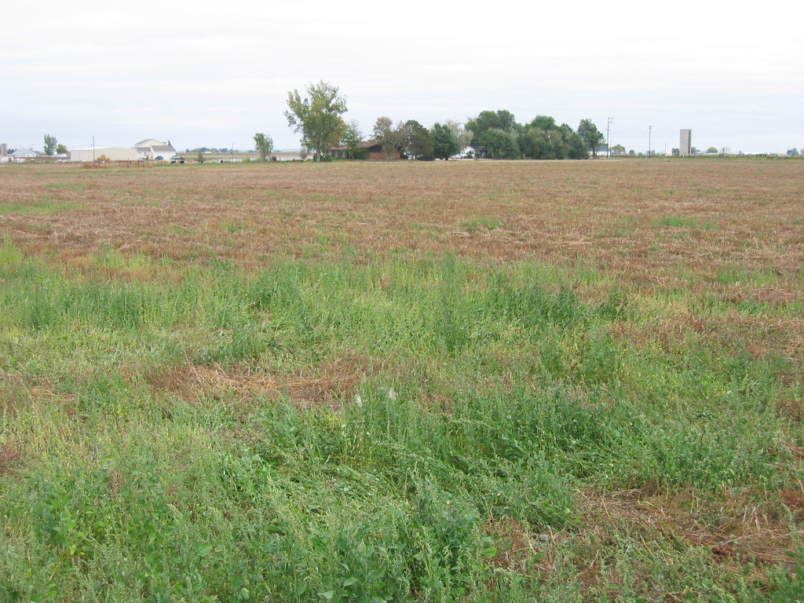
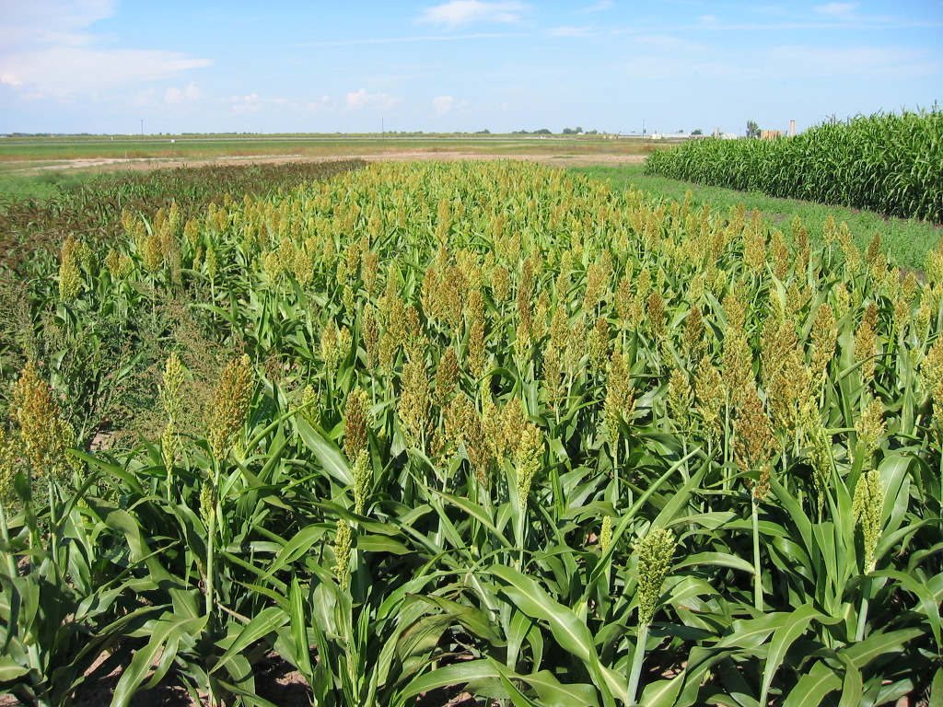
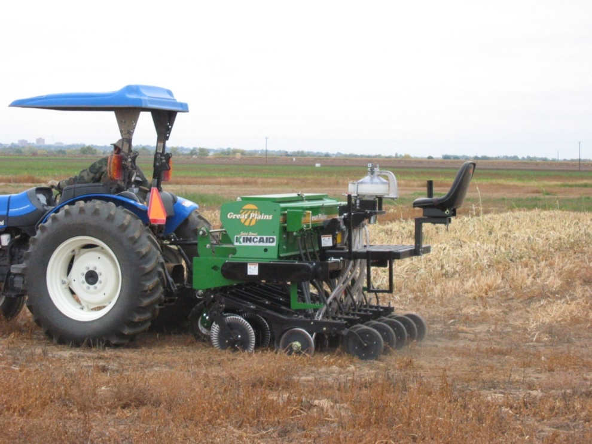
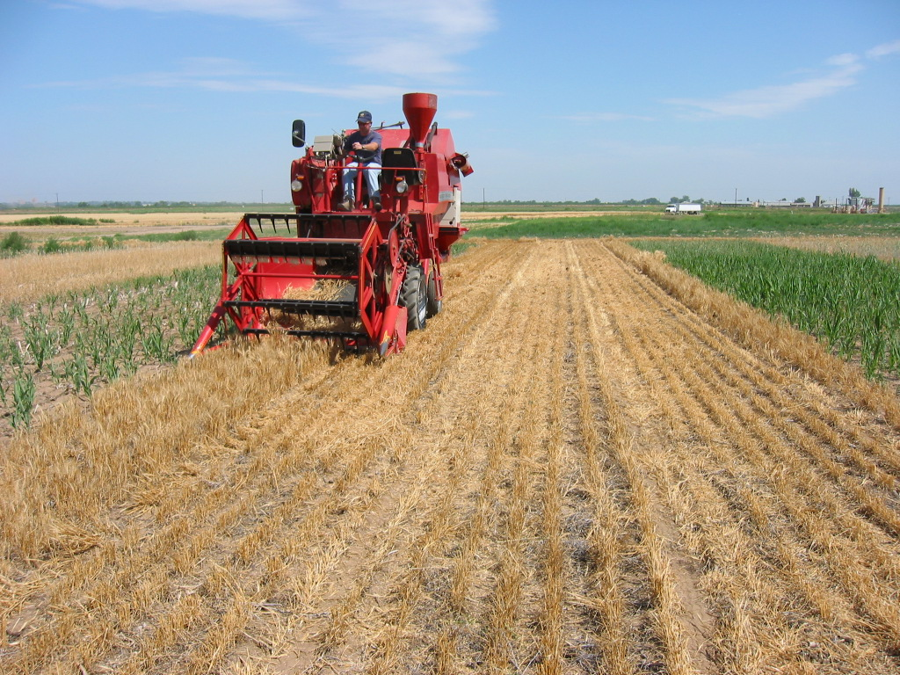
Utilizing Cover Crops to Stabilize and Reclaim Previously Irrigated Cropland
D. A. Wilson, R. J. Pearson, T. A. Bauder, N. C. Hansen & J. E. Brummer
Situation
Drought, competition, urban growth, declining ground water levels, and evolving water laws and policy are contributing to decreasing supplies of irrigation water available to farmers in the semi-arid to arid Western US.
Colorado population is expected to increase by 2.8 million by 2030.
Greater competition for water is expected resulting in large decreases in irrigated acreage.
Along the Front Range of Colorado, irrigated acreage may decrease by 156,000 to 298,000 acres of highly productive cropland by 2030.
Farmers are often forced to temporarily or permanently dry-up and fallow previously irrigated land.
Abruptly halting irrigated crop production on fields that have been intensively managed results in negative consequences: Residual soil nutrients threaten water quality; weed infestations compete with perennial grass establishment; wind and water erosion can be significant; and compaction and salinity can initially limit the non-irrigated crop and restoration planting choices.
Utilizing cover crops may bridge the transition from irrigated production to dryland or grassland production or provide an interim solution to weed and soil management while waiting for irrigation water restoration.
Ground Cover, Residue and Weed Suppression
Plot 4:
8MAY09
Winter Wheat residue from 2008 crop.
S. Sudan residue on right and Sorghum residue on left.
Plot 4:
8JUN09
S. Sudan, no-till seeded 22JUN09.
Transect data was collected at full crop canopy prior to harvest.
Trend illustrated by plots shows increases in cover crop and residue ground cover with decreases in weed population and incidence of bare soil.
Plot 4:
25AUG09
S. Sudan growth following late July rain.
Cover Crop & Grass Biomass Production
Soil Nitrate Uptake and Removal
Objective
Colorado State University Extension is establishing cover crop recommendations for producers who need to assume dryland production or establish grasses into formerly irrigated fields.
Plot 4:
25SEP09
S. Sudan Harvest.
6.74 Tons/Acre.
 | Planting Sequence |  |  |  |  | 2009 | 2010 Plans
Plot
1 | rep 1 | Barley | Triticale |  |  | S. Sudan | Plant S. Sudan
2 |  | Sorghum | Triticale | Millet | Triticale | S. Sudan | Plant Cool Season Grass
3 |  | S. Sudan | Winter Wheat | Sorghum | Pubescent Wheat Grass | Cool Season Grass | Monitor Grass Production
4 |  | Fallow | Winter Wheat |  |  | S. Sudan | Plant S. Sudan
5 |  | Millet | Fallow | S. Sudan |  | Warm Season Grass | Monitor Grass Production
Plot 3: 9SEP09
Cool Season Grass establishment after two years of cover crop.
Crop harvest occurred when individual crops approached maturity.
Samples were analyzed for total N to determine nitrogen uptake.
Biomass production was influenced by timing and amount of precipitation events.
Grasses were mowed once on 21-Aug-09.
Surface horizon (0-1 ft) NO₃-N reductions occurred.
Nitrogen uptake occurred accounting for some of these reductions,NO₃-N leaching is also possible due to rainfall events in 2008 and coarse textured soil.
Nitrogen uptake is greater in higher yielding crops in terms of biomass production.
Plot 5: 9SEP09
Warm Season Grass establishment after two years of cover crop.
High weed infestation two years following irrigation well curtailment. This is a typical scene in many formerly irrigated fields due to their abandonment.
Precipitation
Successful plantings of cover crops are possible in dried-up farmland. Cover crops provide nutrient uptake reducing residual soil N thus lowering NO₃ leaching potential.
Grass Species:
Warm Season Grass: PBSI Native Sandyland Mix which consisted of: 10% Little Blue Stem, 5% Indian Rice Grass, 10% Sideoats Grama, 10% Sand Lovegrass, 20% Prairie Sandreed, 20% Switchgrass, and 5% Sand Bluestem.
Cool Season Grass: Pubescent Wheat Grass.
.
Site History and Characteristics
Location: central Weld County, Colorado.
Average annual precipitation: 12.2 in. seasonal Apr – Sep: 9.1 in.
Soil Type: Vona Sandy Loam.
Last crop was sugar beets in 2005
20 tons manure applied fall 2005 anticipating spring 2006 corn planting.
Irrigation well curtailment, mandated by state policy occurred in Spring 2006.
Cover crops and grass no-till planted –no tillage occurring with project.
Future Plans:
2010 season plans include continuation of summer forage cover crops and a second planting of warm and cool season grass mixes in plots where cover crops have reduced nutrient levels and weed pressure.
Our primary goal is to provide cover crop recommendations for producers who need to assume dryland production or establish grasses into formerly irrigated fields to mitigate soil erosion, and soil nutrient loss thereby protecting our water resources.
Collaboration with area farmers, county extension, NRCS, and conservation districts is expected to increase via additional site trials and/or expansion of current site.
Funding Source: USDA-NRCS CIG: Sustainable Cropping Systems for Transition from Full Irrigation To Limited Irrigation and Dryland,
Ag Chemical and Ground Water Protection Program (CO Dept of Ag),
West Greeley Conservation District
Sources:
Colorado Department of Local Affairs Demography Section
Colorado's Decision Support Systems and Basin Roundtable/Basin Advisor input
Seasonal totals:
2008 = 9.5 inches
2009 = 9.0 inches
Summary
Results from this work show cover crops provide a viable source of soil cover and residue to reduce erosion, suppress weeds and uptake nutrients for restoration of previously irrigated land. Weed suppression allowed proportionate increases in cover crop biomass with decreases in weed seed and biomass production. The CS grass has shown greater potential to compete with weeds than the WS grass has after a two year cover cropping system. This work has generated much interest from the cooperating farmer and surrounding land owners.

