Slide 1
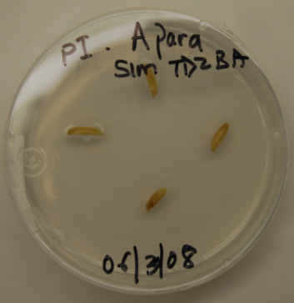
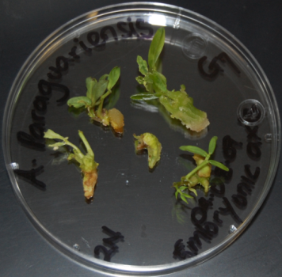
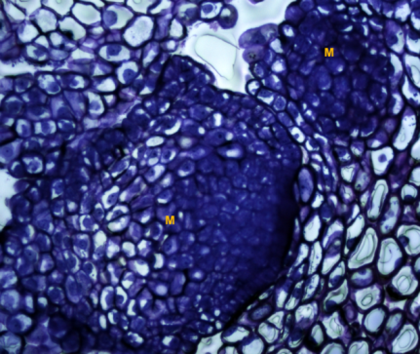
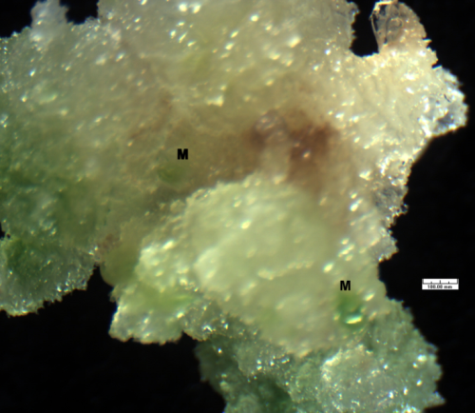
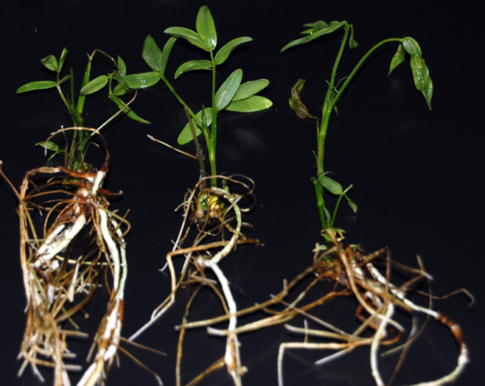
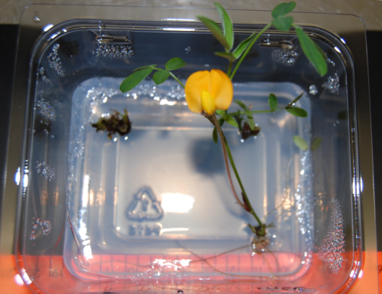
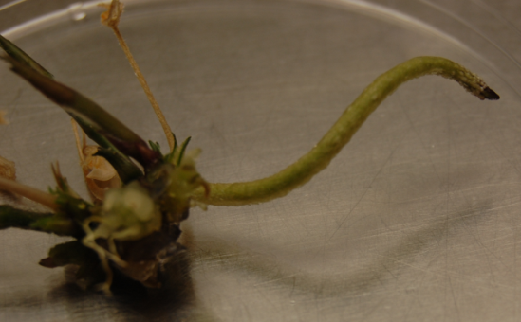
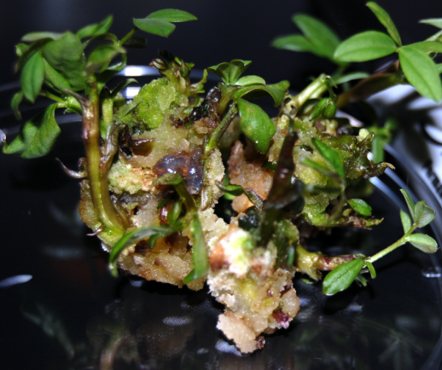
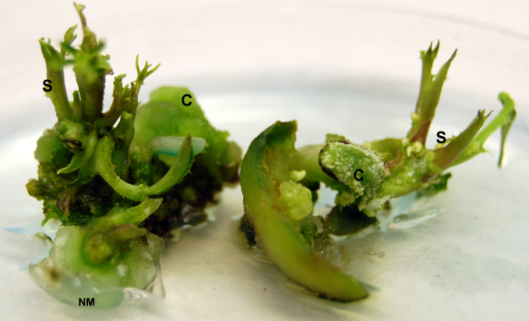
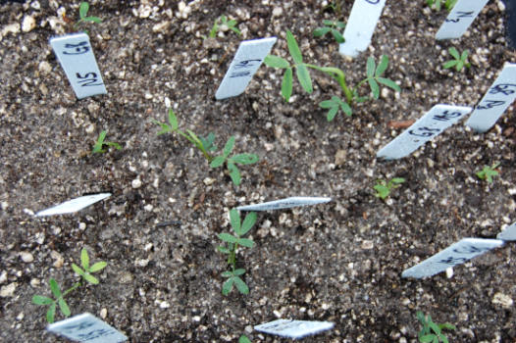

Olubunmi Aina, K. H. Quesenberry and M. Gallo
Department of Agronomy, University of Florida. Email: ainab@ufl.edu
Summary
In Vitro Organogenesis, Regeneration and Flowering of Wild Peanut (Arachis paraguariensis)
Conclusion
This study investigated the roles and interactions of different genotypes, explant sources, and growth regulators in tissue culture regeneration of Arachis paraguariensis Chodat & Hassl. Cotyledon and embryonic axis explants dissected from mature seeds were grown in vitro under continuous light on modified MS medium that was supplemented with different combinations of thidiazuron (TDZ) and benzyl-aminopurine (BAP). A factorial experiment in a complete randomized design led to the development of an efficient protocol for regeneration through organogenesis. Across the six genotypes studied, cotyledons on MS medium supplemented with 4.4 mgl⁻¹ TDZ and 1.1 mgl⁻¹ BAP gave the highest number of shoots per explant and highest plantlet height of 14.8 ± 1.6 and 7.3 ± 0.7 respectively. Shooting frequency increased until the third subculture but declined rapidly throughout additional subcultures. Shoots were transferred onto semi-solid MS medium containing 0.5 mgl⁻¹ BAP and 0.2 mgl⁻¹ NAA for elongation before they were rooted on reduced strength MS medium. Prior to acclimatization, 55.2% of the shoots exhibited flowering while peg formation was observed in 13.3% of the flowered shoots.
A combination of TDZ and BAP as external sources of cytokinin in the tissue culture media is required for induction of indirect organogenesis via the callus phase
There was higher frequency of regeneration in cotyledon explants across all the genotypes.
Plantlets should be removed from culture medium containing high concentration of TDZ immediately after bud formation to prevent inhibition of plantlet elongation
Plantlets that exhibited in vitro flowering and peg formation produced seeds under ex-vitro condition
Results
Successful regeneration of A. paraguariensis was achieved. Direct multiple shoot formed on cotyledon explants within five days of culture incubation. Thidiazuron alone at 4.4 mgl⁻¹ induced shoot formation on embryonic axis and cotyledons while the addition of 4.4 mgl⁻¹ TDZ and 1.1 mgl⁻¹ BAP proved to be optimal for indirect organogenesis. The in vitro response of the six genotypes tested differs with respect to callus induction, shoot formation, rooting, and survival after acclimatization. In vitro flowering and peg formation also occurred in the all the genotypes.
Ongoing work
We have extended the protocols derived for A. paraguariensis to other species of Arachis; in vitro morphogenesis in four genotypes of rhizoma peanut (A. glabrata) is currently being evaluated
Further research is also underway to further elucidate the influence of photoperiod on in vitro reproductive development in wild Arachis species.
Background/ Rationale
Several wild Arachis species are important sources of novel genes for improvement of the cultivated peanut. Arachis paraguariensis Chodat & Hassl. is a wild peanut that is highly resistant to early leaf spot disease. Attempts of conventional hybridization between cultivated peanut and A. paraguariensis have failed (Rao et al., 2003) due to hybridization barriers. Tissue culture and biotechnology techniques offer potential routes for overcoming these barriers. But as with many legumes, these species are generally recalcitrant to regeneration in vitro.
Fig. 4. The influence of cytokinins and number of subcultures on shoot formation
Future work
a
b
c
d
Attempts will be made in the future to utilize in vitro methods for induction of tetraploidy in A. paraguariensis.
Possibility of conducting in vitro pollination between the cultivated peanut and this wild species will be explored.
Fig. 1. Cotyledon explants cultured on modified MS medium (a), multiple shoots on embryonic axis explants (b), formation of meristematic dome (M) after 5 days in culture (c), and organogenic callus with meristematic zones (d). Bar =100 µm.
References
Objectives
h
i
j
Rao, NK., Reddy, LJ. & Bramel, P J. 2003. Potential of wild species for genetic enhancement of some semi-arid food crops. Genetic Resources and Crop Evolution, 50, 707-721.
Simpson, CE. & Bramel, P. 2003. Biogeography of wild Arachis: Assessing conservation status and setting future priorities. Crop Science, 43, 1100-1108.
  To develop protocols for efficient organogenesis and regeneration of Arachis paraguariensis
  To investigate the roles and interactions of different genotypes, explant sources, and cytokinins on tissue culture regeneration via direct and indirect organogenesis
Fig. 5. In vitro rooting (h), flowering (i), and peg formation (j) in plantlets of A. paraguariensis
e
f
g
Table 1. Effects of cytokinin concentrations and combinations on shoot regeneration.
Fig. 2. Indirect multiple shoots from a single callus mass (e), organogenesis with minimal callus (f), and acclimatized plant in soilless mix after transplanting (g). S=shoot; NM=nutrient medium; C= callus
TDZ (mgl⁻¹) | BAP (mgl⁻¹) | Days to Shooting | # shoots/ explant | Plant height at acclimatization
2.2 | 0 | 5.0 ± 0.0c | 2.0 ± 0.0c | 2.5 ± 0.1b
4.4 | 0 | 10.7 ± 0.7a | 3.9 ± 0.3c | 2.8 ± 0.2b
2.2 | 1.1 | 9.5 ± 1.3ab | 4.6 ± 0.8c | 2.3 ± 0.3b
2.2 | 2.2 | 9.5 ± 1.3ab | 4.1 ± 0.5c | 2.6 ± 0.2b
2.2 | 4.4 | 9.7 ± 1.3ab | 3.5 ± 0.4c | 3.1 ± 0.4b
4.4 | 1.1 | 6.0 ± 0.3bc | 14.8 ± 1.6a | 7.3 ± 0.7a
4.4 | 2.2 | 5.8 ± 0.3bc | 10.4 ± 0.7b | 6.2 ± 0.6a
4.4 | 4.4 | 5.8 ± 0.3bc | 8.1 ± 0.3b | 6.3 ± 0.9a
0 | 2.2 | 0 | 0 | 0
0 | 4.4 | 0 | 0 | 0
0 | 0 | 0 | 0 | 0
Acknowledgements
Methodology
The research and this presentation was supported in part by a USDA-CSREES special grant for Tropical and Sub-Tropical Agricultural Research (TSTAR) # 2006 34135 17664 entitled Arachis and Desmodium for Forage and Conservation Use in the Sub-Tropics and Tropics.
The authors express their appreciation to Dr. Roy Pittman, USDA-NPGS Plant Genetic Resource and Conservation Unit, Griffin, GA for providing seeds of A. paraguariensis for use in this research.
Assistance of the UF COM EM Core lab in preparation of samples for histology is also acknowledged.
Culture Environment; Modified semi-solid MS medium at pH of 5.8. Culture incubation was at 26±1ºC under continuous lighting for callus induction and 16 hour photoperiod for shoot elongation and rooting. Subculturing interval was 2 weeks
Experimental design; Factorial experiment in completely randomized design with three replications.
Treatments; 6 genotypes, 2 explant sources (cotyledon and embryonic axis) and 2 cytokinins (TDZ and BAP).
Fig 3. Effect of genotype on shooting, rooting and survival when explants were cultured in MS medium containing 4.4 mgl⁻¹ TDZ and 1.1 mgl⁻¹ BAP
Direct organogenesis
Indirect organogenesis

