Slide 1

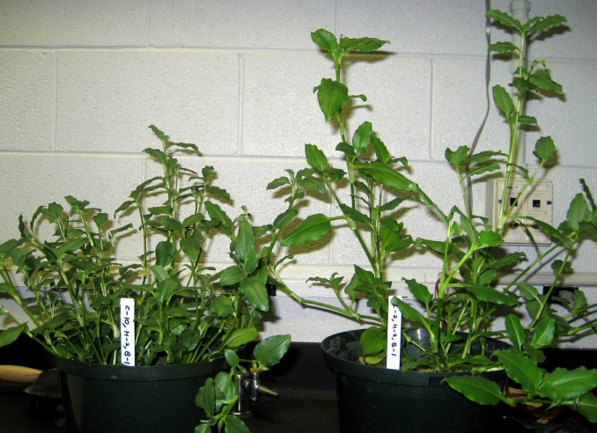
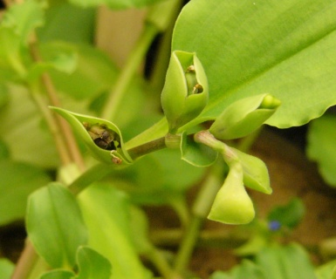
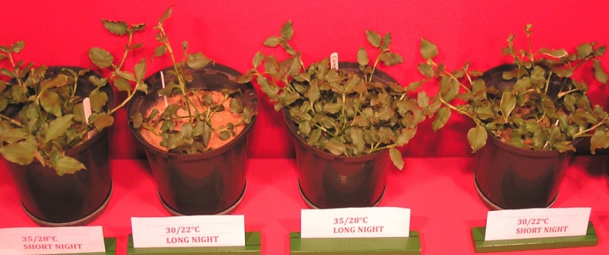
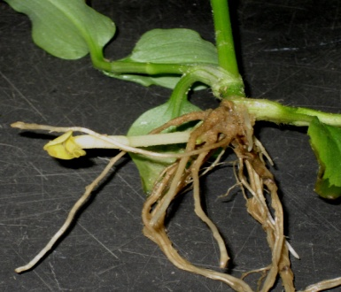

Global climate change: Potential impacts of increasing temperature on the invasive weed Benghal dayflower (Commelina benghalensis L.) Mandeep K. Riar, and Thomas W. Rufty, Department of Crop Science, North Carolina State University
Introduction
Benghal dayflower (Commelina benghalensis L.) is an invasive, noxious weed that is a serious threat to agriculture in the southeastern U.S. Its tolerance to glyphosate, ability to produce both aerial and subterranean seeds, and ability to regenerate from stem fragments make it extremely difficult to control.
This weed is native to tropical Asia, Africa, and the Pacific Islands and has been established in Florida since the early years of last century. It is now the most troublesome weed in cotton and soybean in Georgia, and recent observations suggest it is moving northward into North Carolina.
Global climate change is expected to have far-reaching impacts on agriculture. Higher temperatures associated with global climate change could potentially increase growth and competitiveness of weed species, especially those with tropical origins, like Benghal dayflower, that have high temperature optima. The purpose of this research is to examine the photoperiod and temperature responses of Benghal dayflower, and develop a model that will predict its potential northward range.
a
b
Fig.1.(a). Plant response at 35/28°C–LN; Fig.1.(b). Plant response at 35/28°C–SN.
Fig.3. Aerial spathes containing mature seeds.
Materials and Methods
Experiments were conducted in controlled environmental growth chambers at the NCSU Phytotron. Large aboveground seeds of Benghal dayflower were germinated and plants grown in chambers at a constant day/night temperature of 30°C, with a 9-h day period and 15-h night period. At the one leaf stage, plants were exposed to the following treatments:
30/22°C day/night temperature, 15-h night (LN)
30/22°C day/night temperature,12-h night with 3-h interruption with non-photosynthetic irradiance (SN)
35/28°C day/night temperature, 15-h night (LN)
35/28°C day/night temperature, 12-h night with the 3-h interruption (SN)
Plants were harvested every 14 days over a 56 day period. At each harvest, plants were divided into aboveground and belowground structures. The experimental design was a split plot and data were analyzed using Proc mixed model of SAS version 9.
Fig. 5. Number of aerial and subterranean spathes produced per plant at different harvest intervals.
Fig.2.Response of plant growth at 28 DAIT to different temperature and night length treatments.
Fig.4.Development of subterranean reproductive structures at 14 DAIT.
Results
Flower initiation of plants grown with a night interruption (SN) was delayed by 4-5 days compared to plants with an uninterrupted night (LN)(data not shown), indicating a degree of photoperiod sensitivity. This observation is different from others in the literature, where Bengal dayflower has been found to be day neutral (Gonzalez and Haddad ,1995) .
Vegetative plant growth and biomass were maximized at the higher day/night temperature of 35/28°C irrespective of the day length. The high temperature optimum reflects the tropical origin of Bengal dayflower.
Conclusions
The results, collectively, indicate that the northern range of Bengal dayflower will be expanded by the increasing temperatures associated with climate change.
The apparent independence of aerial and subterranean seed production indicates considerable variation exists in reproduction, regardless of the photoperiod or temperature in the growth environment.
References
Faden, R. B. 1993. The misconstrued and rare species of Commelina (Commelinaceae) in the eastern United States. Ann. Mo. Bot. Gard. 80:208–218.
Gonzalez,C.B and C.R.B.Haddad.1995. Light and temperature effects on flowering and seed germination of Commelina benghalensis L. Arq. Biol. Tecnol. 38:651-659
Krings, A., M. Burton, and A. York. 2002. Commelina benghalensis (Commelinaceae) new to North Carolina and an updated key to Carolina congeners Sida Contr. Bot. 20:419 – 422.
Maheshwari, P., and J. K. Maheshwari. 1955. Floral dimorphism in Commelina forskalaei Vahl and C. benghalensis L. Phytomorphology 5:413–422.
Price,A., G. Brett Runion, S. A. Prior, H.H. Rogers, and H. A. Torbert. Tropical spiderwort (Commelina benghalensis L.) increases growth under elevated atmospheric carbon dioxide. J. Environ. Qual. 38:729-733.
Aerial seed production was suppressed by the night interruption when the plants were growing rapidly at higher temperature. This photoperiod/temperature interaction reflected, in part, the delay in flowering.
Subterranean seed production was not consistently affected by temperature or day length. The absence of a repeatable response pattern suggests control by other factors.

