Slide 1
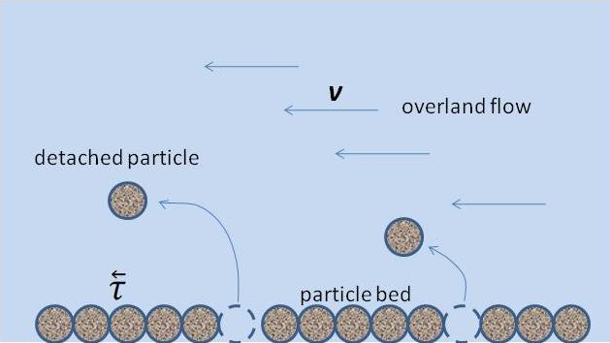

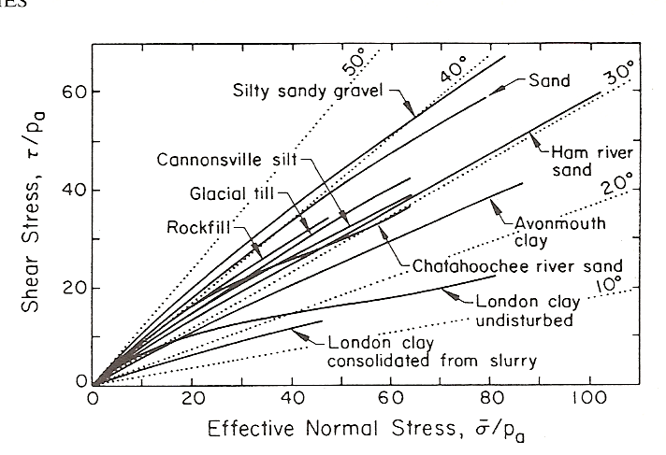
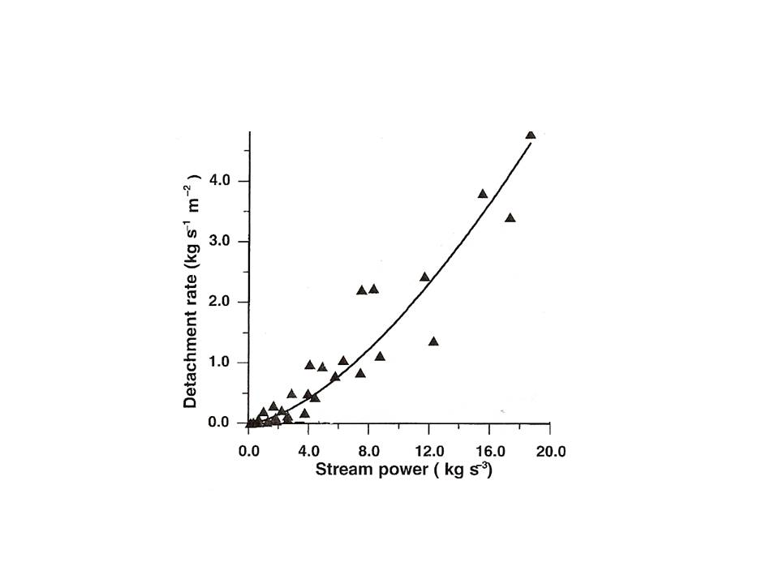
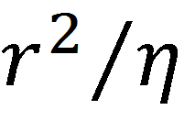
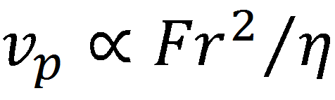
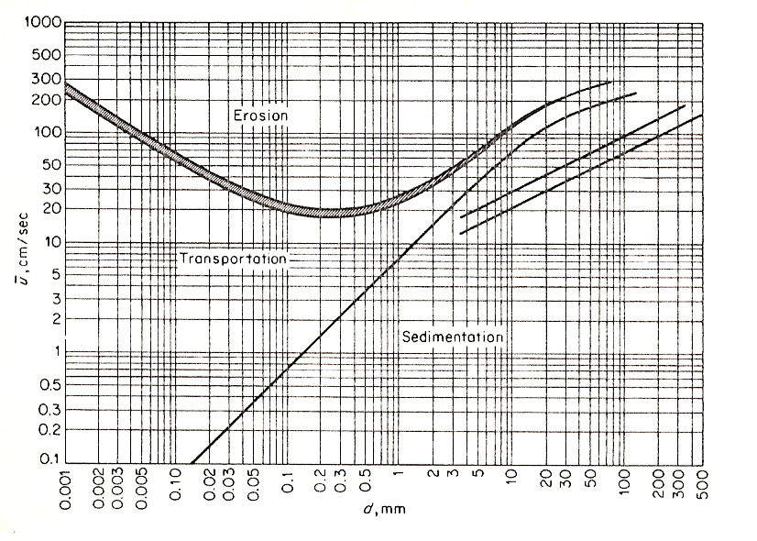
Viscous Resistance of Pore Water to Soil Particle Detachment by Overland Flow
Victor A. Snyder. Dept. of Crops and Agroenvironmental Sciences, University of Puerto Rico Agricultural Experiment Station. San Juan, Puerto Rico
Introduction
Theoretical difficulties regarding Observations
Preliminary scale experiment to test theory
Close packed planar arrays of steel spheres (density = 8 g/cm3), with uniform sphere diameters, were glued onto a base plate and hung upside down in a fluid matrix with viscosity approximately 50,000 times that of water (Fig. 6). One sphere in the middle of the array was left unglued so that it could freely fall out of its cavity in the array as soon as a restraining magnet was removed. From Stokes’ law, settlement velocity of a 2 mm diameter steel sphere in super viscous fluid was similar to that of a 10 μm soil silt particle in water.
Detachment of soil particles by overland flow, illustrated in Fig. 1, is a major component of the soil erosion process.
Observation 1:
The increase in particle detachment rate with increasing shear stress or stream power can be qualitatively explained on the basis of increased momentum transfer from the fluid to the particles. However, a theory explaining quantitative differences in this relation between different soils , based on fundamental soil properties, is still in need of development.
Observation 2:
The increasing flow rate required to achieve a given detachment rate for larger particles, manifested by positive slope on the right hand side of the Hjulström diagram in Fig. 3, can be explained by the increased momentum transfer required to accelerate the larger particles from a state of rest. But this does not explain the inverse relation between particle size and required flow velocity in the case of very fine particles (manifested by negative slope on the left hand side of Fig. 3).
A common explanation for the negative slope of the Hjulström diagram for fine particles is the greater specific surface area of smaller particles, causing greater inter-particle attraction and cementation (cohesion). However, this does not seem consistent with the vanishing cohesion intercept often observed in slow drained shear and tensile tests on fine textured saturated soils (Fig. 4).
plate
magnet
a
d
b
Close-packed
particle bed
viscous fluid
Figure 1. Illustration of particle detachment by overland flow
at velocity v exerting bed shear stress
e
Observation 1
Fig. 4. Shear strength envelopes for several soils under slow drained conditions. Taken from Mitchell. 1993. Fundamentals of Soil Behavior (Wiley).
f
falling particle
Once initiated, the rate of particle detachment for a given soil (Kg m⁻² s⁻¹ ), varies more or less proportionally with bed shear stress τ or stream power vτ (Fig. 2). This relation is typically non-linear, but often does not depart greatly from linearity.
F=mg
Fig. 6. Experimental setup.
Once the magnet was removed, measurements were :1) the time t_{ab} for the particle to travel from position a to b (i.e. to exit the particle bed); and 2) the time t_{ef} for the particle to settle the same distance under unconfined conditions (Stokes‘ law conditions).
Use of large spheres under gravity fall in a super-viscous fluid allowed visually measuring settlement velocity under Newtonian creeping flow conditions, with driving force F in Eq. [1] clearly defined (no confusing boundary layer forces caused by lateral fluid flow).
Assuming validity of Eq. [1] and Stokes’ law for settlement velocity under confined and unconfined conditions, respectively, it follows that, theoretically, independently of particle diameter or fluid viscosity:
t_{ab}/ t_{ef} = constant [2]
Source: Zhang et al. (2002).
Trans. ASAE:45:351-357
WORKING HYPOTHESES:
The velocity at which a particle can move out of a liquid– saturated particle bed is limited by the rate at which liquid can move into the space vacated by the particle (Fig. 5). Since this fluid flow occurs in fine intra-particle pores, it may be considered Newtonian even if the external flow field is turbulent.
For these conditions, neglecting inertial forces, the velocity v_{p} at which the particle initially moves out of its confining space in the bed is directly proportional to the product of the extraction force F and soil hydraulic conductivity, which in turn is proportional to
, where r is particle radius and η is fluid viscosity. That is
Fig. 2. Typical relation between stream power and sediment detachment rate.
Observation 2
For relatively large particles, the shear stress or stream power required to achieve a given particle detachment rate decreases with decreasing particle size. But for smaller particles, the required shear or stream power increases with decreasing particle size. Correspondingly, the most erodible soils tend to be those with sandy and silt texture .
[1]
Note that Eq. [1] is qualitatively consistent with Observation 1 and provides a physical
explanation for the negative slope of the Hjulström diagram in Observation 2, consistent
with the zero –cohesion condition implicit in Fig. 4
Experimental Results:
Diameter (mm) | t_{ab} (sec) | t_{ef} (sec) | t_{ab}/ t_{ef}
1.56 | 227.2 | 11.93 | 19.0
2.36 | 120.3 | 6.88 | 17.5
2.36 | 135.0 | 7.84 | 17.2
4.34 | 73.4 | 2.81 | 23.1
4.34 | 70.7 | 3.16 | 22.2
F
external fluid flow
original particle location
detaching particle
mean flow velocity (cm/sec)
v_{p}
fluid flow into vacated volume
This table shows that theoretical prediction Eq. [2] is reasonably satisfied, and that settling velocity in the particle bed is retarded by a factor of 20 relative to free fall velocity.
Summary and conclusions:
The viscous reaction model of particle detachment from particle beds is supported by preliminary experimental data in a scaling experiment.
The data suggest significant viscous retardation of particle detachment from particle beds, which should be further examined in erosion modeling.
r
r
particle diameter (mm)
Fig. 3. Hjulström diagram showing effect of particle size on overland flow velocity required to measurably erode soil (taken from Graf , W.H. 1971). Hydraulics of Sediment Transport. McGraw – Hill.
Fig. 5. Diagram of detaching particle and compensating fluid flow.

