Slide 1


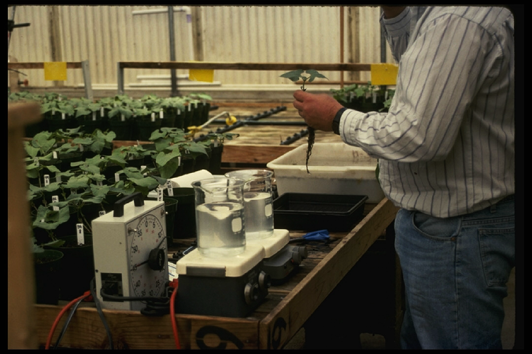
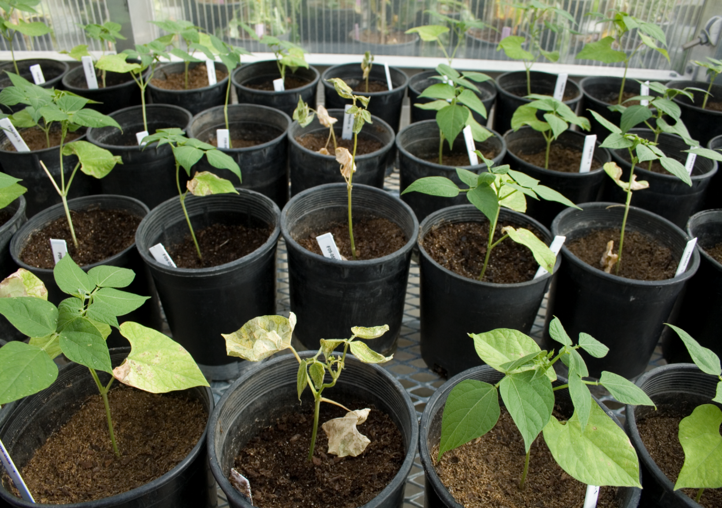
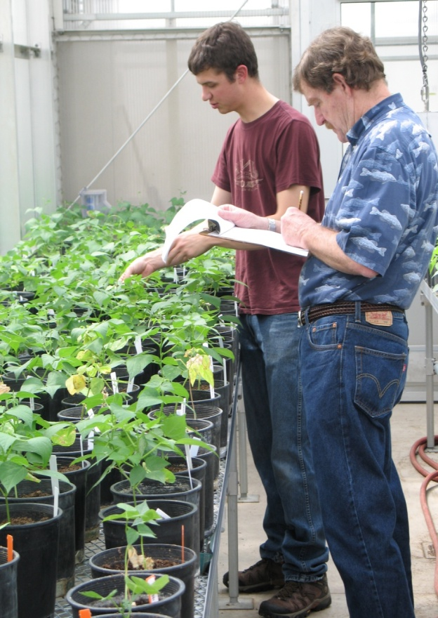
Cross-Pathogenicity of Sugar Beet and Onion Fusarium Wilt Isolates on Common Bean
A.J.Case¹,K.M. Webb²,M.A. Brick¹
¹Colorado State University and ² USDA-ARS, Sugarbeet Research Unit, Ft. Collins, CO
Introduction
Fusarium wilt, also known as Fusarium yellows, is a vascular pathogen with a broad host range including common bean (Phaseolus vulgaris L.), sugar beet (Beta vulgaris L.) and onion (Allium cepa L.). Fusarium wilt is caused by the fungus Fusarium oxysporum which has diversified into sub species known as formae speciales (f. sp.). Forma speciales are defined by their ability to cause disease on a specific host (1). Hence, F. oxysporum f. sp. phaseoli is pathogenic to common beans, F. oxysporum f. sp. betae is pathogenic to sugar beets and F. oxysporum f. sp. cepae is pathogenic to onions. These pathogens occur throughout sugar beet, onion and common bean production areas in the United States where they are regularly grown in rotation. F. oxysporum are typically for pathogenicity only on the host they were isolated from. Therefore, cross-pathogenicity, or the ability of a f. sp. to infect an alternate host, is largely unknown.
Objectives
To determine if isolates of Fusarium oxysporum f. sp. betae are pathogenic on common bean.
To determine if isolates of Fusarium oxysporum f. sp. cepae are pathogenic on common bean
Results: Are isolates of Fusarium oxysporum f. sp. betae pathogenic on common bean.
Summary
None of the F. oxysporum f. sp. betae isolates were pathogenic on common bean.
No differences were observed between F. oxysporum f. sp. betae isolates and the control (water).
Four isolates of F. oxysporum f. sp. phaseoli were used as positive, pathogenic, controls on common bean. Three of the four were pathogenic and one isolate had lost pathogenicity.
Conclusions
None of the F. oxysporum f. sp. betae isolates were pathogenic on common bean providing evidence that F. o. f.sp. betae are not cross pathogenic between common bean and sugar beet. This suggests that crop rotations involving sugar beet and common bean should be an effective control strategy to reduce inoculum of both formae speciales.
Materials and Methods
Plant Material
Seeds of the common bean variety ‘Viva’, which is susceptible to all known pathogenic isolates F. oxysporum f. sp. phaseoli, were germinated in pots containing vermiculite (2). Seedlings were grown in a controlled greenhouse environment with 32ºC day and 16ºC night temperatures for 21 days prior to inoculation (first trifoliate leaf emergence).
Inoculum preparation
A total of 60 isolates of Fusarium oxysporum were collected from various researchers throughout the US. Conidia of F. oxysporum f. sp. betae, f. sp. phaseoli and f. sp. cepae isolates were transferred from cold storage (-20C) onto Petri plates with half strength potato dextrose agar and cultured at 25ºC for two weeks. The day prior to inoculation, the inoculum was suspended in sterile distilled water. The following day the inoculum concentration was diluted to 10⁶ conidia per mL for each isolate (2). This solution was used for the root dip inoculation procedure.
Inoculation procedure
A root dip method of inoculation as described by Pastor-Corrales et al (4) and modified by Salgado et al. (5) was used. At 21 days after planting, seedlings were excavated from the media and roots washed, then placed in sterile distilled water for five minutes. The distal ⅓ of the root system was clipped using sterilized scissors and submerged into the prepared inoculum and allowed to soak for five minutes (Figure 1). The inoculated plants were transplanted into 6” pots with sterilized soil with one plant/pot (2). The plants were then placed into a greenhouse maintained at 22ºC to 25ºC and 13hrs photoperiod (Figure 2). After two to three days temperatures were increased to 32ºC/16ºC (day/night) to provide environmental stress to enhance disease development. Plants were watered every other day as necessary (2).
Disease Scoring
At 21 days after inoculation, the plants were scored using the 1 to 9 CIAT disease severity scale (2) (Figure 3) where 1= no disease symptoms and completely healthy; 3 = 10% of leaf surface showing disease symptoms; 5 = 25% of leaf surface showing disease symptoms as well as some whole plant stunting; 7 = disease symptoms on 50% of leaves and severely stunted; 9 = plant death.
Experiment Design
The experiment was performed using an augmented randomized block design (3). Because all 60 isolates could not be screened at once, 30 isolates were randomly assigned to one of two “sets” with each set replicated twice constituting four inoculation dates (experiments). At each inoculation date, each isolate was inoculated to four bean plants. Significant differences were compared by analysis of variance (ANOVA) using SAS Proc Mixed (SAS Institute, version 9.2, Cary, NC, USA).
Results: Are isolates of Fusarium oxysporum f. sp. cepae pathogenic on common bean.
Summary
None of the F. oxysporum f. sp. cepae isolates were pathogenic on common beanas compared to the pathogenic F. oxysporum f. sp. phaseoli that were used as positive controls. As in the first test, one of the positive controls had lost pathogenicity.
No difference were observed the F. oxysporum f. sp. cepae isolates and the control, water.
Conclusion
None of the F. oxysporum f. sp. cepae isolates were pathogenic on common bean providing evidence that F. o. f.sp. cepae are not cross pathogenic between common bean and onion. This suggests that crop rotations involving onion and common bean should be an effective control strategy to reduce inoculum of both formae speciales. However, only a few isolates of F. oxysporum f. sp. cepae were used therefore a more extensive collection of isolates should be tested prior to making further recommendations.
Refercences
1. Armstrong, G. M. and J. K. Armstrong. 1981. Formae speciales and races of Fusarium oxysporum causing wilt diseases. In Fusarium: Diseases, Biology, and Taxonomy, eds. Nelson, P. E., T. A. Toussoun, and R. J. Cook, 391-399. (University Park, PA: The Pennsylvania State University Press).
2. Brick, M. A., P. F. Byrne, H. F. Schwartz, J. B. Ogg, K. Otto, A. L. Fall, and J. Gilbert. 2006. Reaction to three races of Fusarium Wilt in the Phaseolus vulgaris core collection. Crop Science 46:1245-1252.
3. Federer, W. T. 2005. Augmented split bock experiment design. Agronomy Journal 97:578-586.
4. Pastor-Corrales, M. A. and G. S. Abawi. 1987. Reactions of selected bean germplasms to infection by Fusarium oxysporum f. sp. phaseoli. Plant Disease 71:990-993.
5. Salgado, M. O., H. F. Schwartz, and M. A. Brick. 1995. Inheritance of resistance to a Colorado race of Fusarium oxysporum f. sp. phaseoli in common beans. Plant Disease 79:279-281.
Figure 1
Figure 2
Figure 3
Root dip inoculation procedure
A pathogenic isolate causing symptoms on common bean next to non pathogenic isolates.
Disease scoring

