Slide 1
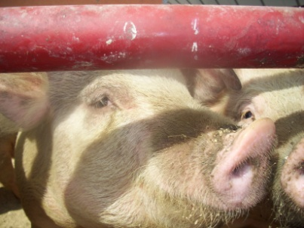
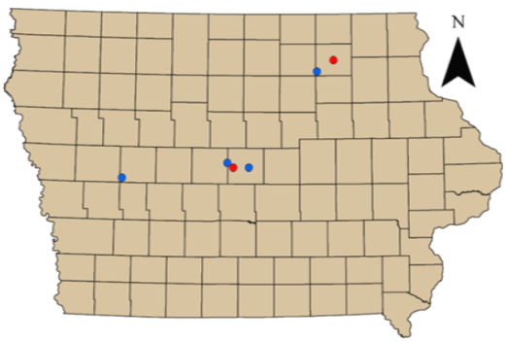
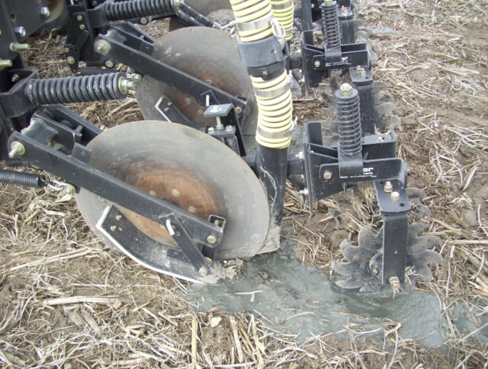
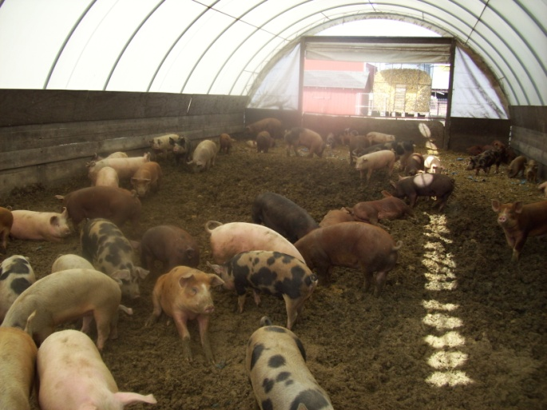
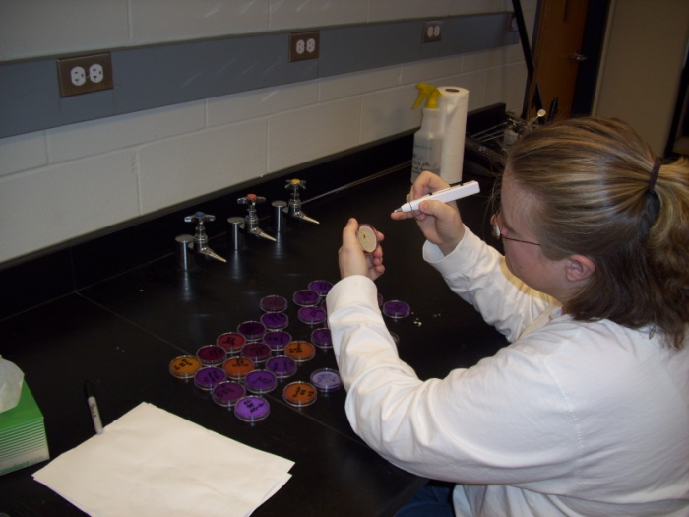
Exploring the Relationship between Transport, Resistance, and Virulence Factors of Escherichia coli Collected from Swine Manure
ABSTRACT
Broad spectrum antibiotics, such as Tylosin (naturally synthesized by Streptomyces fradiae) are used to treat infections in farm animals and are often administered at sub-therapeutic levels along with feed rations. The presence of bacteria resistant to antimicrobials in animal waste has raised concern related to their transport to surface and groundwater. Previous studies have shown that cells preferentially attach to sediments affecting their transport in overland flow; however, a lack of quantitative understanding exists regarding the attachment mechanisms such as extracellular organelles and the relationship between these and virulence factors in humans. In a preliminary study, the presence of Tylosin resistant bacteria have been enumerated in tile drainage samples collected beneath no-till plots. While this study shows the transport potential of resistant bacteria, the method of transport, the relationships between transport and resistance, and attachment and virulence factors is unknown. The objective of this research is to study these relationships in Escherichia coli collected from swine manure. Cultures will be screened for antibiotic resistance, and multiple antibiotic resistances. Resistant and non-resistant cultures will be grown in a chemostat environment to mimic a low nutrient environment. Relationships will be studied in vitro using an attachment assay and PCR. This study will be important in determining the relationship between antibiotic resistant bacteria and their ability to move within the environment and impact human health.
Martha R. Zwonitzer¹, Michelle L. Soupir¹, and Laura R. Jarboe²
¹Iowa State University, Department of Agricultural and Biosystems Engineering, Ames, Iowa 50011; ²Iowa State University, Department of Chemical and Biological Engineering, Ames, Iowa 50011
INTRODUCTION
In swine production, the development of a large number of antibiotics and other additives has helped increase gain and reduce the feed required per unit of gain. At least 11 antimicrobial or antifungal compounds or groups of compounds are widely used in swine feeds. These include various salts of bacitracin, chlortetracycline, dynafac, mycostatin, oxytetracycline, oleandomycin, penicillin, streptomycin, bambermycins, tilmicosin and tylosin (Carlson and Fangman, 2000). Veterinarians commonly use feed-grade antibiotics at therapeutic levels to treat acute disease outbreaks. This ensures that the bacterial pathogen causing the observed symptoms is treated with an antibiotic to which the pathogen has demonstrated susceptibility. However, in many instances, antibiotics are used to promote growth or weight gain and are fed at sub-therapeutic levels on a daily basis.
OBJECTIVE
To demonstrate that selection for antibiotic resistance by sub-therapeutic antibiotic use in agriculture co-selects for bacteria with increased attachment to sediment and increased frequency of virulence-associated genes
ISOLATE COLLECTION
Manure was collected from 6 locations (Figure 1)
2 Organic
Finish operation: 90 hogs
Farrow operation: 168 sows
4 Sub-therapeutic
Farrow operation: 100 sows
Finish operation: 720 hogs
Finish operation: 4000 hogs
Finish operation: 4800 hogs
E. coli colonies were enumerated from manure via membrane filtration
100 typical and atypical colonies from each location were selected for further study
PHENOTYPIC ATTACHMENT
Assay Preparation
Individual strains were grown for 12 hours in 10 mL of Mueller Hinton Broth and transferred to a phosphate buffered water solution
Cultures were diluted to an optical density of 0.5 McFarland Standard
404 strains from a library of 556 strains were characterized by enumeration of total E. coli
0.4 grams of sand particles with an average diameter of 125μm were added to 40 mL of suspended cells
Attachment Assay
Cultures were mixed for 20 minutes on an orbital shaker at room temperature
Static settling occurred for 5 minutes, which is adequate time for the smallest sand particle to settle out of suspension according to Stoke’s Law
Unattached fraction were characterized by enumeration
Attachment phenotype was calculated as the difference between total and unattached E. coli for each strain (Figure 2)
Results
Attachment is statistically significant among the treatments (p <0.0001)
Pressure from the antibiotics from the sub- therapeutic operations may be responsible for increased attachment
Further Research
Further characterization of the phenotypic and genotypic attachment is needed
Isolates will be characterized from an additional organic operation (winter 2009)
ANTIBIOTIC RESISTANCE
Pre-screening
70 Tylosin resistant E. coli colonies were collected, re-plated on agar infused with:
Chloramphenicol (MIC = 2 μg L⁻¹)
Ampicillin (MIC = 2 μg L⁻¹)
Erythromycin (MIC = 8 μg L⁻¹)
Tylosin (MIC = 32 μg L⁻¹)
Plates were incubated at 37°C for 24 hours
ANTIBIOTIC RESISTANCE
Pre-screening continued
Resistance was recorded as presence/absence (Figure 3)
Results
22.9% of the cultures exhibited resistance to all tested antibiotics
55.7% of cultures resistant to tylosin were resistant to > two other antibiotics
Further Research
All library strains will be screened for resistance against 15 antibiotics as identified as being important to both humans and animals by NARMS (2005) and the USDA APHIS Report.
GENOTYPE ATTACHMENT AND VIRULENCE FACTORS
Isolates were queried by gene-specific PCR for known attachment and virulence factors (Table 1)
43 isolates from organic operations
43 isolates from sub-therapeutic operations
Primers specificity was assessed by running a negative and positive control
Results
Increased coding frequency for P pili support our key hypothesis
Genes encoding P pili have been previously reported as being associated with antibiotic resistance (Karami et al., 2008; Arisoy et al., 2008)
Further Research
Continue querying isolates by gene-specific PCR for known virulence and attachment factors
Correlate attachment and antibiotic resistance phenotype with virulence and attachment factor genotype
Figure 3. Percentage of resistance colonies to Tylosin, Erythromicin, Ampicillin, and Chloramphenicol. Resistance was recorded as presence/absence (n=70).
Table 1. E. coli strains isolated from sub-therapeutic operations have increased frequency of the genes encoding P pili relative to isolates from organic operations. Values indicates the percent of the queried population that tested positive for the indicated factor. 43 strains were analyzed from each set by gene-specific PCR.
ACKNOWLEDGEMENTS
The authors would like to extend their thanks to the following people for their help and expertise: Carl Pederson, Pramod Pandey, Bridgette Huss, David Westhoff, Paige Dugal, Ping Liu, the staff Jarboe’s laboratory, and John, Molly and Shannon Zwonitzer.
LITERATURE CITED
Carlson, M.S. and T.J. Fangman. 2000. Swine antibiotics and feed additives: food safety considerations. University of Missouri Extension Publication.
Karami, N., C. Hannoun, I. Adlerberth and A.E. Wold. 2008. Colonization dynamics of ampicillin-resistant Escherichia coli in the infantile colonic microbiota. Journal of Antimicrobial Chemotherpy. 62: 703-708.
Arisoy, M., A.Y. Rad, A. Akin and N. Akar. 2008. Relationship between susceptibility to antimicrobials and virulence factors in paediatric Escherichia coli isolates. International Journal of Antimicrobial Agents. S4-S8.
Figure 2. Percent of E. coli cells attached to sand particles after 20 minutes of shaking. Attached fraction was calculated by taking the difference between the enumerated total and unattached fractions.
Figure 1. Iowa sample locations. Blue circles represent swine operations that feed antibiotics at sub-therapeutic levels; red circles are organic swine operations.

