Slide 1


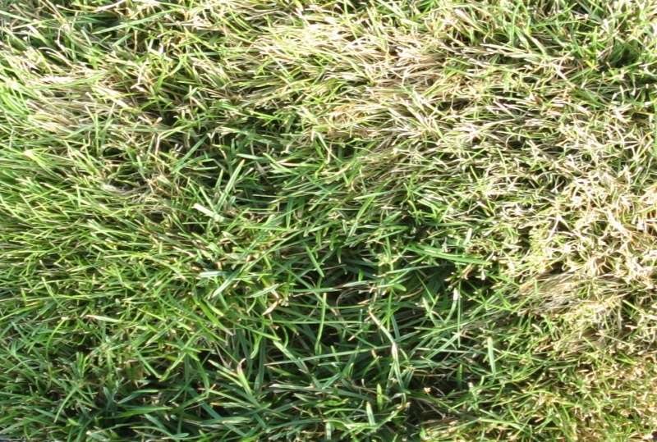
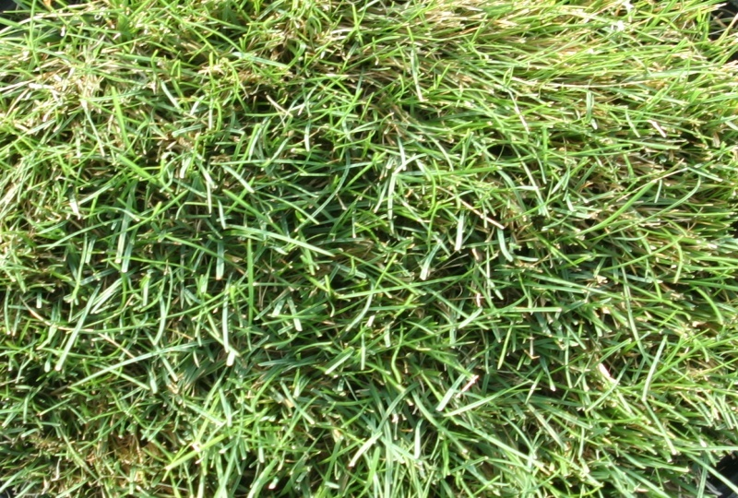
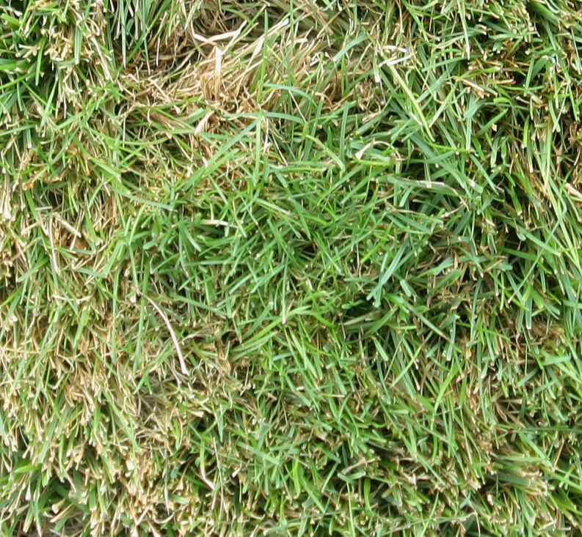
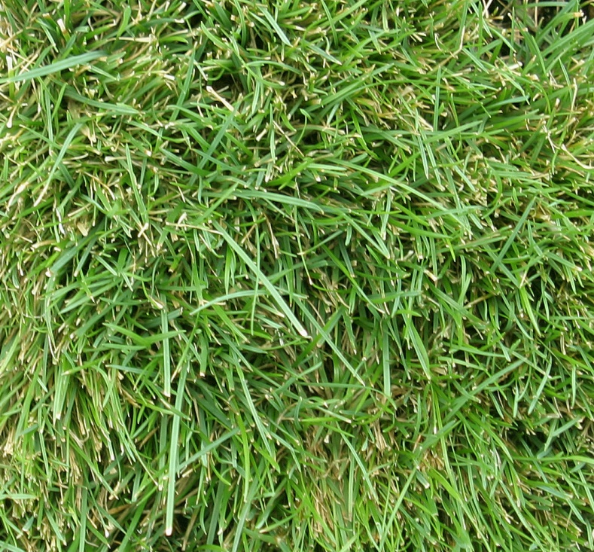

Effects of Biostimulants and other Biological Byproduct Extracts on the Heat Tolerance of Perennial Ryegrass
S.M. Dworak, R.E. Gaussoin, T.J. Arkebauer, G.L. Horst, M.D. Sousek, and A.R. Kohel
Department of Agronomy and Horticulture, University of Nebraska-Lincoln
ABSTRACT
Research has indicated that perennial ryegrass (Lolium perenne L.) treated with a biostimulant has improved photochemical efficiency and leaf membrane thermostability at high air temperature stress in growth chamber studies, suggesting improved overall metabolic responses to heat stress. In this study, the effects of several different biostimulant and biological byproduct extracts on the heat tolerance of perennial ryegrass were investigated. Physiological responses of perennial ryegrass treated with or without several different types of amino acid-containing products and subjected to three separate, consecutive air temperature stresses (~25°C, ~31°C, and ~33°C ) followed by drought stress were investigated in the greenhouse. Multiple rates and applications were also investigated for some, but not all, treatments. Turfgrass visual quality, percentage of leaf firing, and chlorophyll index were measured. Perennial ryegrass treated with lysine-containing biostimulants with unidentified plant cell metabolites consistently showed improved heat tolerance over untreated controls.
MATERIALS AND METHODS
Experimental Design
The study was initiated in March 2009 and conducted inside greenhouses on the University of Nebraska-Lincoln’s East Campus, in Lincoln, NE.
Monterey 3 perennial ryegrass seed was sown at 4.8 kg∙92.9 m⁻² in 21.6-cm diameter x 22.9-cm deep plastic pots of soilless media (peat 34%: perlite 33%: vermiculite 33% with micronutrients) until well established. After establishment, pots were moved to another greenhouse for treatment application and data collection and organized into a completely randomized design with three replications. Treatments were applied as liquid sprays using a CO₂-powered backpack applicator. Pots received 500 mL of water every 2 d to prevent drought stress (except during the drought stress period). Turfgrass was fertilized weekly with 250 mL of Hoagland’s solution (20-20-20) and was clipped to 5.1-cm heights every 3-4 d. Air temperatures were maintained at an average of ~25°C for 14 d (representing the first air temperature stress), followed by 4 d of ~31°C (second temperature stress) and at ~33°C with concurrent drought stress (by withholding water), representing the third temperature stress, for 23 d until plants were dead.
Chlorophyll index was measured using a Spectrum Technologies, Inc., FieldScout CM 1000 chlorophyll meter (Plainfield, Ill). Visual quality ratings followed the National Turfgrass Evaluation Program (NTEP) measurement method. Leaf firing (%) was visually assessed concurrently with visual quality. Data were analyzed using analysis of variance (ANOVA) and Fisher’s least significant difference (LSD) using the PROC GLM and PROC MIXED procedures of SAS v9.1 statistical analysis software (SAS Institute, Inc., Cary, NC).
Treatment Design
Biostimulants are considered materials, other than fertilizers, that promote plant growth when applied in small quantities (Zhang and Schmidt, 1997). Biostimulants used in this study (Table 1) are amino acid-containing products (AACP), byproducts of fermentation processes that contain various residual amino acids (Table 2), sugars, mineral nutrients, organic acids, and inert material (data not shown). Lysine-based biostimulants contain ~5.7% (by weight) total N content, with threonine-based containing ~2.9%. Some treatments used repeat applications but differed in rate or number of applications (Table 1). Second applications for those select treatments were applied 14 d after first treatment [DA(F)T].
A
B
A
B
Figure 1. Representative photographs of (A) an untreated control and (B) a Lysine ML (CM) biostimulant-treated stand of turfgrass, taken 33 days after (first) treatment [DA(F)T], in ~33°C temperature stress. Each turfgrass pictured received visual quality scores of 4 and 6, respectively, out of 9, and treatment means were significantly different (α = 0.05).
Figure 2. Representative photographs of (A) an untreated control and (B) a Lysine ML (CM) biostimulant-treated stand of turfgrass, taken 29 days after first treatment [DA(F)T], in ~33°C temperature stress. Each turfgrass pictured received chlorophyll indices of 245 and 310, respectively, and treatment means were significantly different (α = 0.05).
RESULTS AND DISCUSSION
Significant differences in turfgrass visual qualities between several biostimulant-treated turfgrasses compared to untreated controls occurred in each temperature stress period, with most differences during the third air temperature stress. Significant differences were observed 15, 22, 29, and 33 DA(F)T (Figures 1 and 3A).
Leaf firing percentage was also affected by select biostimulant treatments. Significant differences were observed between several treatments and untreated controls during the second air temperature stress and early into the third, at 22 and 26 DA(F)T (Figure 3B).
Significant differences in chlorophyll indices were observed between several biostimulant-treated turfgrasses and untreated controls in both the first and third air temperature stresses. Significant differences occurred during four consecutive days of data collection, at 26, 29, 33, and 39 and once at 15 DA(F)T (Figures 2 and 3C).
Table 1. List of treatments, respective rates, and number of treatment applications involved in the study.
Lys = L-Lysine; Thr = L-Threonine; CM = contains unidentified plant cell metabolites; ML = mother liquor
CONCLUSION
Research has suggested improved overall metabolic responses to heat stress in biostimulant-treated perennial ryegrass (Kauffman et al., 2007). In this study, perennial ryegrass treated with lysine-containing biostimulants with unidentified plant cell metabolites consistently showed improved heat tolerance over untreated controls as measured by visual quality, leaf firing percentage, and chlorophyll index. These effects are likely not attributable to added N content, as N contents of biostimulants were negligible compared to regular fertilization applications. It is suggested these select lysine-containing biostimulants be moved forward to field trials before eventual implementation into turfgrass management programs and marketable commercial products.
Table 2. Amino acid profiles of lysine and threonine biostimulants. CM = contains unidentified plant cell metabolites
Trt. No. |  |  | Treatment | Rate, per app (g·92.9 m⁻²) | Applications
 | 1 |  | Untreated control | --- | ---
 | 2 |  | Thr ML 1X | 56.7 | 1
 | 3 |  | Thr ML 2X | 113.4 | 1
 | 4 |  | Thr ML 0.5X | 28.3 | 1
 | 5 |  | 50/50 Lys/Thr 1X | 56.7 | 1
 | 6 |  | 50/50 Lys/Thr 2X | 113.4 | 1
 | 7 |  | 50/50 Lys/Thr 0.5X | 28.3 | 1
 | 8 |  | Lys ML 1X | 56.7 | 1
 | 9 |  | Lys ML 2X | 113.4 | 1
 | 10 |  | Lys ML 0.5X | 28.3 | 1
 | 11 |  | Lys ML (CM) 1X | 56.7 | 1
 | 12 |  | Lys ML (CM) 2X | 113.4 | 1
 | 13 |  | Lys ML (CM) 0.5X | 28.3 | 1
 | 14 |  | Thr ML 1X | 56.7 | 2
 | 15 |  | Thr ML 0.5X | 28.3 | 2
 | 16 |  | 50/50 Lys/Thr 1X | 56.7 | 2
 | 17 |  | 50/50 Lys/Thr 0.5X | 28.3 | 2
 | 18 |  | Lys ML 1X | 56.7 | 2
 | 19 |  | Lys ML 0.5X | 28.3 | 2
 | 20 |  | Lys ML (CM) 1X | 56.7 | 2
 | 21 |  | Lys ML (CM) 0.5X | 28.3 | 2
Amino acid | Lysine (g∙100 g sample) | Lysine (CM) (g∙100 g sample) | Threonine (g∙100 g sample)
Taurine | 0.04 | 0.03 | 0.03
Hydroxyproline | 0.00 | 0.00 | 0.00
Aspartic acid | 0.00 | 0.11 | 0.03
Threonine | 0.00 | 0.16 | 6.72
Serine | 0.00 | 0.02 | 0.08
Glutamic acid | 0.23 | 1.01 | 0.30
Proline | 0.07 | 0.06 | 0.04
Lanthionine | 0.00 | 0.00 | 0.01
Glycine | 0.08 | 0.17 | 0.18
Alanine | 0.02 | 0.52 | 0.07
Cysteine | 0.00 | 0.12 | 0.10
Valine | 0.04 | 0.05 | 0.21
Isoleucine | 0.00 | 0.03 | 0.12
Leucine | 0.00 | 0.09 | 0.04
Tyrosine | 0.00 | 0.08 | 0.06
Phenylalanine | 0.00 | 0.08 | 0.19
Lysine | 0.27 | 0.57 | 0.14
Histidine | 0.02 | 0.02 | 0.01
Arginine | 0.00 | 0.04 | 0.01
Tryptophan | <0.04 | <0.04 | <0.04
Total: | 0.77 | 3.17 | 8.34
Figure 3. (A) Mean visual quality ratings (1 = poor, 9 = excellent), (B) leaf firing (%), and (C) chlorophyll indices of perennial ryegrass treated with select biostimulant treatments. Asterisks (color respective of treatment) indicate significant difference (α = 0.05) from untreated controls. Air temperature stress periods (~25°C, ~31°C, and ~33°C) are indicated by the three colored blocks. Arrow at 34 DA(F)T indicates onset of drought stress.
REFERENCES
Kauffman III, G.L., D.P. Kneivel, and T.L. Watschke. 2007. Effects of a biostimulant on the heat tolerance associated with photosynthetic capacity, membrane thermostability, and polyphenol production of perennial ryegrass. Crop Sci 47: 261-267.
Zhang, X., and R.E. Schmidt. 1997. Biostimulating turfgrasses. Grounds Maintenance November, 1999. p. 15-32.

