Slide 1

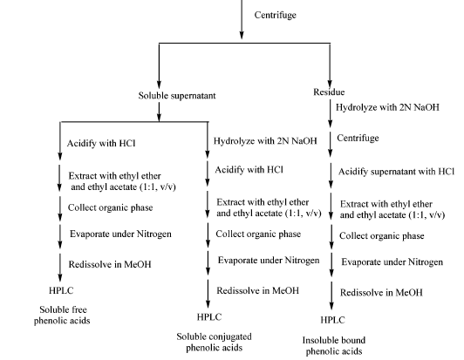
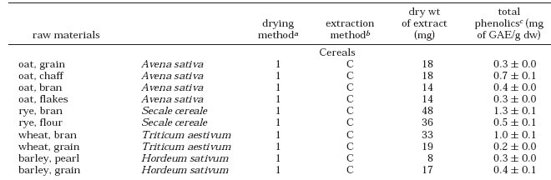
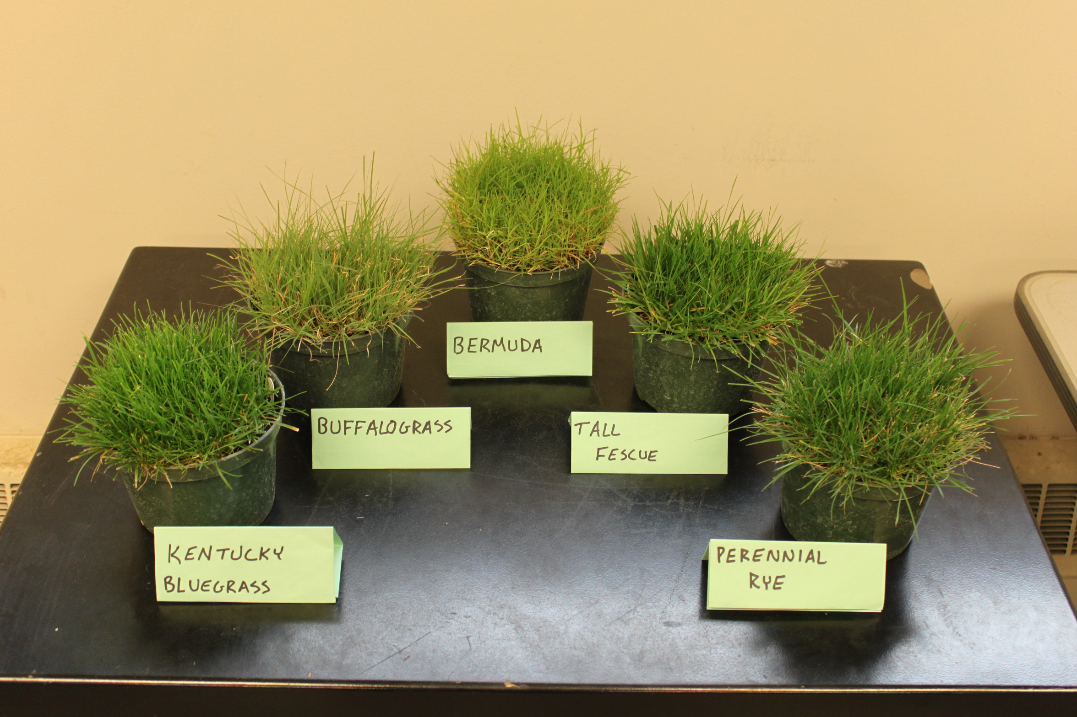
Exploring the Nutraceutical Benefits of Turfgrass
C.J Wegner, R.E. Gaussoin, V.L. Schlegel, M.A. Pedersen
Department of Agronomy and Horticulture and Department of Food Science University of Nebraska-Lincoln
Nutraceutical; nu·tra·ceu·ti·cal: A naturally occurring food supplement thought to have a beneficial effect on human health.
Phenols: Class of chemical compound that has reducing power to potentially prevent oxidative stress. Flavonoid: Most common group of polyphenolic compound known for antioxidant abilities.
Introduction
Members of the Poaceae family are an integral resource for nearly every culture throughout the global community; more so than any other member of the plant kingdom. Grasses also represent the most abundant plant family on Earth. A critical lack of information appears to exist where many functional uses of grass have not been investigated. Research began in the summer of 2009 at the University of Nebraska-Lincoln to start filling this gap in knowledge. This research will help identify baseline primary nutraceutical potential of selected grass genus’ for mammalian health.
Discussion
Preliminary results suggest that turfgrasses are host to nutraceutical qualities that could possibly be exploited for human health benefits. This information is substantial because nature is the backbone of the pharmaceutical industry, although an extremely large percentage of Earth’s plant biochemistry remains unexplored. Currently, the looming climate change is threatening the existence of many plants with nutraceutical qualities, so it may be logical to first look at the Poaceae family, the most abundant plant family. Results for this research are just beginning to be obtained, so conclusive conclusions are not yet available. What is known is that significant differences are present between turfgrass species in terms of antioxidant capacites (illustrated by figures 2a and 2b). Also, ratios of flavonoids : phenols (figure 3a) differ between turfgrass species, which may prove to be an important consumption factor in clinical testing. Finally, the baseline results reported indicate that turfgrasses possess antioxidant capacities that, in theory, rival some fruits and vegetables with documented antioxidative abilities (figure 4a).
Future Research
The investigation of nutraceutical uses of turfgrass will continue for years to come. Plans include to begin testing for bound phenolic concentration to identify total phenolic levels and to increase the specificity of antioxidative identification including radical scavenging abilities. Clinical testing and cancer assays using turfgrass extracts will also be examined to truly understand the nutraceutical abilities possessed by the most abudant plant family on Earth.
Percent Flavonoid Composition of Total Soluble Phenols
Soluble Phenols
Figure 2a
Figure 3a
Objective
The objective of this research is to identify secondary metabolites in antioxidant agents from cultivated turfgrass species of different centers of origin. The metabolites investigated have been linked to prevention of chronic conditions such a cancer, diabetes, and heart disease.
mg g⁻¹ of fresh material
Materials and Methods
Turfgrass Samples. Five turfgrass species were selected that are native to various geographical regions. The turfgrass species included ‘Cheyenne II’ bermudagrass [Cynodon dactylon (L.) Pers.], ‘Bowie’ buffalograss [Bouteloua dactyloides (Nutt.) J.T. Columbus], ‘Apple GL’ perennial ryegrass [Lolium perenne (L.)], ‘RTF’ tall fescue [Festuca arundinaceae Schreb.] and ‘4 Season’ Kentucky bluegrass [Poa pratensis (L.)]. Turfgrass species were grown in a climate-controlled greenhouse on the University of Nebraska-Lincoln’s East Campus in Lincoln, NE. Samples were collected by cutting each grass at the growing point and collecting the clippings.
Extraction Procedure. One gram of clipping material was ground into a powder immediately after freezing with liquid nitrogen. This powder was transferred to a test tube and combined with 5 ml of 50% MeOH and 0.5 ml of 1.2 N HCl. After the solution and samples were agitated for an hour on a rocker, the individual test tubes for each species were centrifuged and the respective supernatants were removed. This procedure was repeated starting with the addition of MeOH and HCl for the remaining sample material in the test tubes. Supernatants were pooled together and 7.5 ml of extraction solution was obtained for each sample.
Total Soluble Phenolic Content Figure 1a
(Moore et al 2005)
Total Flavonoids. A solution consisting of 125 µL of sample extract, 1.025 ml of nano-pure water, 37.5 µL of 5% sodium nitrite, 75 µL of 10% aluminum chloride and 250 µL of sodium hydroxide was prepared for each extraction sample. The absorbance of each solution was measured at 510 nm with a spectrophotometer. Total flavonoids were calculated with their respective absorbencies using t-cinnamic acid as a standard.
References
Moore J, Z Hao, K Zhou, M Luther, J Costa, L Yu. 2005. Carotenoid, Tocopherol, Phenolic Acid, and Antioxidant Properties
of Maryland-Grown Soft Wheat. J Agric Food Chem, 53, 6649-6657.
Marja P. Kähkönen,,, Anu I. Hopia,, Heikki J. Vuorela,, Jussi-Pekka Rauha,, Kalevi Pihlaja,, Tytti S. Kujala, and, Marina
Heinonen. 1999. Antioxidant Activity of Plant Extracts Containing Phenolic Compounds. J Agric Food Chem, 47 (10),
3954-3962
Soluble Flavonoids
Figure 4a
(Kähkönen et al 2009)
Figure 2b
mg g⁻¹ of fresh material
* Values that have a different alphabetical letter are statistically different at the 95% confidence interval with the Tukey HSD test.

