Slide 1

Using NIRS to Predict Palmitic Fatty Acid in Peanut Seeds
Barry L. Tillman and George Person

Slide 2
Why are oleic, linoleic, and palmitic acid important?
Dominant fatty acids in peanut oil
  High oleic acid
    US Patent- 6,063,984, Knauft, Gorbet, Norden
    Trait is simply inherited- two recessive genes
 | Oleic acid (18:1) | Linoleic acid (18:2) | Palmitic acid (16:0)
Normal | 50-60% | 20-30% | 8-12%
High Oleic | 74-84% | 2-8% | 5-7%

Slide 3
Relationship among Palmitic, Linoleic, and Oleic Acids

Slide 4
High oleic peanuts have commercial and health benefits.
Commercial benefits
  High oleic peanuts have 5x-15x the shelf life of normal peanuts
    Maintain flavor
  Oil quality similar to olive oil
Health (have more of what makes normal peanuts healthy)
  High in monounsaturated fats
    Lowers total cholesterol
    Lowers bad LDL cholesterol
    Maintains beneficial HDL cholesterol
    Lowers triglycerides
  May reduce risk of heart disease when eaten regularly
Developing high oleic (HO) peanut varieties is a priority

Slide 5
At Least 18 High oleic acid peanut cultivars have been released.
SunOleic 95R
SunOleic 97R
GK7
VC-2
AT1-1
AT201
Flavor Runner
Georgia HiOL
Georgia 02C
Olin
Tamrun OL01R
ANorden
Hull
Tamrun OL02R
AT3085RO
McCloud
York
Florida-07

Slide 6
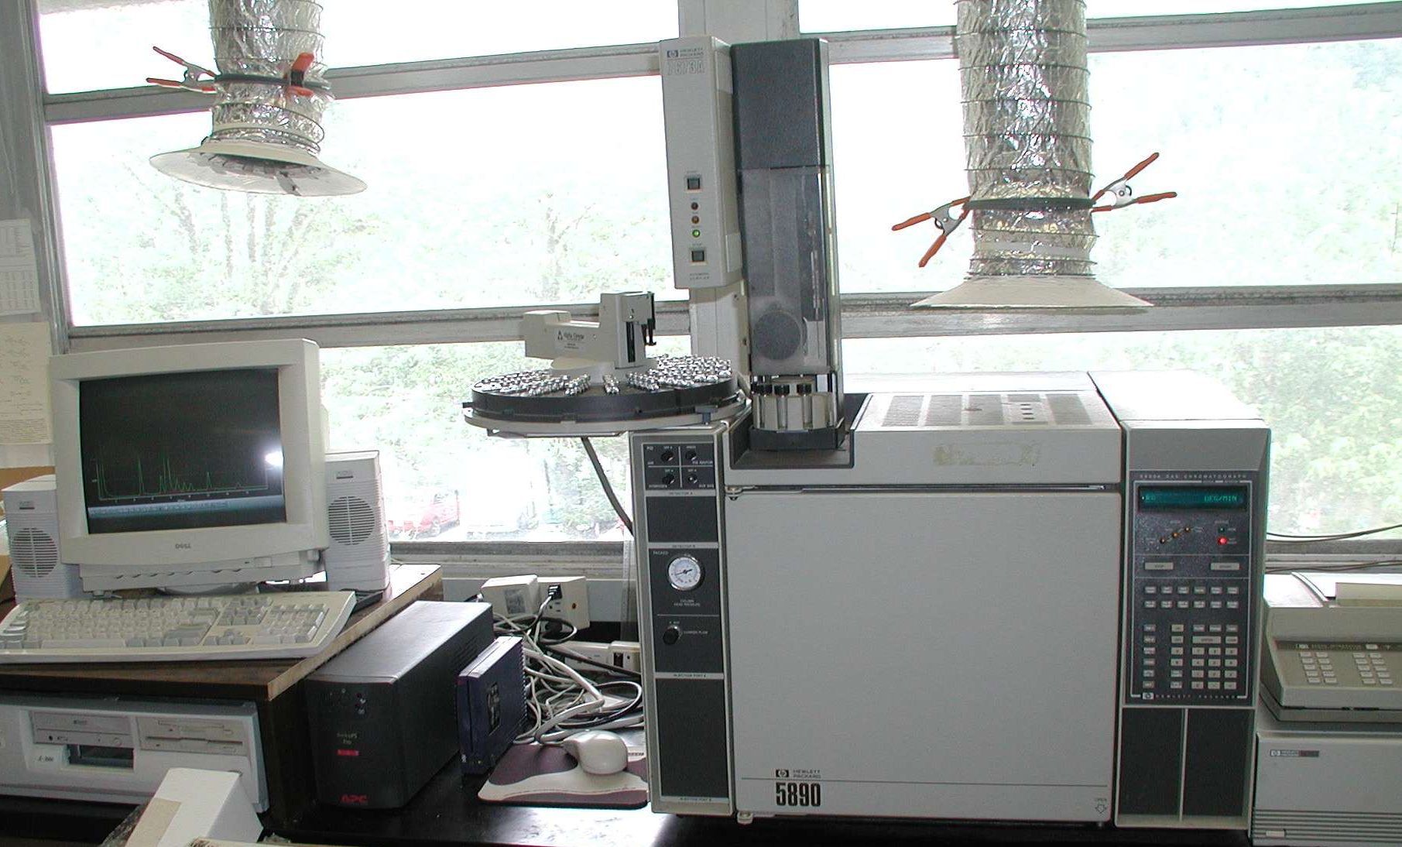
How do we measure fatty acid content?
Gas chromatography (GC)
  Accurate
  Always destructive/injurious
  Time consuming (15-20 min./sample)

Slide 7
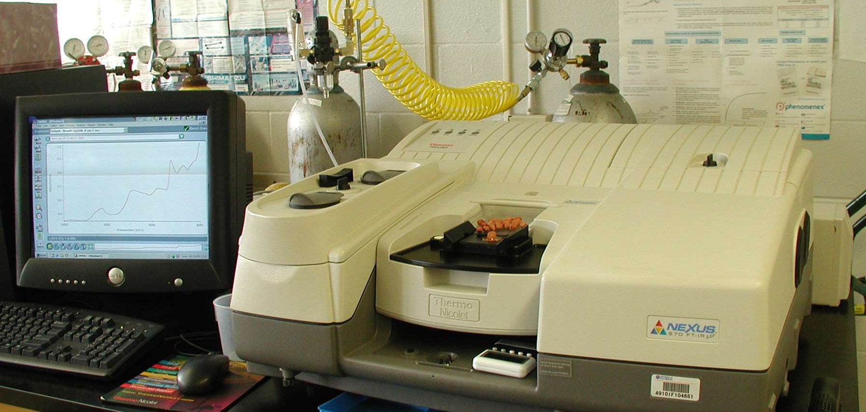
Can we reliably measure oleic, linoleic and palmitic acid content with NIR and replace GC?
We test about 800-900 samples per year using GC
Need to test 3-4 times that number
  Near infrared reflectance spectroscopy (NIR)
    Less accurate
    Can be non-destructive
    Fast (3-5 min./sample)

Slide 8
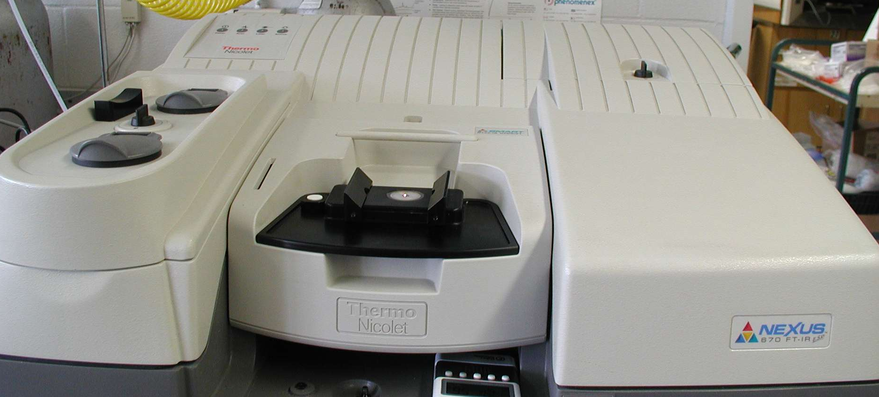
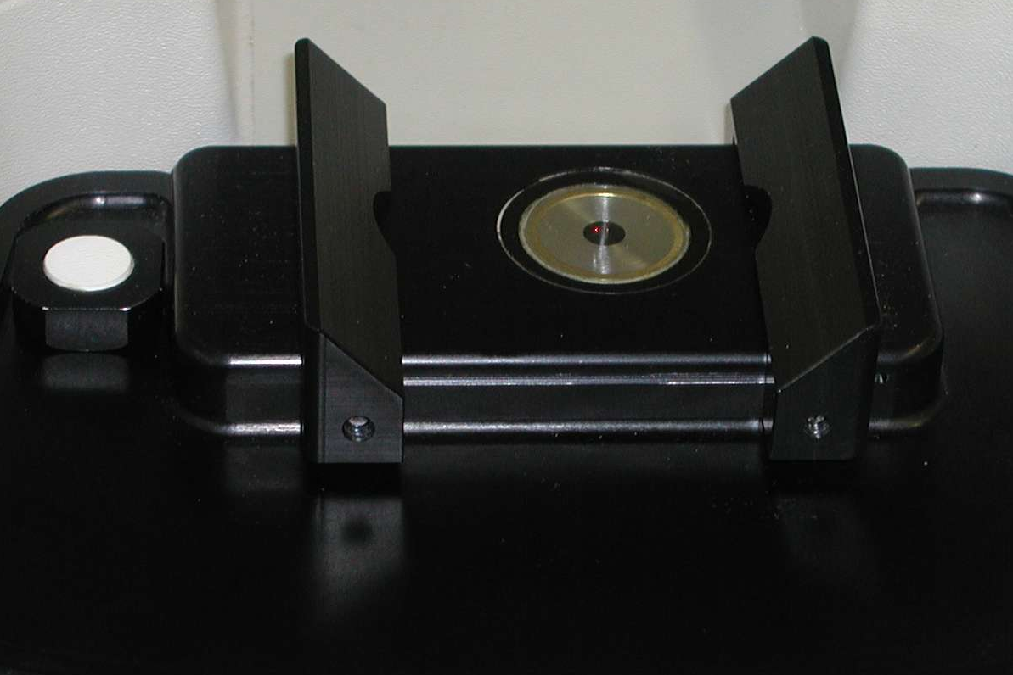
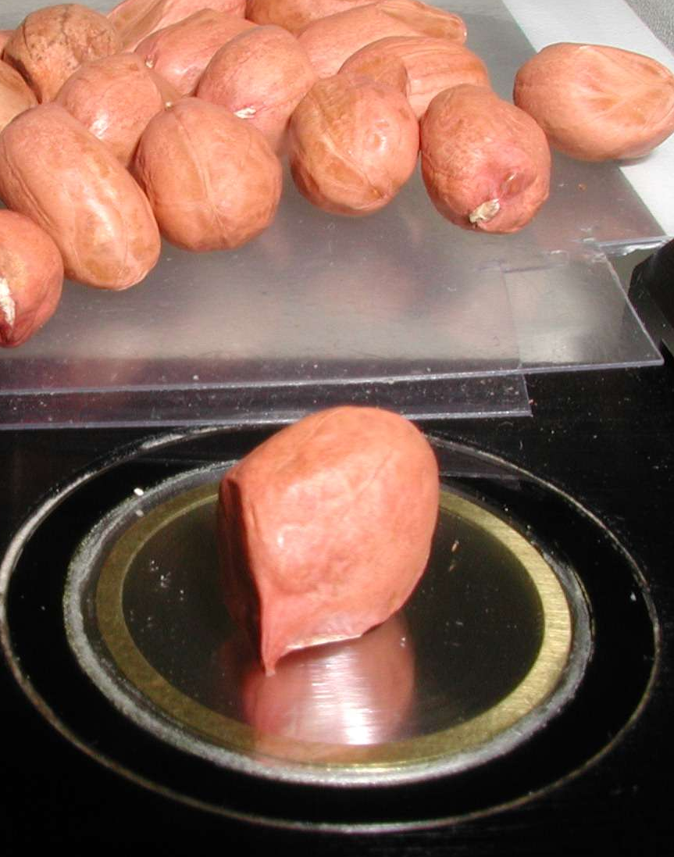
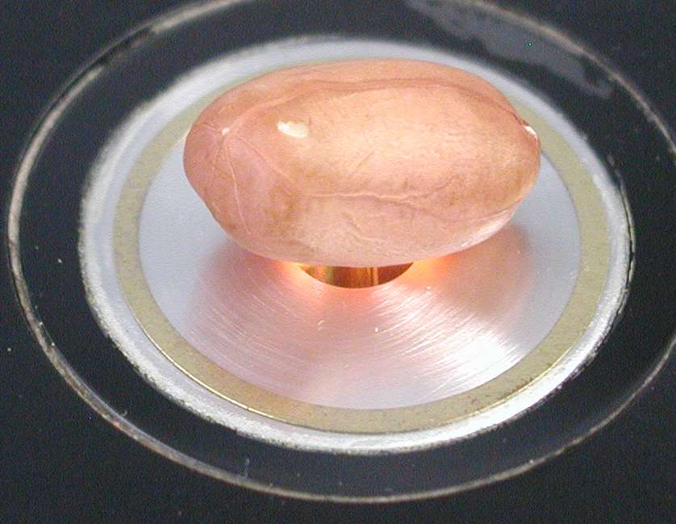
NIR requires minimal sample preparation

Slide 9
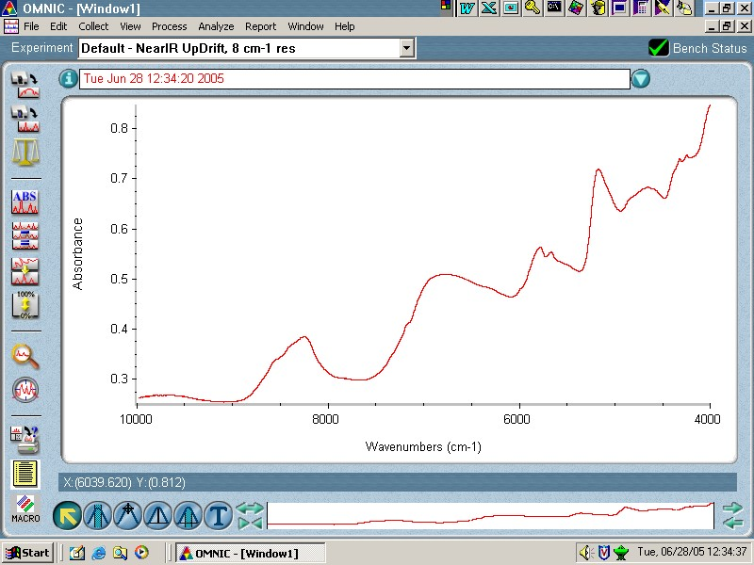
NIR captures and stores light absorbance data

Slide 10
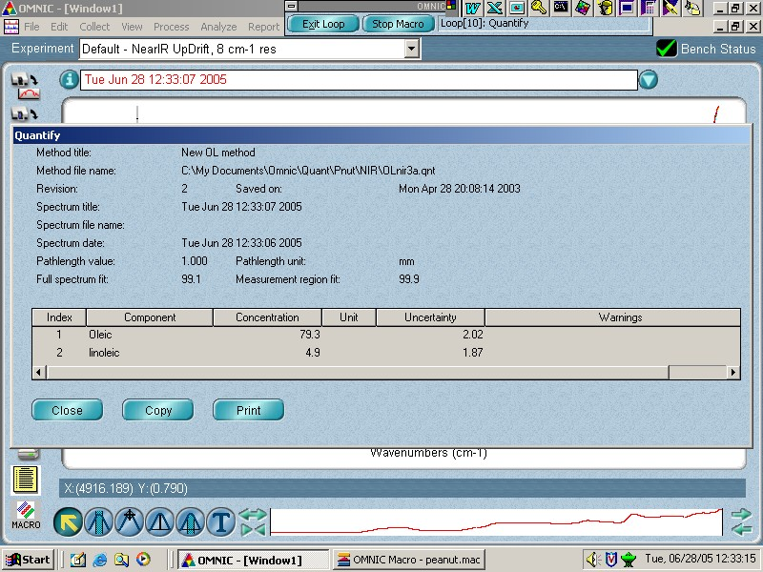
Absorbance data used to estimate chemical content based on calibration

Slide 11
NIR Calibration - Fatty Acids in Peanut
Previous Calibration & Validation
  Predicts Oleic and Linoleic acids
  Misclassifies 4-5% of single seeds tested
    (Crop Sci. 46:2121–2126 (2006))
Goals of New Calibration
  Predict Oleic, Linoleic and Palmitic acids
  Reduce % misclassified seeds

Slide 12
Previous calibration- Oleic Acid
Agreement between NIR and GC is very good
NIR
R²=0.98
y = 1.01x – 4.4
slope: p>|t|<0.0001
intercept: p>|t|=0.6059
n =132
GC

Slide 13
Previous validation- Oleic Acid
4 out of 43 HO (4/94 total) kernels were misclassified by NIR
NIR
R²=0.84
y = 1.01x – 2.0
slope: p>|t|<0.0001
intercept: p>|t|=0.9475
n =94
GC

Slide 14
NIR Calibration - Fatty Acids in Peanut
Previous Calibration & Validation
  Predicts Oleic and Linoleic acids
  Misclassifies 4-5% of single seeds tested
    (Crop Sci. 46:2121–2126 (2006))
Goals of New Calibration & Validation
  Predict Oleic, Linoleic and Palmitic acids
  Reduce % Misclassified seeds

Slide 15
New Model Oleic Acid Calibration
(single seeds)

Slide 16
New validation- Oleic Acid
1 out of 43 HO (1/94 total) kernels were misclassified by NIR

Slide 17
New Model Palmitic acid calibration
(single seeds)

Slide 18
New Model Palmitic acid validation
(single seeds)

Slide 19
NIR Calibration - Fatty Acids in Peanut
Previous Calibration & Validation
  Predicts Oleic and Linoleic acids
  Misclassifies 4-5% of single seeds tested
    (Crop Sci. 46:2121–2126 (2006))
Goals of New Calibration & Validation
  Predict Oleic, Linoleic and Palmitic acids
  Reduce % Misclassified seeds
Results- New Calibration & Validation
  Predicts Oleic, Linoleic and Palmitic acids
  Misclassifies 1 % of single seeds tested

Slide 20
Old Model Oleic acid validation
(average of 5 spectra)

Slide 21
New Model Oleic acid validation
(average of 5 spectra)

Slide 22
Previous Model - Oleic acid validation
(average of 5 seeds)

Slide 23
% Misclassified (average of spectra)

Slide 24
Old model % misclassified
(average of seeds)

