Slide 1


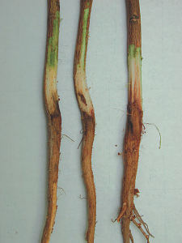
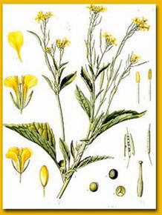
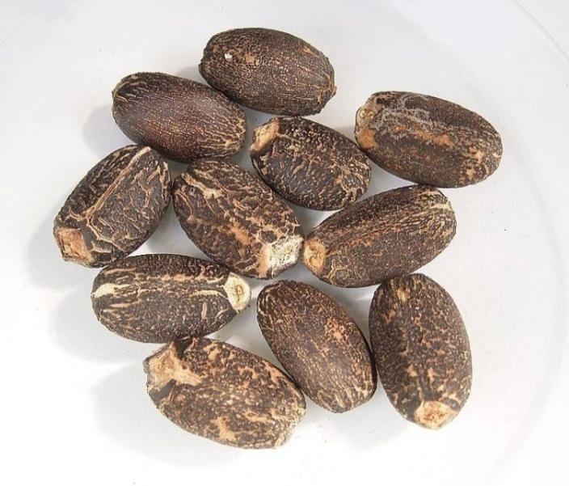
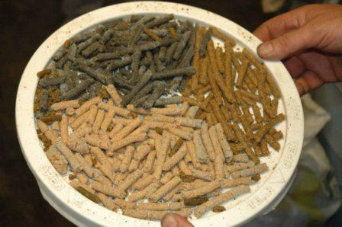
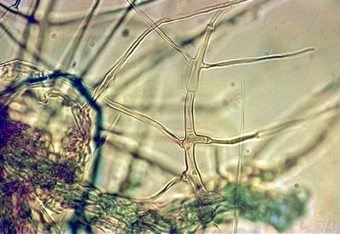
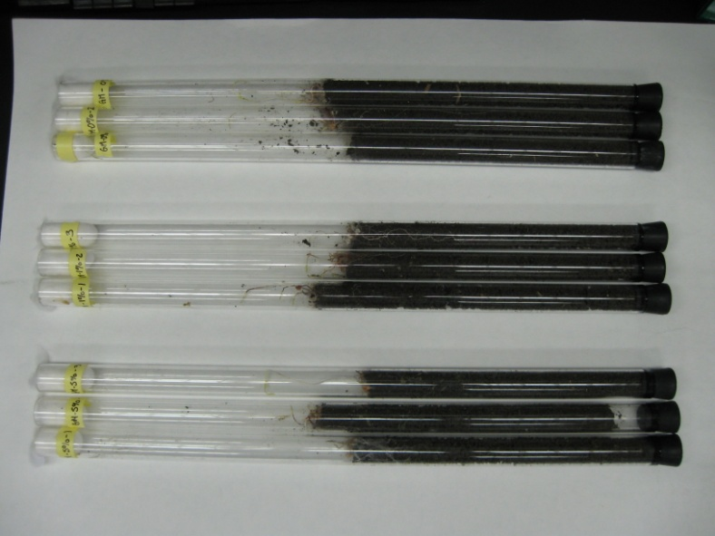
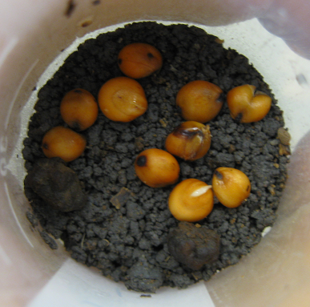
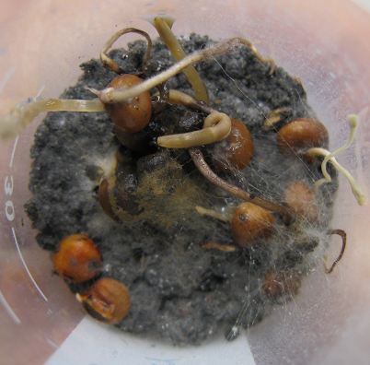
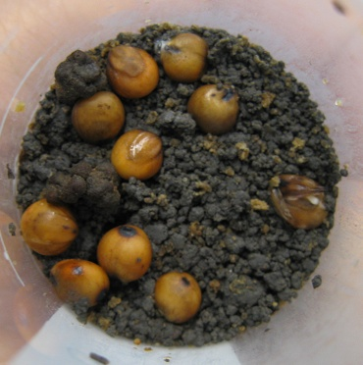
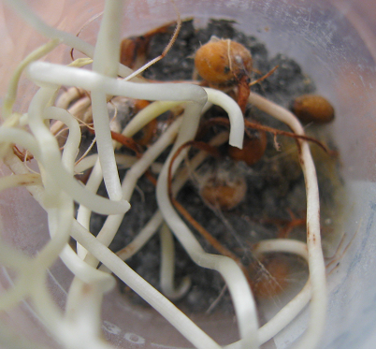
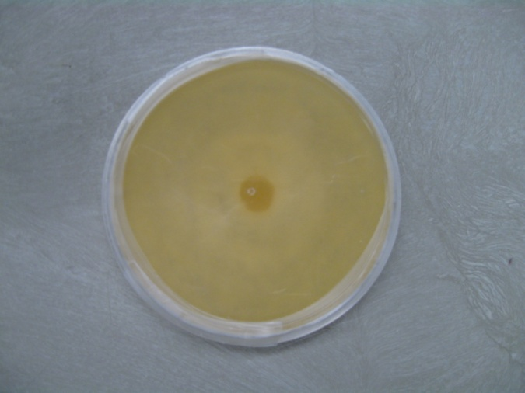


Inhibition of Phymatotrichopsis omnivora (Cotton Root Rot) Germination and
Growth in Soil following Application of Various Oilseed Meals
Ping Hu¹, Autumn Wang¹, Amanda Engledow¹, John Matocha², Tony Provin¹, Frank Hons¹, and Terry Gentry¹
¹Department of Soil and Crop Sciences, Texas A&M University, College Station, Texas 77843-2474
²Texas AgriLife Research and Extension Center, Corpus Christi, TX 78406
Introduction
Effect of oilseed meals on survival and germination of P. omnivora sclerotia
Discussion
The meals (co-products remaining after oil extraction) from many oilseed crops contain toxic chemicals that are known to inhibit the growth and activity of some soil microorganisms including several plant pathogens. The fungus Phymatotrichopsis omnivora is a very serious and recalcitrant soil borne fungal pathogen and the causal agent of cotton root rot. This fungus has greatly hindered the production of cotton and alfalfa in the alkaline, low-organic-matter soils in many parts of Texas and the Southwestern USA. We investigated the effects of oilseed meals from both Brassicaceous and non-Brassicaceous crops on P. omnivora sclerotial germination and hyphal growth in soil as well as the effects of individual isothiocyanates (ITCs) on P. omnivora in pure culture.
1. P. omnivora inhibition by Brassicaceae:
Mustard seed meal was the most effective treatment for suppressing germination of sclerotia and hyphal growth. Rapeseed and camelina showed less effective control of sclerotial germination and fungal hyphal growth than did mustard.
2. Sclerotial vs hyphal growth inhibition
Generally, the tested seed meals inhibited hyphal growth to a greater extent than they inhibited the germination of sclerotia. This may due to the differences in the morphology and structure of sclerotia and their relative sensitivities to the allelochemicals released from the added seed meals.
3. Effect of ITCs on P. omnivora growth
The mechanisms involved in the inhibition of P. omnivora by various seed meals have not been fully elucidated, but previous studies on other pathogens indicated that allelochemicals from seed meals played a major role. ITCs, thought to be one of the major hydrolysis products from Brassicaceae seed meals, were found to suppress P. omnivora hyphal growth in pure culture. Allyl-ITC, which is the most concentrated type of ITC in the mustard used in this experiment, was found to be highly suppressive to the growth of P. omnivora. These results suggest that suppression of P. omnivora by selected seed meals may be largely due to the production of allelochemicals (e.g., allyl-ITC) following application.
Different letters indicate significant difference (P<0.05).
Sclerotia that survived include those already germinated in soil (shown as green bars) and those inhibited in soil but germinated when isolated from soil (shown as brown bars).
Cotton root infected by P. omnivora http://pestdata.ncsu.edu:
Cotton root
Indian mustard
http://www.umass.edu/.../ Webpages/phytoremediation.htm
Jatropha seed http://en.wikipedia.org/wiki/ Jatropha_curcas
Oilseed meals
http://www.vsjf.org/biofuels/ vermont_biofuels_initiative.StateLine.shtml
P. omnivora mycelia
www.eppo.org/.../
PHMPOM_images.htm
Materials and Methods
1. Soil: Branyon clay (Fine, smectitic, thermic Udic Haplusterts).
2. Experimental design:
Oilseed meals on P. omnivora: A laboratory study with a completely randomized design (CRD) and two factorial treatments was used. The two treatment factors were application rate and type of oilseed meals. Application rates were 1 and 5% (w/w), while added oilseed meals included Indian mustard, camelina, and rapeseed as well as non-Brassicaceous plants including jatropha and flax. Each treatment had 3 replications. A total of 65 g moist soil (52.2 g dry weight equivalent) mixed with oilseed meals were used in the fungal hyphal growth study while 30 g of moist soil (24.1 g dry weight equivalent) were used in the sclerotial germination rate study. All microcosms were incubated at 28°C. At the end of the 4th week, ungerminated sclerotia were isolated from soil, put onto wet filter paper, and incubated at 28°C for 1 week to determine if they were still viable (survival rates).
ITCs on P. omnivora: A laboratory study with a completely randomized design (CRD) and two factorial treatments was used. The two treatment factors were chemical application rate and type of ITC. Dilution series of ITCs were made at 10⁻⁴,10⁻³,0.5X10⁻², 10⁻²,0.5X10⁻¹, 10⁻¹ and 10⁰ from pure ITCs resulting in chemical concentrations in the head space from 1.36X10⁻¹-1.36X10³ (µL L⁻¹). Tested ITCs included allyl, phenyl, butyl, and benzyl ITC. Each treatment had 3 replicates.
The higher application rate of 5% of Brassicaceae and Jatropha seed meals resulted in significantly lower P. omnivora sclerotial survival rates compared with the control, while only mustard seed meal significantly suppressed the survival rate among the lower application rate of 1.0%.
Effect of oilseed meals on P. omnivora hyphal growth
Different letters indicate significant difference (P<0.05).
All of the tested oilseed meals significantly reduced P. omnivora fungal hyphal growth in soil with rapeseed and mustard seed meals being the most effective.
Glass tubes filled with oilseed meal treated soil with P. omnivora strands on soil surface
Sclerotia and sorghum
5% Mustard
Sclerotia and sorghum
1% Rapeseed
Sclerotia and sorghum seeds 5% Camelina
Sclerotia and sorghum seed Control
P. omnivora grown on PDA
Conclusions
Results
Effect of isothiocyanates on P. omnivora hyphal growth
Oilseed meals of Brassicaceae and Jatropha in our study inhibited P. omnivora sclerotial germination and hyphal growth in soil. This suggests that land application of such seed meals, especially mustard, might be a promising strategy for controlling cotton root rot.
P. omnivora sclerotial germination rates after 1, 2, 3, and 4 weeks of incubation.
All tested ITCs inhibited P. omnivora hyphal growth at a minimum concentration of 68 µL L⁻¹ for benzyl-ITC and 6.8 µL L⁻¹ for butyl, phenyl, and allyl-ITC. Allyl and phenyl-ITCs showed the greatest inhibition of P. omnivora hyphal growth while benzyl- ITC showed the least level of inhibition.
Treatments | Week 1 | Week 2 | Week 3 | Week 4
 | ------------------- Germination Rates (%) -------------------
Control | 100ª | 100ª | 100ª | 100ª
Mustard 1% | 0^{d} | 0^{d} | 0^{d} | 0^{d}
Mustard 5 % | 0^{d} | 0^{d} | 0^{d} | 0^{d}
Camelina 1% | 100ª | 100ª | 100ª | 100ª
Camelina 5% | 3^{d} | 7^{d} | 7^{d} | 40^{c}
Rapeseed 1% | 100ª | 100ª | 100ª | 100ª
Rapeseed 5% | 28^{c} | 28^{c} | 38^{c} | 45^{c}
Jatropha 1% | 100ª | 100ª | 100ª | 100ª
Jatropha 5% | 38^{b} | 57^{b} | 65^{b} | 70^{b}
Flax 1% | 100ª | 100ª | 100ª | 100ª
Flax 5% | 100ª | 100ª | 100ª | 100ª
Germination rates were calculated based on 20 sclerotia per sample. Different letters indicate a significant difference within each week (P<0.05).
The highest application rate of 5% of Brassicaceae and Jatropha seed meals significantly inhibited P. omnivora sclerotial germination.
Mustard most effectively suppressed P. omnivora sclerotial germination.
Sclerotial germination rates increased over time in some treatments. This may due to volatilization and/ or degradation of the toxic chemicals.
Acknowledgements
We thank Chevron Technology Ventures, a division of Chevron, U.S.A. Inc., and Cotton Incorporated for financial support and also Dr. Charlie Rush for providing P. omnivora sclerotia.

