Slide 1

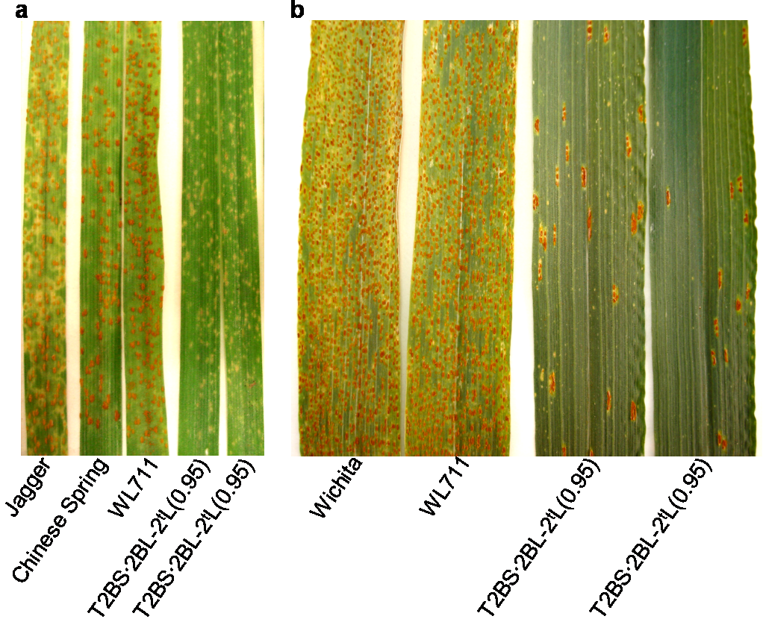
Development of a PCR assay and marker-assisted transfer of leaf rust resistance gene Lr58 into hard red winter wheats
Vasu Kuraparthy¹, Shilpa Sood²,, and Bikram S. Gill³, Gina Brown-Guedira²
(1) Crop Science Department, North Carolina State University, Raleigh, NC 27695, USA (2) Plant Science Research Unit, USDA-ARS, Crop Science Department, North Carolina State University, Raleigh, NC 27695, USA (3) Department of Plant Pathology, Kansas State University, Manhattan, KS 66506, USA.
Introduction
The small wheat-Aegilops triuncialis introgression T2BS·2BL-2^{t}L(0.95) carrying leaf rust resistance gene Lr58 is a source of resistance against many isolates of the rust pathogen in US and India (Fig. 1). The rust resistant introgression in T2BS·2BL-2^{t}L(0.95) was found to be less than 5% of the chromosome arm 2BL and was diagnostically detected by Restriction Fragment Length Polymorphism (RFLP) markers and dominant simple sequence repeat (SSR) marker (Xcfd50) (Kuraparthy et al. 2007a). Introgression T2BS·2BL-2^{t}L(0.95) is present in cultivar WL711 background which is an Indian soft white spring wheat. We report here the marker assisted transfer (MAS) of Lr58 into adapted winter wheats and the development of diagnostic co-dominant PCR based marker and assayed its applicability for MAS in wheat breeding programs in the USA.
Screening the backcross derivatives at seedling stage with leaf rust races showed that the infection types of the backcross derivatives were almost similar to the original source germplasm line to all the four rust pathotypes tested (Table 1).
Discussion
Although RFLP marker (XksuH16) was co-dominant and efficient in genotyping, it is cumbersome and expensive to use, so it was converted into PCR based STS marker (X08-Lr58-MAS-1/XNCWM1) for its use in wheat breeding programs. Since rust resistant introgression T2BS·2BL-2^{t}L(0.95) does not recombine with wheat chromosomes, XNCWM1 marker acts almost like a ‘perfect marker’ for Lr58. The co-dominant nature of diagnostic STS marker could help discern the heterozygotes which is of great value in early generations of advancement (i.e BC₁, BC₂, F₂ etc.) when transferring the Lr58 into adapted cultivars. Detection of diagnostic co-dominant polymorphism in both the agarose based and capillary based platforms suggests the utility and compatibility of the STS marker XNCWM1 in the wheat MAS programs in US involving robust genotyping platforms. Though gel based assays could not be used in MAS involving line P91193 of Indiana, use of capillary based platforms could circumvent this problem. Screening the backcross derivatives carrying Lr58 with rust races at seedling stage suggested expression of the transferred rust resistance in adapted winter wheats is stable in both recurrent parents backgrounds. The winter wheat germplasm with Lr58 will provide breeders with adapted lines having an additional source of resistance that can be used in combination with other rust resistance genes to achieve durability of resistance
Materials& Methods
For developing STS marker(s), primer pairs were designed from the RFLP markers (XksuH16, XksuF11, Xksud23) diagnostically detecting the Ae. triuncialis segment in the translocation T2BS·2BL-2^{t}L(0.95) (Kuraparthy et al. 2007a). Full-length cDNAs or tentative consensus (TC) sequences of the selected ESTs were extracted from the Wheat Gene Index release 10.0 (http://compbio.dfci.harvard.edu/tgi/) by using BLASTn searches (Altschul et al., 1997). Primer3 software (http://frodo.wi.mit.edu/primer3/) was used to design primers and amplicons of 125-400bp were targeted. Validation of the STS marker for MAS on capillary based platforms was performed on a set of 50 wheat cultivars/lines that were selected by the wheat Coordinated Agricultural Project (CAP) of the USDA-CSREES (http://maswheat.ucdavis.edu/Mapping/index.htm). ABI 3130XL Prism Genetic Analyzer using 36-cm capillaries was used to resolve the PCR products at the USDA-ARS Regional Small Grain Genotyping Laboratory, North Carolina State University, Raleigh, NC. The ABI generated profiles were screened using GeneMarker V. 1.5.
The germplasm line T2BS·2BL-2^{t}L(0.95) (NCSU, NT09; KSU, TA5605) derived from Ae. triuncialis in WL711 background (Kuraparthy et al., 2007a) was used as the source of leaf rust resistance gene Lr58 for the MAS. Adapted hard red winter wheats Jagger and Overley were used as recurrent female parents in crosses with the source germplasm NT09 and with the back cross F₁ plants carrying the alien segment in subsequent backcross generations. STS and RFLP markers were used to select derivatives with Lr58 during the backcrossing using MAS in both Jagger and Overley backgrounds. The rust reaction of the recurrent parents (Jagger, Overley), backcrossed derivatives and line NT09 was tested using four pathotypes (PRTUS25, PRTUS35, PNMQ, MCDL) of leaf rust at the two-leaf seedling stage and infection types were scored as illustrated in McIntosh et al. (1995).
T2BS·2BL-2^{t}L(0.95)
Ae. triuncialis
Jagger
07-370-BC₃F₂
WL711
*
*
Results
Out of the total twelve primers tested, one primer pair (08-Lr58-MAS-1/NCWM1), based on RFLP marker XksuH16, developed diagnostic co-dominant marker polymorphism between the introgression line (NW09) and WL711 and recurrent parents Jagger and Overley in an agarose gel based assay (Fig. 2). BC₁F₁, BC₂F₁, BC₃F₁ plants with Lr58 gene was efficiently identified using STS marker (X08-Lr58-MAS-1/XNCWM1) in the marker assisted backcrossing (Fig. 2). These BC₂F₁ and BC₃F₁ plants with Lr58 were further selected for winter type growth habit. BC₃F₂ plants homozygous for rust resistant gene Lr58 were also selected based on the co-dominant inheritance of the diagnostic PCR based marker.
Testing the marker XNCWM1 on a set of wheat cultivars/lines selected by US CAP project showed that the Ae. triuncialis specific diagnostic marker allele is polymorphic with most wheat allele(s) except for a line involving P91193 from Indiana and is compatible for MAS of Lr58 using both gel based and capillary based assay platforms for most of the US wheat breeding programs. Line P91193 showed similar amplicon size as developed by the introgression line in gel based assays. However, in the capillary based assay P91193 showed 405bp and 184bp fragments compared to 137bp and 404bp amplicons amplified by NT09.
Figure 2. Co-dominant sequence tagged site (STS) marker pattern of the parents and BC₃F₂ plants in Jagger background. The STS marker (XNCWM1) was based on wheat RFLP marker XksuH16. PCR product was resolved on 1% agarose gel. Homozygous BC₃F₂ plants selected for the presence of Ae. triuncialis-derived resistance gene Lr58 are indicated with an asterisk.
Cultivar/ line/BC₃F_{2:3} | Diagnostic Ae. triuncialis specific marker allele |  | Infection type
 | STS | RFLP | Race
 | XNCWM1 | XksuH16 | PNMR (PNMQ) | MCDSB (MCDL) | PRTUS6 | PRTUS25 | PRTUS35
Wichita | - | - | 4 | 3+ | 4 | 4- | 3+
Jagger | - | - | 33+ | 3+ | 3+ | 3- | 3+
Overley | - | - | 3- | - | ;1+ | 0; | 3
NT09 | + | + | ;1 | ;1 | ; | 0 | 33+
07-370-2A-S2 | - | - | 3+ | 3+ | 3 | 3+ | -
07-370-9B-5 | + | + | 1 | ; | 1- | 0 | -
07-371-1-7 | + | + | - | 0 | ; | 0 | 3
07-371-1-16 | + | + | - | 0 | 1 | 0 | -
07-371-2-9 | + | + | 1+ | ; | - | ; | 3
Table 1. infection types of BC₃F_{2:3} plants homozygous for the presence and absence of Ae. triuncialis segment along with the parents. All lines were tested for co-dominant RFLP (XksuH16) and STS marker XNCWM1. Jagger derivatives: 07-370; Oveley derivatives: 07-371
References
Figure 1. Rust resistance in the introgression line NT09. a. Leaf rust (race: PRTUS25) reaction of the parents and NT09 at the seedling stage. b. Leaf rust (race: MCDL) reaction of the parents and NT09 line at the adult plant stage.
Kuraparthy V, Sood S, Chhuneja P, Dhaliwal HS, Kaur S, Bowden RL, and Gill BS. 2007. A cryptic wheat-Aegilops triuncialis translocation with leaf rust resistance gene Lr58. Crop Sci 47:1995–2003
McIntosh RA, Wellings CR, and Park RF. 1995. Wheat rusts, an atlas of resistance genes. CSIRO, Melbourne, Australia

