Slide 1

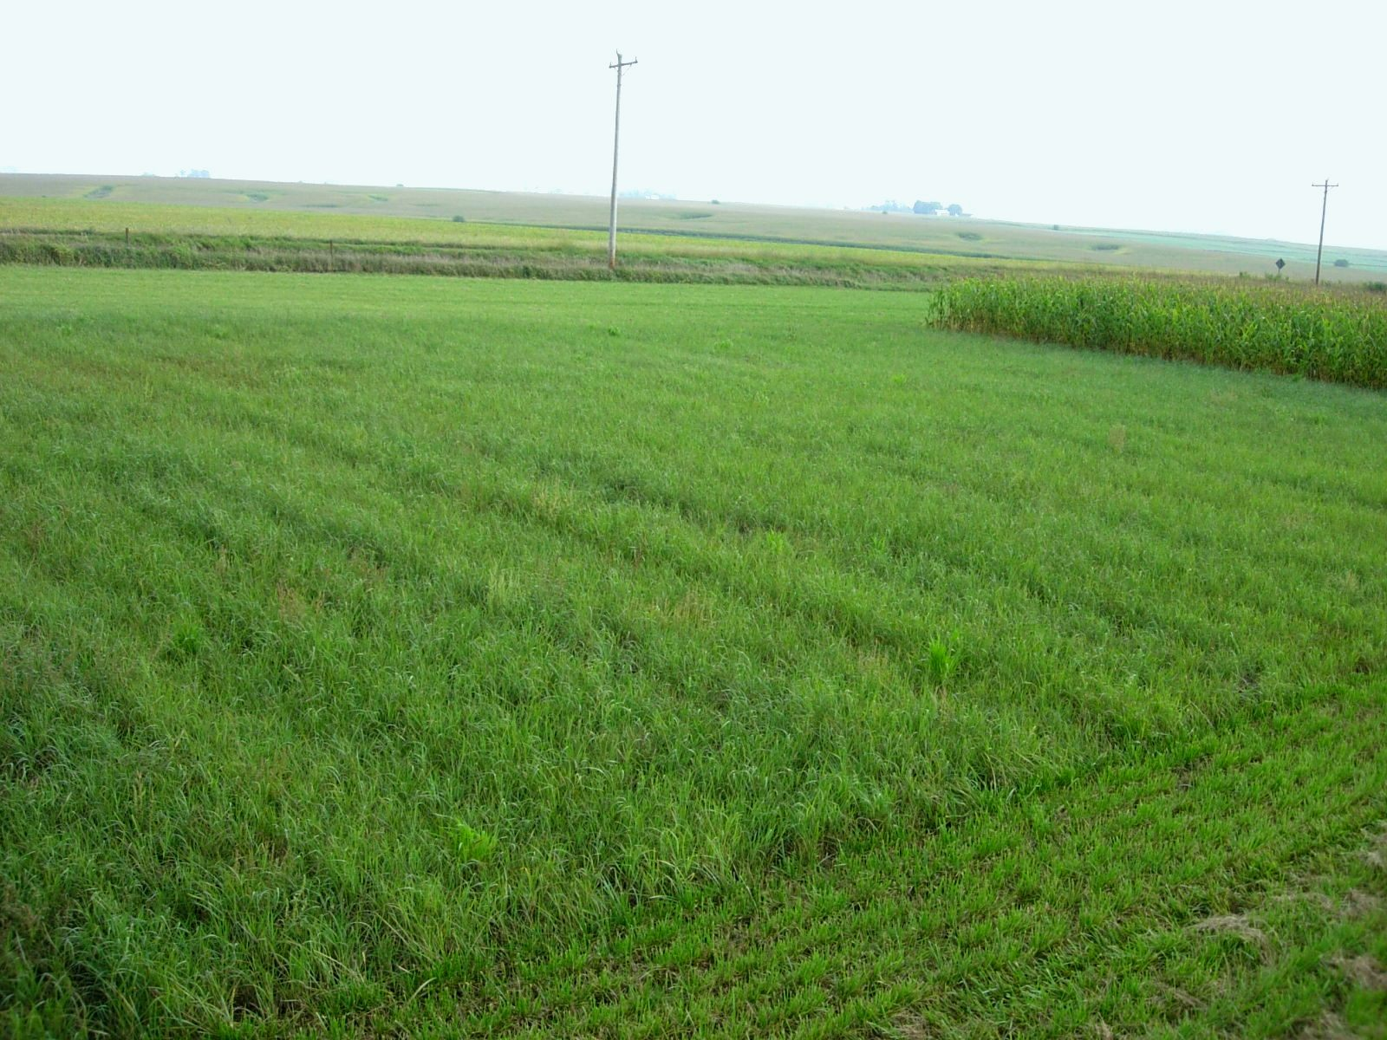
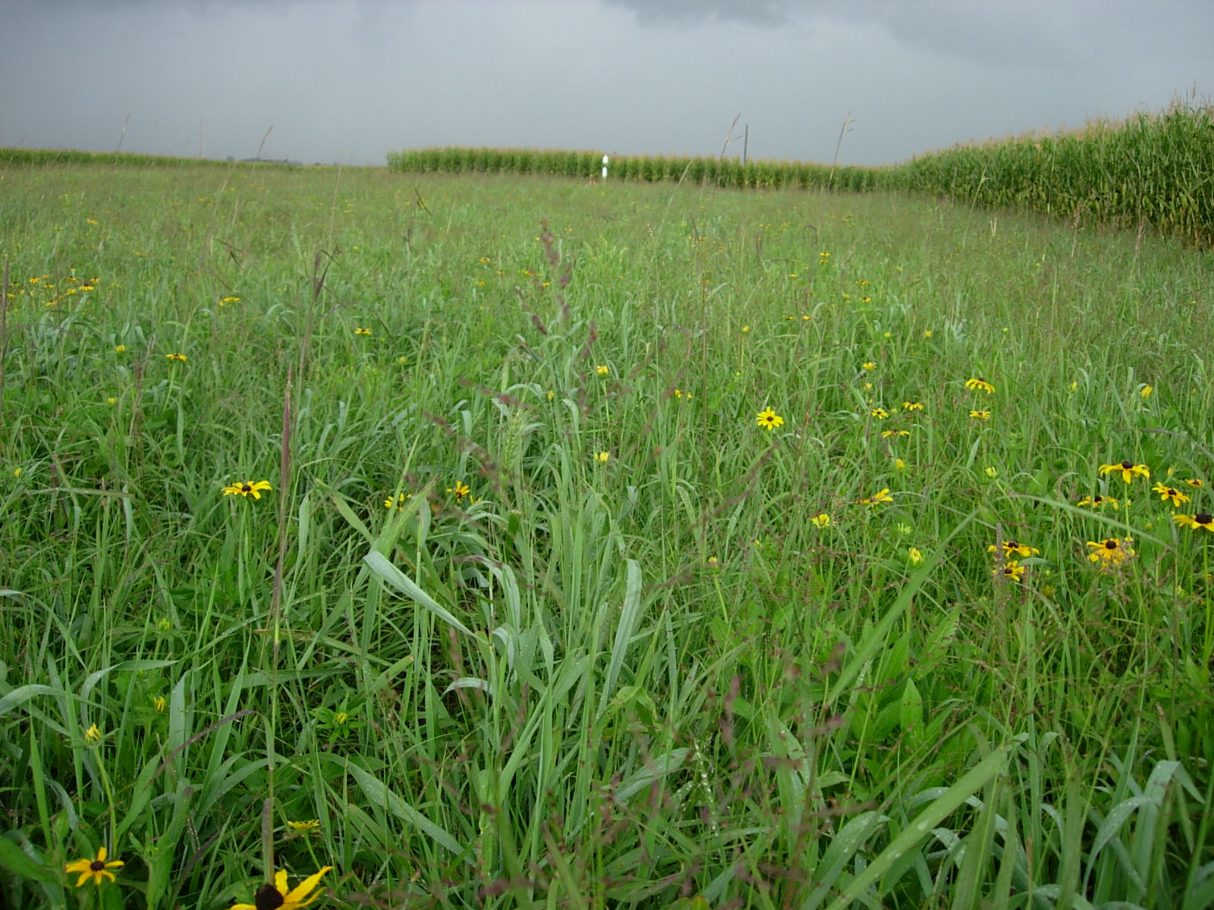
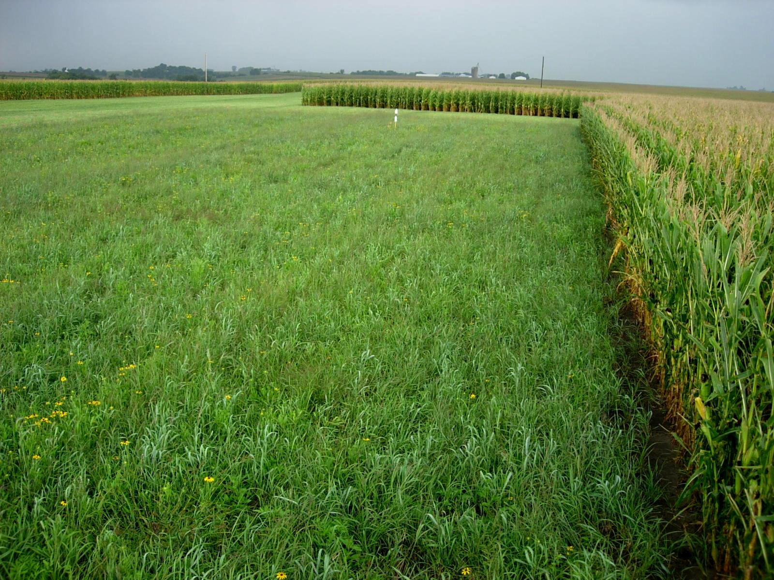
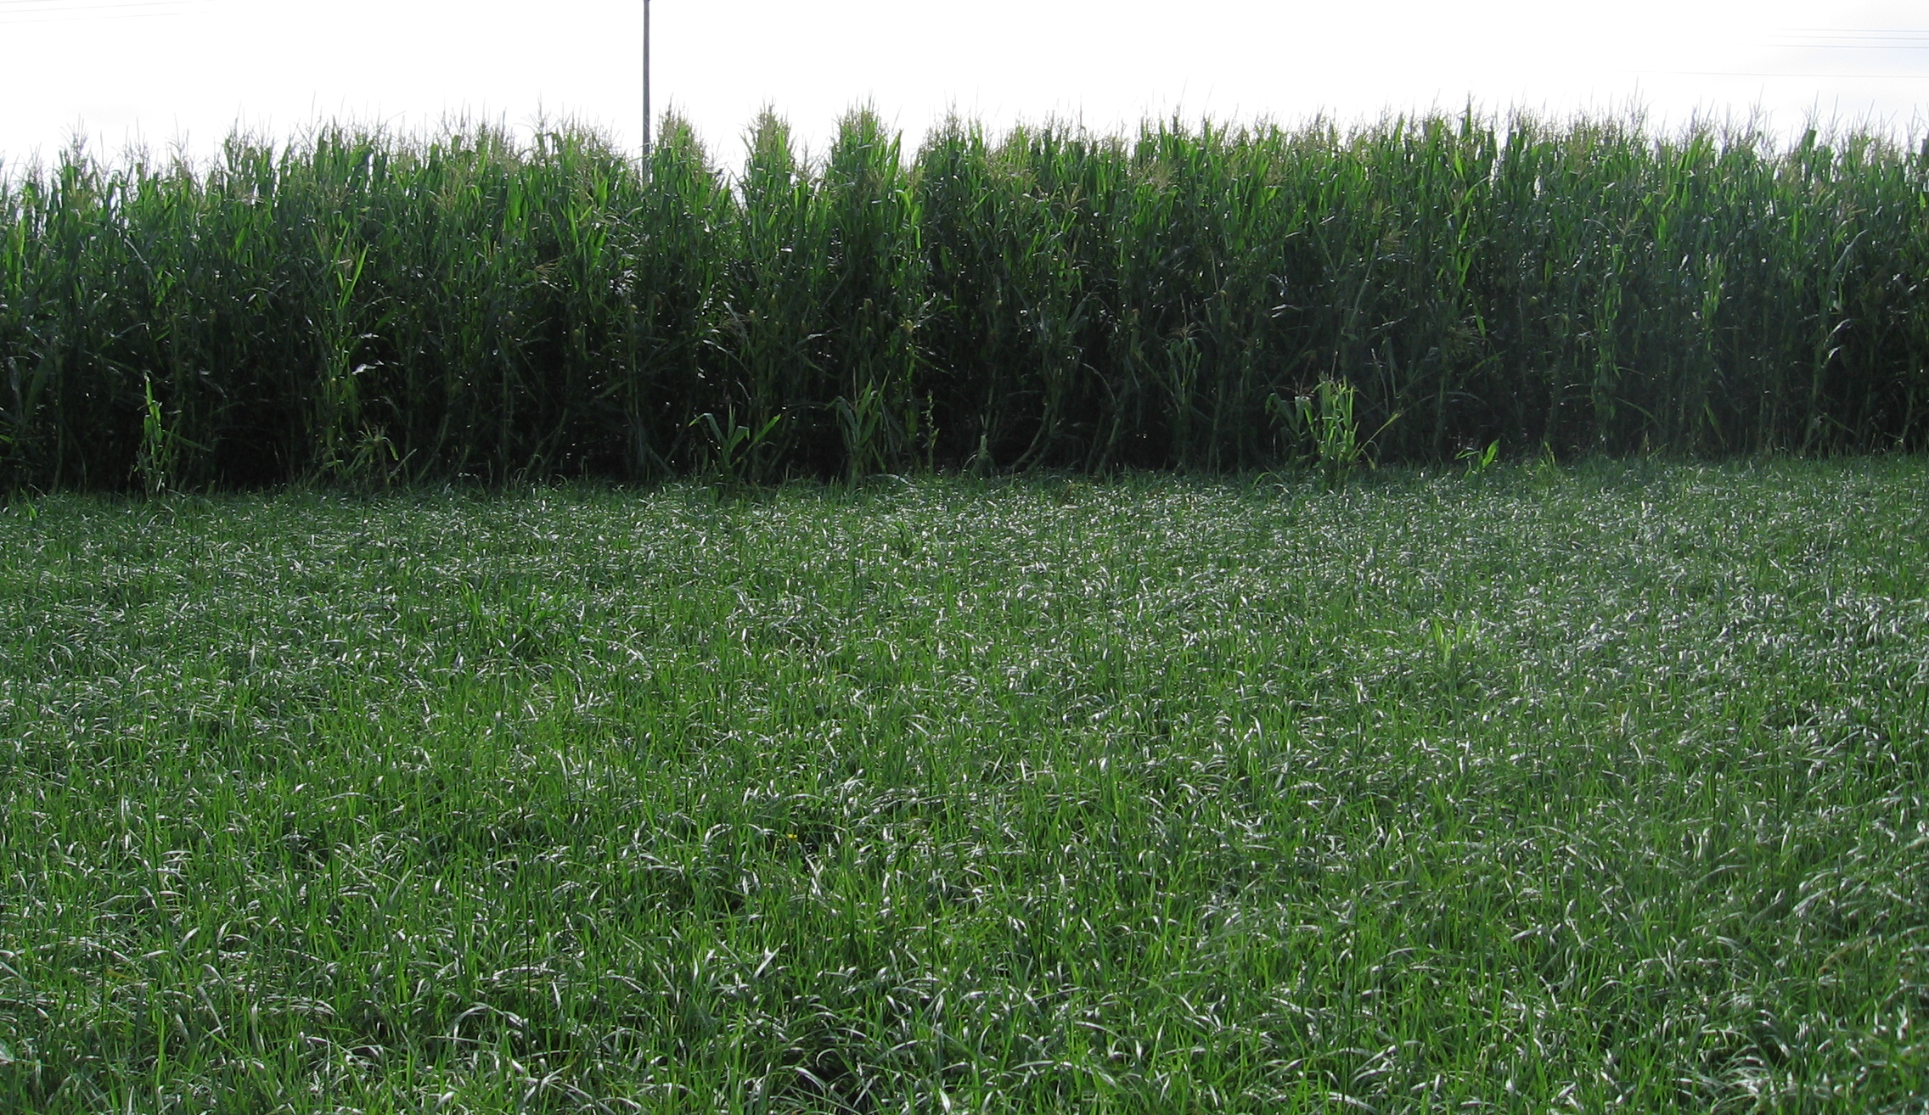
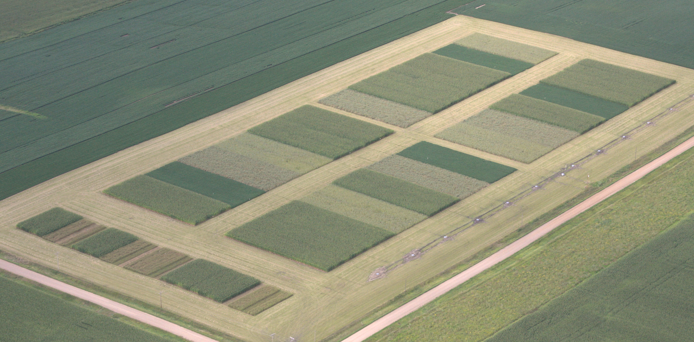
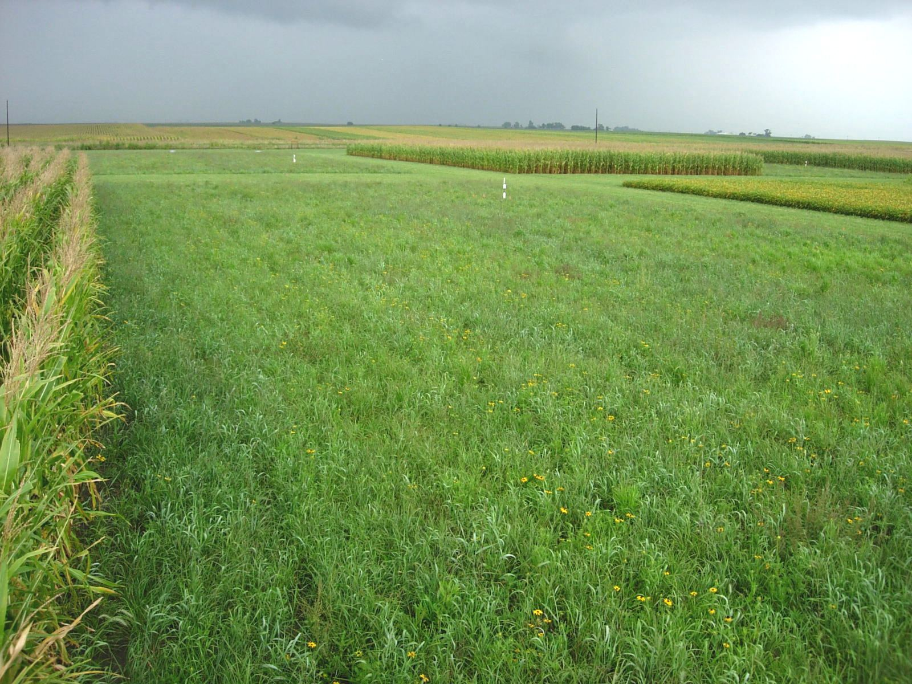
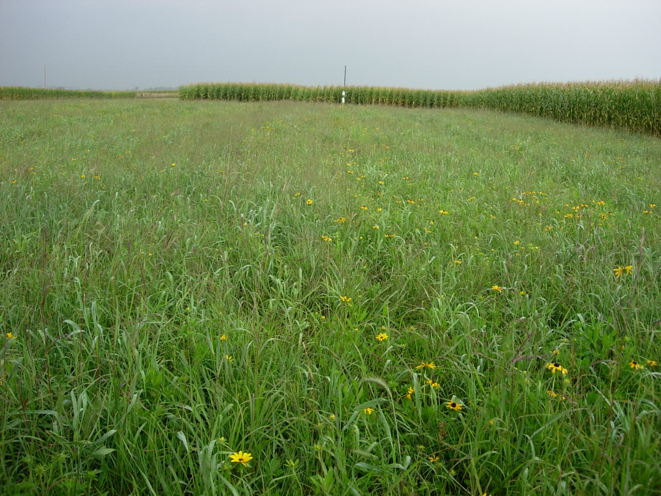

A Comparison of Biomass Production in Corn- and Prairie-Based Biofuel Cropping Systems
Ranae Dietzel, Meghann Jarchow, David Sundberg, Matt Liebman
Background
Deriving fuel from biological sources is an idea that has become popular as fossil fuel supplies are diminished, atmospheric carbon dioxide (CO₂) levels increase, and our nation desires to become more independent of foreign fuel sources. The Energy Independence and Security Act of 2007 requires an increase in biofuel production from 4.7 billion gallons to 36 billion gallons of biofuel per year by 2022. Biofuel from non-edible sources is required to constitute 60% of this production. The best biofuel feedstock production systems to achieve these ambitious goals are still unclear, but ideally such systems will have a high net energy yield, be environmentally resilient, and decrease greenhouse gases in the atmosphere. Tilman et al. (2006) found evidence that low-input, high-diversity prairie systems may fit this description by producing more usable energy and greater greenhouse gas reductions than corn grain ethanol or soybean based biodiesel. However, prairie data in that study was site-specific, whereas corn and soybean data were drawn from national databases. A direct comparison of energy yield and greenhouse gas reduction in prairie and corn cropping systems is needed and has been established at the Iowa State University South Reynoldson Farm, Boone Co., IA. An important component of this experiment is the determination of how much biomass is produced aboveground for biofuel use and belowground for carbon (C) sequestration.
Prairie-based vs. corn-based biofuel feedstock cropping systems
Which yields more biomass for energy production?
Which yields more biomass for C sequestration?
How do biomass production mechanisms differ?
Results
a
a
a
a
a
a
b
c
b
b
b
c
Methods
In the establishment year (2008), corn-based systems yielded more biomass aboveground and prairie-based systems yielded more biomass belowground.
In 2009, prairie-based systems yielded more than in 2008, with a significant fertilizer effect. Corn-based systems continued to yield more aboveground biomass.
60 m
a
With consideration to further hypotheses, corn- and prairie- based treatments (see map to left) were established at the ISU South Reynoldson Farm in the spring of 2008, though fertilizer was not applied to the PF treatment in this initial year. Stover was removed in continuous corn treatments, but retained in corn-soybean treatments.
Aboveground standing biomass was harvested in all treatments in fall of 2008 and separated into grain, stover, and/or remaining residue. It was then dried and weighed.
To determine belowground root biomass, soil cores were taken at a 1 m depth and separated into 0-30 cm, 30-60 cm, and 60-100 cm sections. Roots and soil were separated and live roots were then separated from dead organic matter. Live roots were dried, weighed, and analyzed for carbon and nitrogen content.
In 2009, aboveground biomass samples were also taken every two weeks to determine relative growth rate. Fall sampling and analysis is ongoing.
Continuous Corn (winter cover)
30 m
a
Continuous Corn (no winter cover)
CCW
CC
b
b
b
b
Corn-soybean
C2
Different letters denote significant differences
Soybean-corn
S2
Prairie (unfertilized)
Carbon:Nitrogen Ratio in Root Biomass
Prairie (fertilized)
P
Decay Rate
PF
30
Randomized and replicated 4 times
20
Comparison of Biofuel
Systems (COBS)
10
0
Prairie-based systems utilized more of the growing season. The rye provided cover early in the spring before the corn began to grow in the continuous corn systems. Mean biomass was greatest in the fertilized prairie, intermediate in the corn-systems, and least in the unfertilized prairie.
Biomass deposited underground in prairie-based systems had greater C:N ratios than corn-based biomass, indicating greater recalcitrance of prairie roots.
Conclusions and Ongoing Work
In the establishment year of the study, corn-based biofuel production systems produced more aboveground biomass available for energy production while prairie-based systems produced a greater amount of underground biomass for C sequestration. Both sources of biomass are expected to increase with further establishment in the prairies-based systems.
Belowground biomass of prairie species had a higher C:N ratio than did belowground corn biomass and should be more recalcitrant.
Prairie-based systems utilized more of the growing season than corn-based systems, but the rye cover crop extended the amount of the growing season used in the continuous corn systems.
The comparison of biofuels systems (a.k.a. COBS) continues. In the next several years, we and our collaborators will examine treatment effects on soil and water quality, develop greenhouse gas budgets, model soil carbon dynamics, and conduct life cycle assessments.
Acknowledgments
ConocoPhillips Company
Graduate Program in Sustainable Agriculture
Iowa State College of Agriculture and Life Sciences
Tilman, D., Hill, J., Lehman, C., 2006. Carbon-negative biofuels from low-input high-diversity grassland biomass. Science 314, 1598-1600.

